Slide 1
OCR GCSE (9–1) in Computer Science (J277)
Programming Languages and Integrated Development Environments
This pack is intended for students to use once they have covered the GCSE content, either in preparation for their L1 & L2 exam, or more likely alongside year 2 of the course to improve fluency, recall and pace on GCSE topics. It could be used as lesson starters, or supplied to students for independent use.

Slide 2
Bell Work
State the difference between a high level language and a low level language.
What is machine code?

Slide 3
2.5 Learn about Integrated Development Environments.
2.5 Learn about Integrated Development Environments.
State the role of an IDE.
Discuss the features of an IDE.
Explain the benefits of using an IDE to code.

Slide 4
2.5 Translators and Languages
High Level
Python
Pascal
Fortran
JAVA
C++
C
Assembly
1s and 0s
Low Level
Machine Code

Slide 5
2.5 Translators and Languages
High level languages are languages that are written with complex words.
Like when we wrote our Python programs.
Print / Round / Input / If / Else

Slide 6
2.5 Translators and Languages
Assembly languages use a range of short words to create code.
ADD / SUB / AX / MOV
Low level languages are machine code and assembly languages.

Slide 7
2.5 Translators and Languages
What is machine code?
Machine code is the language computers understand.
1s and 0s
How is data stored in a computer?
All data stored in a computer is stored as binary (1s and 0s). The machine understands nothing else other than 1s and 0s.

Slide 8
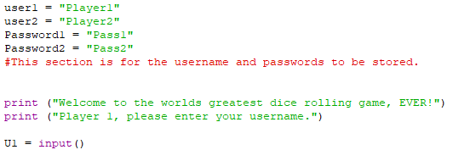
2.5 Translators and Languages
What is machine code?
Machine code is the language computers understand.
1s and 0s
How is data stored in a computer?
All data stored in a computer is stored as binary (1s and 0s). The machine understands nothing else other than 1s and 0s.
Any programming you do must be converted into correct 1s or 0s.

Slide 9
2.5 Translators and Languages
Computers also need our programming languages to translate into the language a machine understands (machine code).
We use a translator (two types):
Compiler
interpreter

Slide 10
2.5 Translators and Languages
One of them compiles a program into a separate document, then executes the program.
The other executes the program line-by-line.
Which one do you think is a description for a compiler?
Compiler – executable file
Interpreter – line-by-line

Slide 11
2.5 Translators and Languages
Compiler
Takes the whole program and converts this into machine code.
Creates a single file to be executed.
What if you have an error though? Will it be easy to find?

Slide 12
2.5 Translators and Languages
Interpreter
Runs the code line by line.
Is an error easier to spot on this type of translator?
Think about when you built your programs in Python, what happened if you made an error?

Slide 13
2.5 Translators and Languages
Compilers allow a software engineer to create code, compile it into machine code (separate file), and keep the source code secret.
The machine code is saved as a single file separate from the source code.

Slide 14
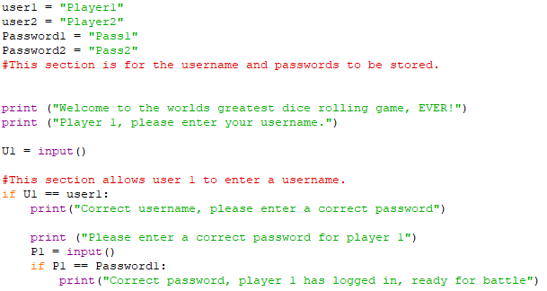
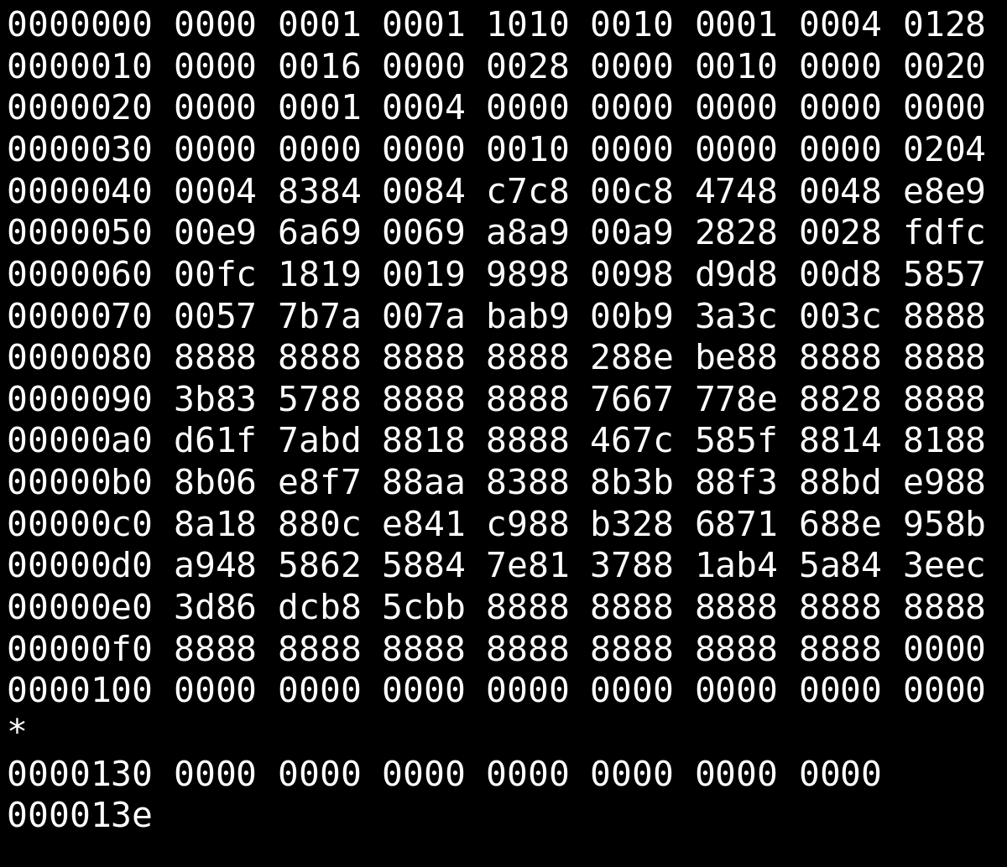
2.5 Translators and Languages
You use a compiler to translate the language into machine code.
You create your billion £ program.

Slide 15
2.5 Translators and Languages
Nobody has access to your amazing source code. Nobody can copy it and sell it cheaper!
People only see the binary file.

Slide 16
2.5 Translators and Languages
If you sell this the person who buys it can view your source code.
They can use it to create a similar program and sell it cheaper.

Slide 17
2.5 Translators and Languages
1
Compiler translates all the code in one go…
…Whereas an interpreter translates one line at a time.
Compiler creates an executable file…
…Whereas an interpreter does not/executes one line at a time.
Compiler reports all errors at the end…
…Whereas an interpreter stops when it finds an error.
1
1
1
1
1

Slide 18
2.5 Translators and Languages
What is an Integrated Development Environment (IDE).
When you used the IDLE for python what benefits did you get from it?

Slide 19
2.5 Translators and Languages
IDEs provide a variety of tools in one place for programmers to utilise.
What tools did we utilise?

Slide 20
2.5 Translators and Languages
Syntax highlighting

Slide 21
2.5 Translators and Languages
Syntax highlighting
Automatic Indentation

Slide 22
2.5 Translators and Languages
Syntax highlighting
Automatic Indentation
Error diagnostic tools – what does this mean?

Slide 23
2.5 Translators and Languages
Syntax highlighting
Automatic Indentation
Error diagnostic tools – what does this mean?
Runtime Environment

Slide 24
2.5 Translators and Languages
Syntax highlighting
Automatic Indentation
Error diagnostic tools – what does this mean?
Runtime Environment
Translators

Slide 25
2.5 Translators and Languages
If you do not code in an IDE you do not benefit from any of the tools it has.
Does using an IDE make it easier or harder to code?

Slide 26
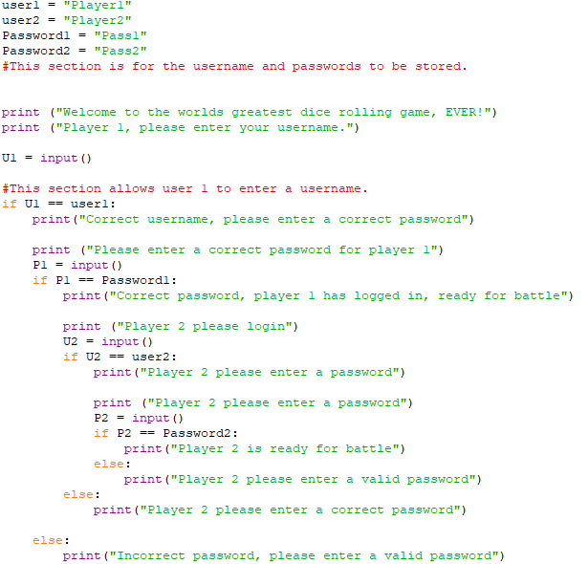
2.5 Translators and Languages

Slide 27
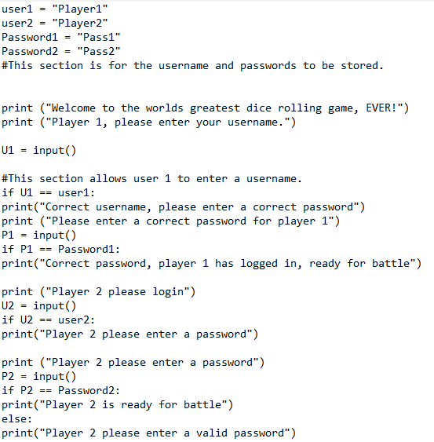
2.5 Translators and Languages

Slide 28
2.5 Translators and Languages

Slide 29
2.5 Translators and Languages

Slide 30
2.5 Translators and Languages

Slide 31
2.5 Translators and Languages

Slide 32
2.5 Translators and Languages

Slide 33
2.5 Translators and Languages

Slide 34
2.5 Translators and Languages
What benefit does an error diagnostic tool have over not having one?

Slide 35
2.5 Translators and Languages
What benefit does an error diagnostic tool have over not having one?
Error diagnostic tools allow the programmer to spot errors easily.
Errors are flagged up – could even tell you what line the error is on and what type of error it is

Slide 36
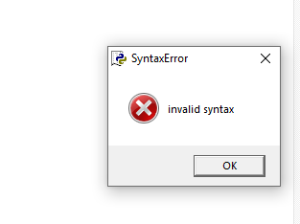
2.5 Translators and Languages
What benefit does an error diagnostic tool have over not having one?
Error diagnostic tools allow the programmer to spot errors easily.
Errors are flagged up – could even tell you what line the error is on and what type of error it is

Slide 37
2.5 Translators and Languages
What benefit does an error diagnostic tool have over not having one?
Error diagnostic tools allow the programmer to spot errors easily.
Errors are flagged up – could even tell you what line the error is on and what type of error it is

Slide 38
2.5 Translators and Languages
Think back to 2.2 and our infinite loops.
What is an infinite loop?
How does a runtime environment help us with infinite loops?

Slide 39
2.5 Translators and Languages
Runtime Environments allow the programmer to execute the program in a safe mode.
If there is an error the IDE will not close down or crash the computer.

Slide 40
2.5 Translators and Languages
Runtime Environments allow the programmer to execute the program in a safe mode.
If there is an error the IDE will not close down or crash the computer.

Slide 41
2.5 Translators and Languages
Explain how an IDE may help a programmer when coding. [2]

Slide 42
2.5 Translators and Languages
Alan is creating a new program.
Explain to Alan what and IDE is and why he should use one when coding.

Slide 43
2.5 Translators and Languages
Alan is creating a new program.
Explain to Alan what and IDE is and why he should use one when coding.
Integrated Design Environment – IDEs help programmers identify errors as they have error diagnostic tools.

Slide 44
2.5 Translators and Languages
Alan is creating a new program.
Explain to Alan what and IDE is and why he should use one when coding.
IDEs allow a programmer to run their code in safe environment, as they have in built run-time environments.

Slide 45
2.5 Translators and Languages
Alan is creating a new program.
Explain to Alan what and IDE is and why he should use one when coding.
IDEs allow a programmer keep the code organised as the IDE will automatically indent any code that needs to be indented.

Slide 46
2.5 Translators and Languages
Alan is creating a new program.
Explain to Alan what and IDE is and why he should use one when coding.
IDEs allow a programmer to translate their code into machine code as they usually have in built translators.

Slide 47
2.5 Translators and Languages
Alan is creating a new program.
Explain to Alan what and IDE is and why he should use one when coding.
IDEs highlight the syntax when it is written correctly. This will allow the programmer to easily identify any mistakes they may have made with code, such as a spelling error.

