Slide 1
OCR GCSE (9–1) in Computer Science (J277)
Producing Robust Programs
This pack is intended for students to use once they have covered the GCSE content, either in preparation for their L1 & L2 exam, or more likely alongside year 2 of the course to improve fluency, recall and pace on GCSE topics. It could be used as lesson starters, or supplied to students for independent use.

Slide 2
2.3 Bell Work
What do each of the terms below mean?
Input Sanitisation
Validation
Planning for Contingencies
Anticipating Misuse
Authentication

Slide 3
2.3 – Learn about test data types in programming.
2.3 – Learn about test data types in programming.
State the different test data types.
Explain how to test different programs.
Complete exam questions based on test data types.

Slide 4
2.3 Testing
What is testing?
Why would we test our programs?

Slide 5
2.3 Testing
What is testing?
Testing is checking to see if something works. We can do this by using it.
Why would we test our programs?

Slide 6
2.3 Testing
What is testing?
Testing is checking to see if something works. We can do this by using it.
Why would we test our programs?
We tested our programs to see if the program works as it should do.

Slide 7
2.3 Testing
When we created our program, how did we test it?

Slide 8
2.3 Testing
When we created our program, how did we test it?
While creating the program
At the end when it was complete

Slide 9
2.3 Testing
When we created our program, how did we test it?
While creating the program
At the end when it was complete
Final Testing
Iterative Testing

Slide 10
2.3 Testing
When we created our program, how did we test it?
While creating the program
At the end when it was complete
Iterative Testing
Final Testing

Slide 11
2.3 Testing
Using examples, define the two types of testing.
Final Testing
Iterative Testing

Slide 12
2.3 Testing
Testing the program once it is complete at the end.
What type of testing?
Final Testing
Iterative Testing

Slide 13
2.3 Testing
Testing the program once it is complete at the end.
What type of testing?
Final Testing
Iterative Testing

Slide 14
2.3 Testing
Testing while you are creating the program, testing a line or section at a time.
What type of testing?
Final Testing
Iterative Testing

Slide 15
2.3 Testing
Testing while you are creating the program, testing a line or section at a time.
What type of testing?
Final Testing
Iterative Testing

Slide 16
2.3 Testing
How do you test that a program works then?
How can I test that my quiz works?

Slide 17
2.3 Testing
How do you test that a program works then?
You can test it using data.
How can I test that my quiz works?

Slide 18
2.3 Testing
How do you test that a program works then?
You can test it using data.
How can I test that my quiz works?
Enter a variety of different answers and see if it works.

Slide 19
2.3 Testing
2.3 Testing
2 Test Types
3 Test Data Types
Iterative
Final
Normal
Boundary
Erroneous

Slide 20
2.3 Testing
Normal
Boundary
Erroneous
What do each of them mean?
How does this relate to testing data?

Slide 21
2.3 Testing
Normal
Boundary
Erroneous
Enter data that you would usually expect to work.

Slide 22
2.3 Testing
Normal
Boundary
Erroneous
Enter data that you would usually expect to work.

Slide 23
2.3 Testing
Normal
Boundary
Erroneous
Enter data that is the complete wrong type of data.

Slide 24
2.3 Testing
Normal
Boundary
Erroneous
Enter data that is the complete wrong type of data.

Slide 25
2.3 Testing
Normal
Boundary
Erroneous
Enter data that is at the limit of just being accepted or refused.

Slide 26
2.3 Testing
Normal
Boundary
Erroneous
Enter data that is at the limit of just being accepted or refused.

Slide 27
2.3 Testing
2.3 Testing
2 Test Types
3 Test Data Types
Iterative
Final
Normal
Boundary
Erroneous

Slide 28
2.3 Testing
What test could be performed on the code below to check that it works?

Slide 29
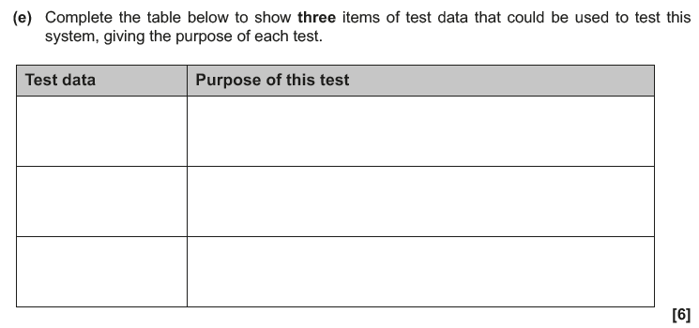
2.3 Testing

Slide 30
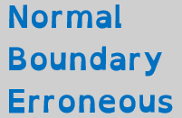
2.3 Testing

Slide 31
2.3 Testing

Slide 32
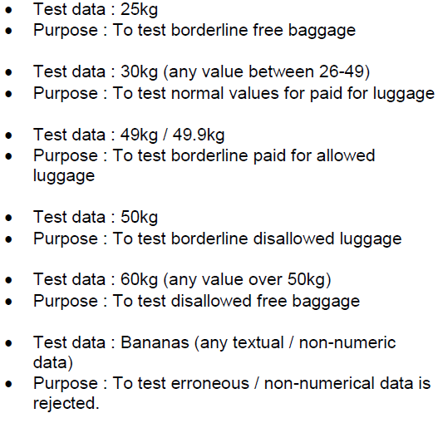
2.3 Testing

