Slide 1
OCR GCSE (9–1) in Computer Science (J277)
Programming Fundamentals
This pack is intended for students to use once they have covered the GCSE content, either in preparation for their L1 & L2 exam, or more likely alongside year 2 of the course to improve fluency, recall and pace on GCSE topics. It could be used as lesson starters, or supplied to students for independent use.

Slide 2
Bell Work
State the difference between sequence and iteration.
Explain how the ELIF function works.

Slide 3
Learn about loops in programming.
Learn about loops in programming.
State what the two types of loops are.
Explain how each type of loop works.
Complete exam questions on different types of loops.

Slide 4
Iteration
Iteration in programming is loops.
It means it repeats the program again.
There are 2 types of loops:
Count-controlled
Forever

Slide 5
Iteration
Iteration - loops – code is simply repeated until a certain criteria is met.
What was the loop called we used in the NEA?

Slide 6
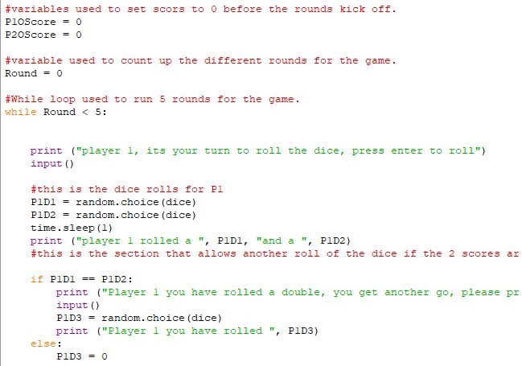
Iteration

Slide 7
Iteration

Slide 8
Iteration
A while loop repeats the game UNTIL condition is met.
What happens if the condition is never met?

Slide 9
Iteration
What will happen in this program?

Slide 10
Iteration
The program will continuously print 1 as the i is equal to 1. it won’t stop unless i changes.

Slide 11
Iteration
What will happen in this program?

Slide 12
Iteration
This program will not print anything as i is not greater than 1. i is equal to 1.

Slide 13
Iteration
What will happen in this program?

Slide 14
Iteration
The list will be printed out in order, once.

Slide 15
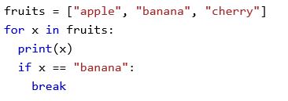
Iteration
What do you think will happen in this loop?

Slide 16
Iteration
This loop will print both apple and banana, but not cherry. Why?

Slide 17
Iteration
What do you think will happen in this loop?

Slide 18
Iteration
This will print the values of each dice value multiplied together.

Slide 19
EQP

Slide 20
EQP

Slide 21
EQP
Loop | Will Loop Infinitely | Won’t Loop Infinitely
X = 5 While True print x Endwhile
Y = 0 While Y < 10 print y
X = 2 While x = 2 print x
Y = 1 While Y < 10 print Y Y = Y + 1

Slide 22
EQP
Loop | Will Loop Infinitely | Won’t Loop Infinitely
X = 5 While True print x Endwhile
Y = 0 While Y < 10 print y
X = 2 While x = 2 print x
Y = 1 While Y < 10 print Y Y = Y + 1

Slide 23
EQP
Loop | Will Loop Infinitely | Won’t Loop Infinitely
X = 5 While True print x Endwhile
Y = 0 While Y < 10 print y
X = 2 While x = 2 print x
Y = 1 While Y < 10 print Y Y = Y + 1

Slide 24
EQP
Loop | Will Loop Infinitely | Won’t Loop Infinitely
X = 5 While True print x Endwhile
Y = 0 While Y < 10 print y
X = 2 While x = 2 print x
Y = 1 While Y < 10 print Y Y = Y + 1

Slide 25
EQP
Loop | Will Loop Infinitely | Won’t Loop Infinitely
X = 5 While True print x Endwhile
Y = 0 While Y < 10 print y
X = 2 While x = 2 print x
Y = 1 While Y < 10 print Y Y = Y + 1

Slide 26
EQP
Loop | Will Loop Infinitely | Won’t Loop Infinitely
X = 5 While True print x Endwhile
Y = 0 While Y < 10 print y
X = 2 While x = 2 print x
Y = 1 While Y < 10 print Y Y = Y + 1

