Slide 1
OCR GCSE (9–1) in Computer Science (J277)
Network Security
This pack is intended for students to use once they have covered the GCSE content, either in preparation for their L1 & L2 exam, or more likely alongside year 2 of the course to improve fluency, recall and pace on GCSE topics. It could be used as lesson starters, or supplied to students for independent use.

Slide 2
Bell Work
State what SQL injection is.
List down the different ways people can be the weak point of a network.

Slide 3
1.4 Learn how to prevent different attacks on a network.
1.4 Learn how to prevent different attacks on a network.
State some of the different prevention measures.
Discuss what some of the prevention measures stop.
Explain how different prevention measures work.

Slide 4
1.4 Security
There are different threats to a network including:
Malware
Phishing
Brute force attacks
DoS Attacks
People – weak point
Data interception and theft
SQL injection
Poor network policy

Slide 5
1.4 Security
Malware is malicious software.
There are different types of malware that can have devastating effects on your computer.

Slide 6
1.4 Security
Types of Malware:
Viruses
Worms
Trojan Horses
Ransomware
Spyware
Rootkits
Back doors

Slide 7
1.4 Security
Phishing – an email link that takes the user to fake website that looks like a real website. The user is prompted to enter personal details.
Pharming – a piece of software that redirects the user to a fake website. The user is prompted to enter fake details.

Slide 8
1.4 Security
DDoS is an attempt by hackers to deny the service of a website.
It loads software onto a person’s computer, and that software loads up a webpage without the users knowledge.

Slide 9
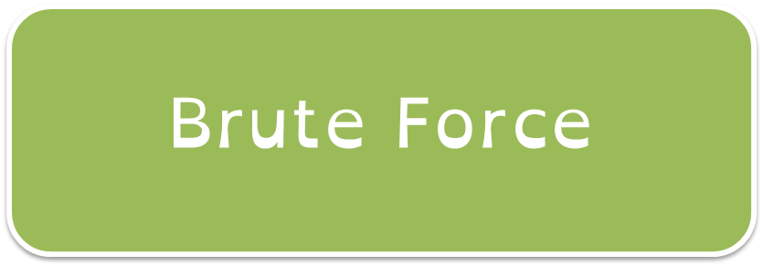
1.4 Security
An attack that just uses lots of attempts to gain access to your system.
It will keep trying different password combinations until the attempt is correct.

Slide 10
1.4 Security
Humans can be lazy, and don’t always follow the rules strictly.
Leave computers logged on
Writing down passwords
Sharing passwords
Not updating software
Opening unchecked/unsafe email attachments

Slide 11
1.4 Security
Data interception/theft is when data is intercepted from the network.
It can occur directly from the network or during transmission.

Slide 12
1.4 Security
SQL injection is when a hacker will use code to download all of the data behind a login screen.
It only works on web pages that have data bases attached to them.

Slide 13
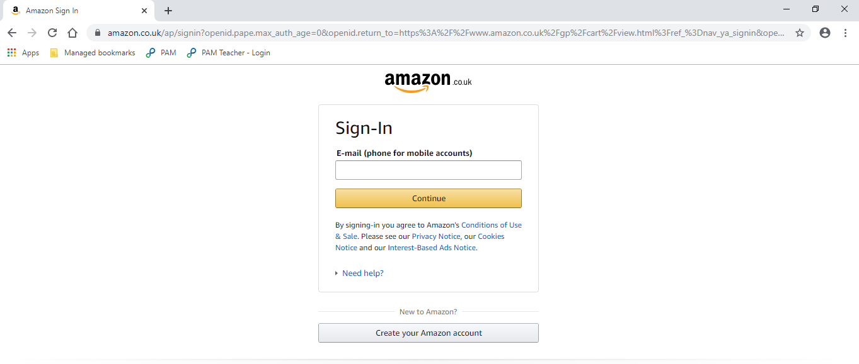
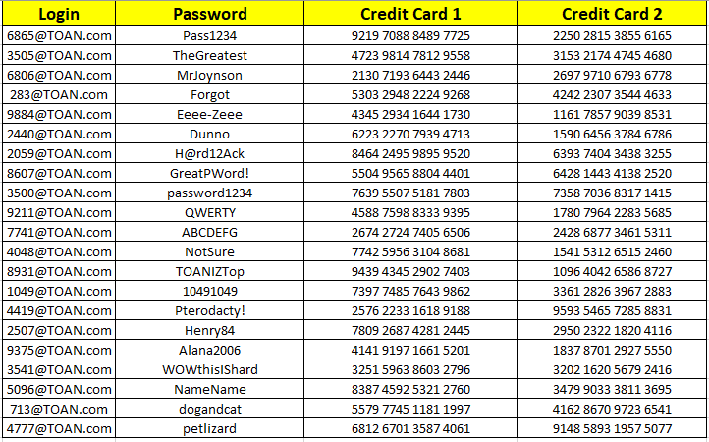
1.4 Security
MrJoynson@TOAN.com

Slide 14
1.4 Security
State what SQL injection is.
Explain how SQL injection is used to gain information.
SQL injection is using basic code to gain access to information from the database.
SQL injection is used to gain information from websites by inserting basic language into the login page of a website. If the website is not protected, the code will allow hackers to gain all of the data from the database attached to the login page.

Slide 15
1.4 Security
What is data interception?
State two reasons why humans may be the weak point in a network.
Data interception is when a hacker intercepts or steals data from a network.
Humans might be the weak link in a network as they can share passwords with other people and they don’t always update software when they should.

Slide 16
1.4 Security
Clearly, there are huge amounts of risks that are a threat to networks. So it is incredibly important for us to take preventative measures.
Has anyone heard of any prevention measures we can take?

Slide 17
1.4 Security
Prevention measures:
Anti-virus/malware software
Firewalls
Penetration testing
User Access Levels
Strong passwords
Encryption
Network forensics
Network policies

Slide 18
1.4 Security
What does anti-virus/malware software do?
Why is it important to use anti-virus software.

Slide 19
1.4 Security
Anti-virus/malware software scans your computer.
It then removes any malware types that it recognises.
Scans can be set to happen regularly.

Slide 20
1.4 Security
What is the role of a firewall?
Is a firewall the same as anti-malware software?

Slide 21
1.4 Security
Firewalls are a piece of software that block some packets of data from being received from the network or the internet.

Slide 22
1.4 Security
Firewalls are a piece of software that block some packets of data from being received from the network or the internet.

Slide 23
1.4 Security
Firewalls are a piece of software that block some packets of data from being received from the network or the internet.
They are the main defence against DoS attacks.
Packet-filter firewalls inspect each packet of data, and stop packets that do not meet the criteria set by the firewall.

Slide 24
1.4 Security
Firewalls are a piece of software that block some packets of data from being received from the network or the internet.
They are the main defence against DoS attacks.
Packet-filter firewalls inspect each packet of data, and stop packets that do not meet the criteria set by the firewall.

Slide 25
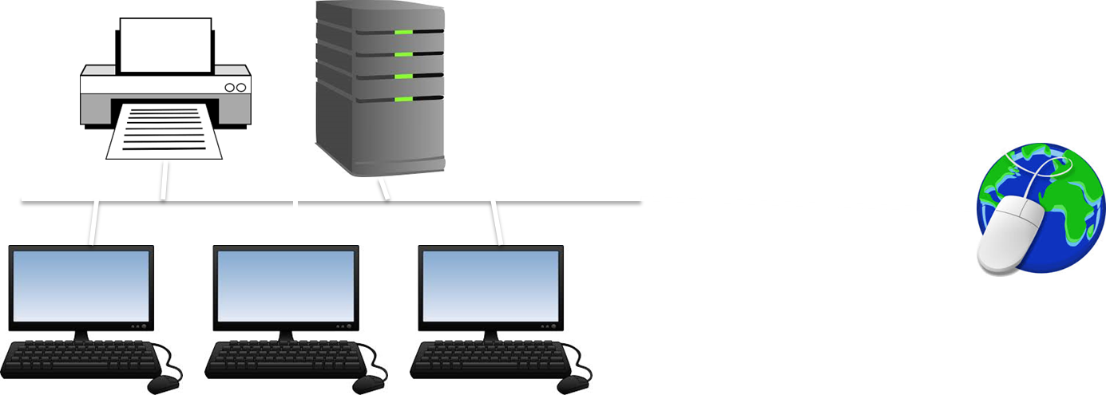
1.4 Security

Slide 26
1.4 Security

Slide 27
1.4 Security

Slide 28
1.4 Security

Slide 29
1.4 Security

Slide 30
1.4 Security

Slide 31
1.4 Security

Slide 32
1.4 Security

Slide 33
1.4 Security

Slide 34
1.4 Security

Slide 35
1.4 Security

Slide 36
1.4 Security

Slide 37
1.4 Security

Slide 38
1.4 Security

Slide 39
1.4 Security

Slide 40
1.4 Security

Slide 41
1.4 Security

Slide 42
1.4 Security

Slide 43
1.4 Security

Slide 44
1.4 Security

Slide 45
1.4 Security

Slide 46
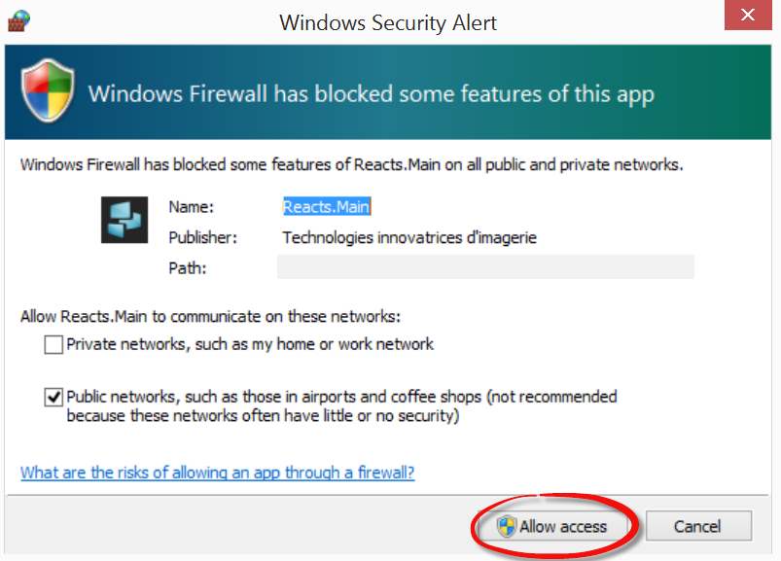
1.4 Security

Slide 47
1.4 Security

Slide 48
1.4 Security

Slide 49
1.4 Security

Slide 50
1.4 Security
This is where the company pays another person to purposely try to break into the network.
If they are successful they report back on how they did it.

Slide 51
1.4 Security
This is where the company pays another person to purposely try to break into the network.
If they are successful they report back on how they did it.
Penetration Testing

Slide 52
1.4 Security
This is where the company pays another person to purposely try to break into the network.
If they are successful they report back on how they did it.
Penetration Testing

Slide 53
1.4 Security
This allows the company to fix any bugs or loopholes in their system, safely.
They will pay the company depending on how many security flaws they have found.

Slide 54
1.4 Security
User Access Levels – refers to stopping the content users can view based on their role within the business.
The network manager will have full access.
An admin assistant will only have limited access to what they need to view.

Slide 55
1.4 Security
Entire network
A drive
B drive
C drive
IT tech team
Login accounts
Teaching staff
N drive
CBT resources
Students
SIMS - register

Slide 56
1.4 Security
Entire network
A drive
B drive
C drive
IT tech team
Login accounts
Teaching staff
N drive
CBT resources
Students
SIMS - register

Slide 57
1.4 Security
Entire network
A drive
B drive
C drive
IT tech team
Login accounts
Teaching staff
N drive
CBT resources
Students
SIMS - register

Slide 58
1.4 Security
Entire network
A drive
B drive
C drive
IT tech team
Login accounts
Teaching staff
N drive
CBT resources
Students
SIMS - register

Slide 59
1.4 Security
Entire network
A drive
B drive
C drive
IT tech team
Login accounts
Teaching staff
N drive
CBT resources
Students
SIMS - register

Slide 60
1.4 Security
Entire network
A drive
B drive
C drive
IT tech team
Login accounts
Teaching staff
N drive
CBT resources
Students
SIMS - register

Slide 61
1.4 Security
Entire network
A drive
B drive
C drive
IT tech team
Login accounts
Teaching staff
N drive
CBT resources
Students
SIMS - register

Slide 62
1.4 Security
To keep a network safe people must ensure they protect themselves with a strong password.
As we have already seen humans can be the weak part of the network.

Slide 63
1.4 Security
How does a weak password leave us exposed?
What are the characteristics of a strong password?

Slide 64
1.4 Security
8 characters or more
Mix of upper and lower case letters
Mix of numbers, letters and special characters
Not something that is easy to guess (i.e. pets name)
Changed often
Different passwords for different accounts.

Slide 65
1.4 Security
Think back to 1.4 – what is encryption?
What does encryption do?
Does it stop hackers?

Slide 66
1.4 Security
Encryption:
Scrambles data.
Makes it unreadable.
If data is hacked/intercepted the hacker cannot read the data.
Protects sensitive information.

Slide 67
1.4 Security
Encryption:
Scrambles data.
Makes it unreadable.
If data is hacked/intercepted the hacker cannot read the data.
Protects sensitive information.

Slide 68
1.4 Security
Network Forensics is the monitoring of the network to allow managers to see if misuse is happening.
This can be done using a spyware – this is legal as consent is usually gained.
This can help managers identify who might have been responsible for a network breach.

Slide 69
1.4 Security
Network Forensics is the monitoring of the network to allow managers to see if misuse is happening.
This can be done using a spyware – this is legal as consent is usually gained.
This can help managers identify who might have been responsible for a network breach.

Slide 70
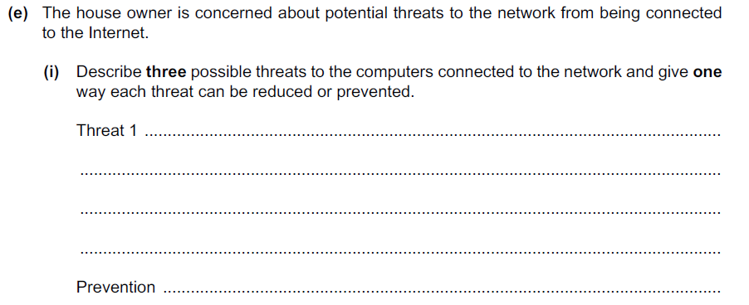
1.4 Security
How many marks do you think this question is worth?

Slide 71
1.4 Security
9 marks

Slide 72
1.4 Security
9 marks

Slide 73
1.4 Security
3 threats – 1 mark for threat name, 1 for description and 1 for preventing threat.

Slide 74
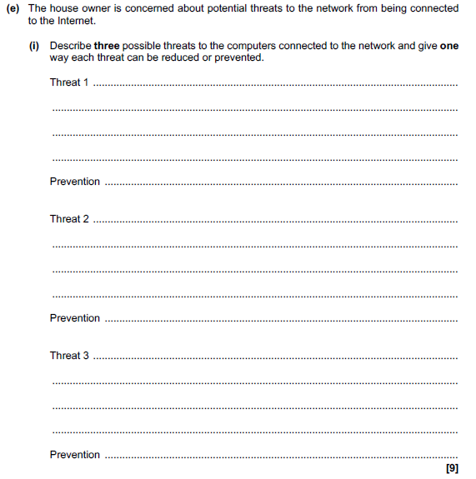
1.4 Security

Slide 75
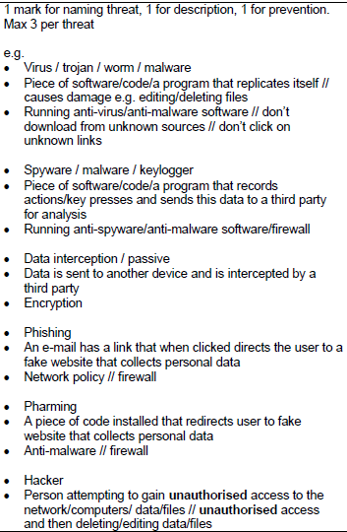
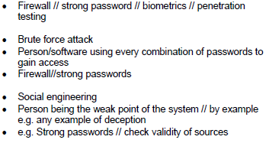
1.4 Security

Slide 76
1.4 Security

Slide 77
1.4 Security

Slide 78
1.4 Security
Threat name – this is where…
You can prevent this by…

Slide 79
1.4 Security
1
2
Threat name – this is where…
You can prevent this by…
3

Slide 80
1.4 Security
Virus
1
2
Threat name – this is where…
You can prevent this by…
3

Slide 81
1.4 Security
Virus – this is a piece of software that replicates itself and causes damage to the computer.
1
2
Threat name – this is where…
You can prevent this by…
3

Slide 82
1.4 Security
Virus – this is a piece of software that replicates itself and causes damage to the computer.
Anti-virus software.
1
2
Threat name – this is where…
You can prevent this by…
3

Slide 83
1.4 Security
Virus – this is a piece of software that replicates itself and causes damage to the computer.
Anti-virus software.
1
1
2
Threat name – this is where…
You can prevent this by…
3

Slide 84
1.4 Security
Virus – this is a piece of software that replicates itself and causes damage to the computer.
Anti-virus software.
1
1
1
2
Threat name – this is where…
You can prevent this by…
3

Slide 85
1.4 Security
Virus – this is a piece of software that replicates itself and causes damage to the computer.
Anti-virus software.
1
1
1
2
Threat name – this is where…
You can prevent this by…
1
3

