Slide 1
OCR GCSE (9–1) in Computer Science (J277)
Network Security
This pack is intended for students to use once they have covered the GCSE content, either in preparation for their L1 & L2 exam, or more likely alongside year 2 of the course to improve fluency, recall and pace on GCSE topics. It could be used as lesson starters, or supplied to students for independent use.

Slide 2
Bell Work
Bullet down the rules of packet switching.
Explain what layering is.

Slide 3
1.4 Learn about type of Malware, DoS and Brute Force attacks.
1.4 Learn about type of Malware, DoS and Brute Force attacks.
State types of malware.
Discuss the features of a brute force and DoS attack.
Compare the different types of attacks.

Slide 4
1.4 Networks
1500 bytes in total size.
1 Packet of Data to be sent over the network.
Receiver MAC address – 6 bytes.
Sender MAC address – 6 bytes.
Protocol type – 2 bytes.
CRC – error checking data – 4 bytes.
Data to be sent – up to 1486 bytes.

Slide 5
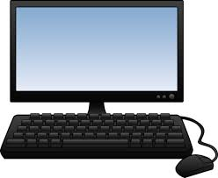
1.3 Networks

Slide 6
1.3 Networks

Slide 7
1.3 Networks

Slide 8
1.3 Networks

Slide 9
1.3 Networks

Slide 10
1.3 Networks
TCP/IP has 4 main layers:
Application Layer
Transport Layer
Network Layer
Link Layer
Each layer is responsible for a different part of the sending/receiving of data.

Slide 11
1.3 Networks
Using apps/software
Application Layer
Transport Layer
Network Layer
Link Layer
Cables to send data.

Slide 12
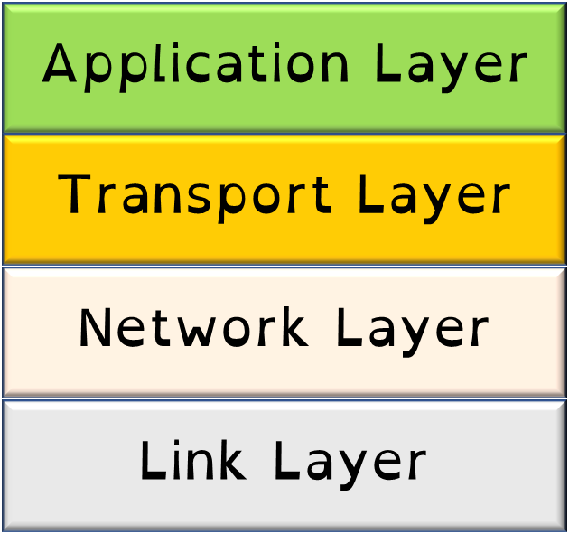
1.3 Networks
Transport layer – sets up the communication between the two nodes, agreeing on the rules to be used.
i.e. packet size.

Slide 13
1.3 Networks
Transport layer
Maximum 1000 bytes per packet

Slide 14
1.3 Networks
Network layer – packets are addressed in this section and routes the data to the link layer.

Slide 15
1.3 Networks
Network layer
MAS– FF:01:A1:74:D2
MAR– D0:10:ED:45:7F

Slide 16
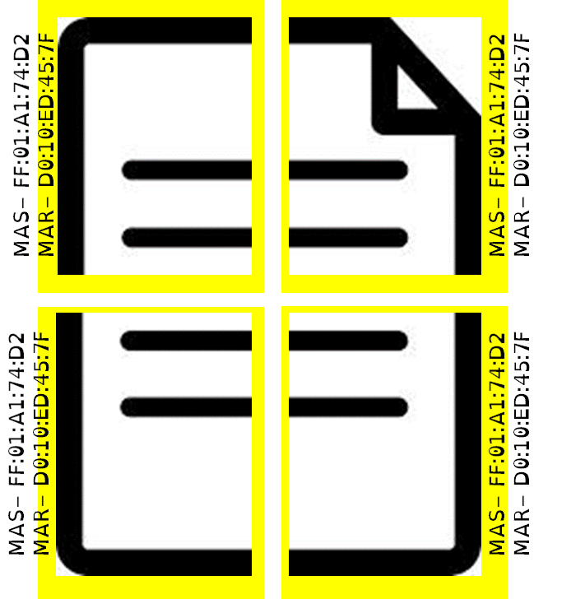
1.3 Networks
Network layer
Pushed on to the link layer.

Slide 17
1.3 Networks
Link layer – this is where the hardware used to send data operates.
i.e. Ethernet cables.

Slide 18
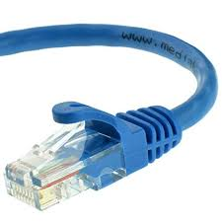
1.3 Networks
Link layer

Slide 19
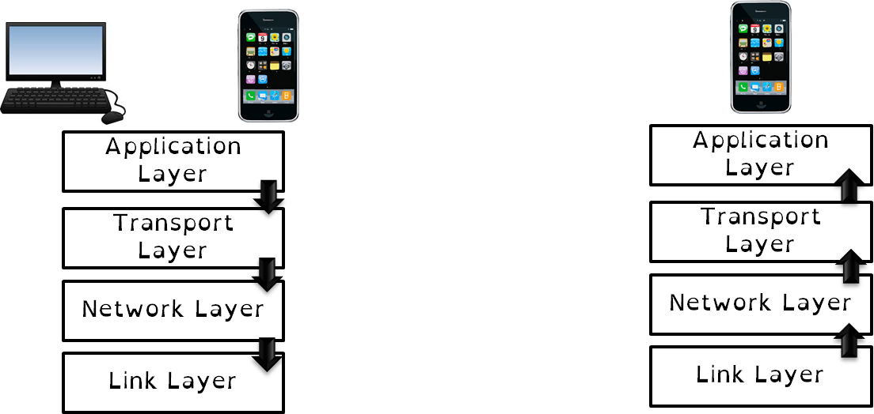
1.3 Networks
FTP
TCP
IP
WIFI

Slide 20
1.3 Networks
FTP
TCP
IP
WIFI

Slide 21
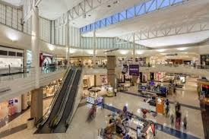
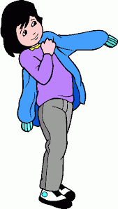
Notes:
Mall + wear = malware

Slide 22
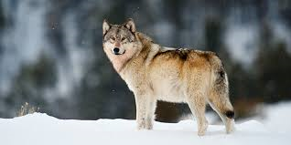
Notes:
Ransom + warewolf – wolf = ransomware

Slide 23
Notes:
Fire + ross = Virus

Slide 24
1.4 Security
There are different threats to a network including:
Malware
Phishing
Brute force attacks
DoS Attacks
People – weak point
Data interception and theft
SQL injection
Poor network policy

Slide 25
1.4 Security
There are different threats to a network including:
Malware
Phishing / Pharming
Brute force attacks
DoS Attacks
People – weak point
Data interception and theft
SQL injection
Poor network policy

Slide 26
1.4 Security
Malware is malicious software.
There are different types of malware that can have devastating effects on your computer.

Slide 27
1.4 Security
Malware is malicious software.
There are different types of malware that can have devastating effects on your computer.

Slide 28
1.4 Security
Types of Malware:
Viruses
Worms
Trojans
Ransomware
Spyware
Rootkits
Back doors

Slide 29
1.4 Security
Types of Malware:
Viruses
Worms
Trojans
Ransomware
Spyware
Rootkits
Back doors
These are all software / code / programs.

Slide 30
1.4 Security
Types of Malware:
Viruses
Worms
Trojans
Ransomware
Spyware
Rootkits
Back doors
Written by other people.

Slide 31
1.4 Security
Types of Malware:
Viruses
Worms
Trojans
Ransomware
Spyware
Rootkits
Back doors
Created to cause damage or disruption to data or computers.

Slide 32
1.4 Security
Types of Malware:
Viruses
Worms
Trojans
Ransomware
Spyware
Rootkits
Back doors
A program, usually hidden in another program. It replicates itself and usually causes some sort of damage such as deleting files.

Slide 33
1.4 Security
Types of Malware:
Viruses
Worms
Trojans
Ransomware
Spyware
Rootkits
Back doors
A program, usually hidden in another program. It replicates itself and usually causes some sort of damage such as deleting files.

Slide 34
1.4 Security
Types of Malware:
Viruses
Worms
Trojans
Ransomware
Spyware
Rootkits
Back doors
A program, usually hidden in another program. It replicates itself and usually causes some sort of damage such as deleting files.

Slide 35
1.4 Security
Types of Malware:
Viruses
Worms
Trojans
Ransomware
Spyware
Rootkits
Back doors
A malicious program that the user is tricked into installing under the pretence it is actually something useful.

Slide 36
1.4 Security
Types of Malware:
Viruses
Worms
Trojans
Ransomware
Spyware
Rootkits
Back doors
A malicious program that the user is tricked into installing under the pretence it is actually something useful.

Slide 37
1.4 Security
Types of Malware:
Viruses
Worms
Trojans
Ransomware
Spyware
Rootkits
Back doors
Software that gathers information about a user or organisation and sends it to the originator. i.e. keyloggers.

Slide 38
1.4 Security
Types of Malware:
Viruses
Worms
Trojans
Ransomware
Spyware
Rootkits
Back doors
Software that gathers information about a user or organisation and sends it to the originator. i.e. keyloggers.

Slide 39
1.4 Security
Types of Malware:
Viruses
Worms
Trojans
Ransomware
Spyware
Rootkits
Back doors
Software that gathers information about a user or organisation and sends it to the originator. i.e. keyloggers.

Slide 40
1.4 Security
Types of Malware:
Viruses
Worms
Trojans
Ransomware
Spyware
Rootkits
Back doors
Malware that modifies the host operating system to avoid detection.

Slide 41
1.4 Security
Types of Malware:
Viruses
Worms
Trojans
Ransomware
Spyware
Rootkits
Back doors
Malware that modifies the host operating system to avoid detection.

Slide 42
1.4 Security
Types of Malware:
Viruses
Worms
Trojans
Ransomware
Spyware
Rootkits
Back doors
Malware that modifies the host operating system to avoid detection.

Slide 43
1.4 Security
Types of Malware:
Viruses
Worms
Trojans
Ransomware
Spyware
Rootkits
Back doors
Malware that either interferes with the users operation of a computer or threatens to do so unless a sum of money is paid. Some types encrypt the contents of the computer.

Slide 44
1.4 Security
Types of Malware:
Viruses
Worms
Trojans
Ransomware
Spyware
Rootkits
Back doors
Malware that either interferes with the users operation of a computer or threatens to do so unless a sum of money is paid. Some types encrypt the contents of the computer.

Slide 45
1.4 Security
Types of Malware:
Viruses
Worms
Trojans
Ransomware
Spyware
Rootkits
Back doors
Malware that either interferes with the users operation of a computer or threatens to do so unless a sum of money is paid. Some types encrypt the contents of the computer.

Slide 46
1.4 Security
Types of Malware:
Viruses
Worms
Trojans
Ransomware
Spyware
Rootkits
Back doors
An approach whereby the malware opens an access channel to outsiders that can bypass normal security checks.

Slide 47
1.4 Security
Types of Malware:
Viruses
Worms
Trojans
Ransomware
Spyware
Rootkits
Back doors
An approach whereby the malware opens an access channel to outsiders that can bypass normal security checks.

Slide 48
1.4 Security
Types of Malware:
Viruses
Worms
Trojans
Ransomware
Spyware
Rootkits
Back doors
An approach whereby the malware opens an access channel to outsiders that can bypass normal security checks.

Slide 49
1.4 Security
Phishing and Pharming
What are they?

Slide 50
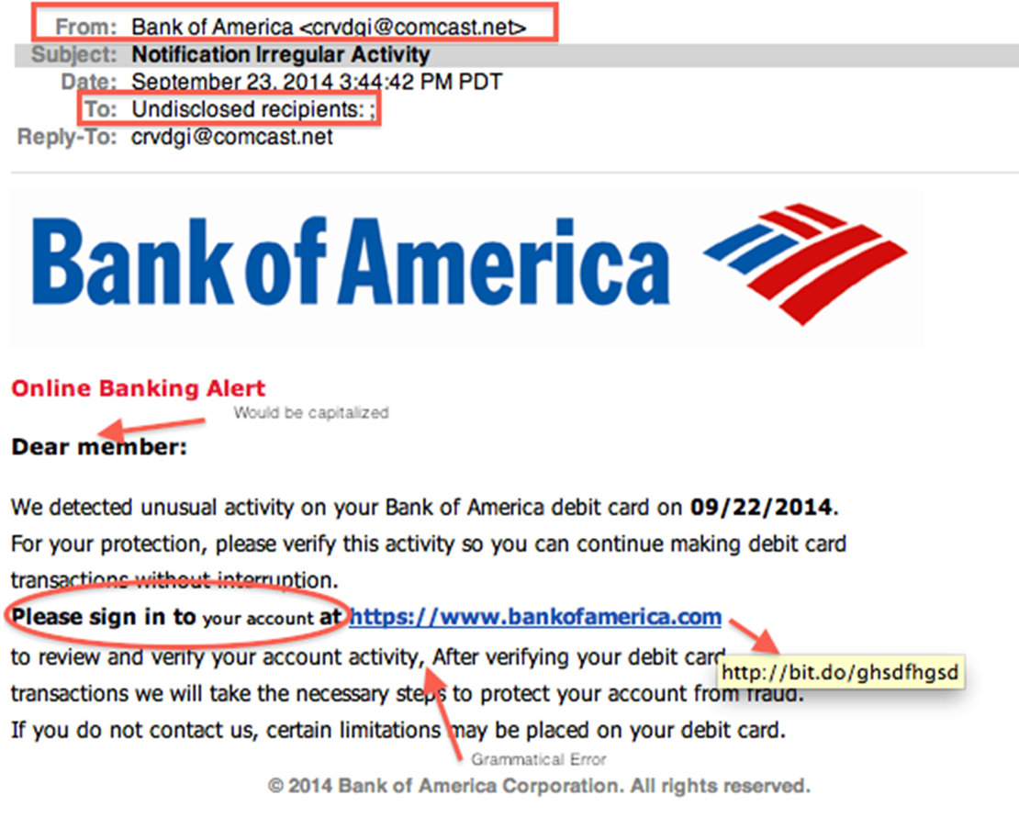
1.4 Security
Phishing and Pharming

Slide 51
1.4 Security
Phishing and Pharming

Slide 52
1.4 Security
Phishing and Pharming

Slide 53
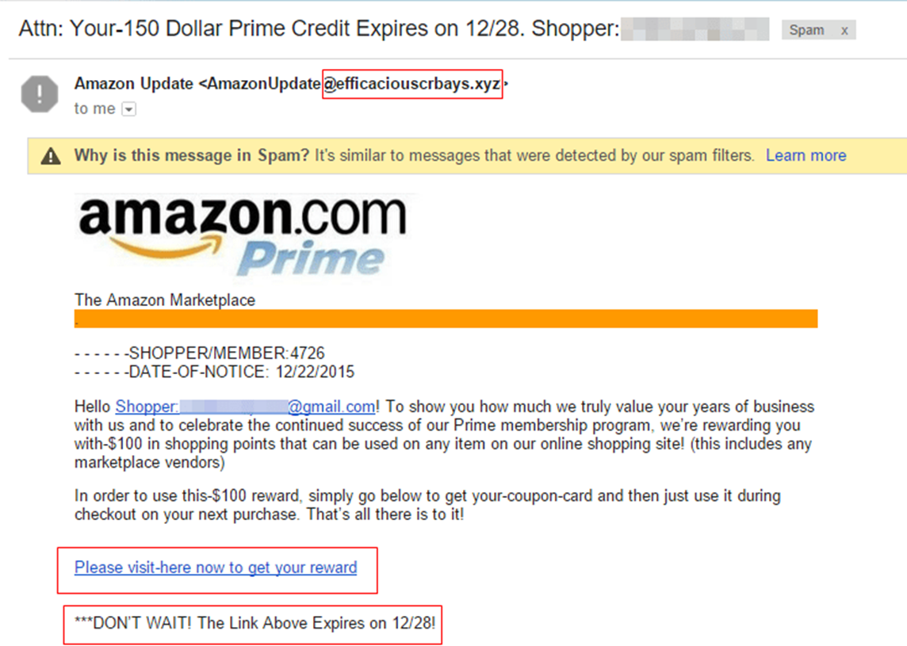
1.4 Security
Phishing and Pharming

Slide 54
1.4 Security
Phishing – a website link that takes the user to fake website that looks like a real website. The user is prompted to enter personal details.

Slide 55
1.4 Security
Phishing – an email link that takes the user to fake website that looks like a real website. The user is prompted to enter personal details.
Pharming – a piece of software that redirects the user to a fake website. The user is prompted to enter fake details.

Slide 56
1.4 Security
Phishing – an email link that takes the user to fake website that looks like a real website. The user is prompted to enter personal details.
Pharming – a piece of software that redirects the user to a fake website. The user is prompted to enter fake details.

Slide 57
1.4 Security
Phishing – an email link that takes the user to fake website that looks like a real website. The user is prompted to enter personal details.
Pharming – a piece of software that redirects the user to a fake website. The user is prompted to enter fake details.

Slide 58
1.4 Security
Phishing
or
Pharming

Slide 59
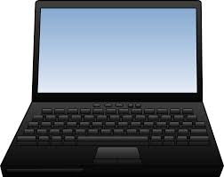
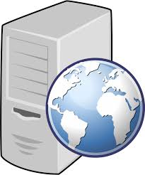
1.4 Security
Phishing
or
Pharming

Slide 60
1.4 Security
Phishing
or
Pharming

Slide 61
1.4 Security
Phishing
or
Pharming

Slide 62
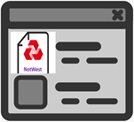
1.4 Security
Phishing
or
Pharming

Slide 63
1.4 Security
Phishing
or
Pharming

Slide 64
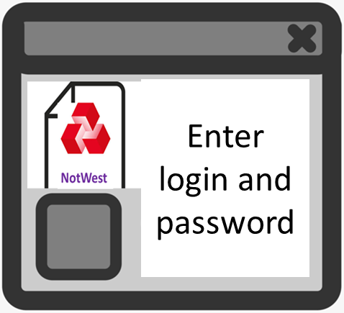
1.4 Security
Phishing
or
Pharming

Slide 65
1.4 Security
Phishing
or
Pharming

Slide 66
1.4 Security
Phishing
or
Pharming

Slide 67
1.4 Security
Phishing
or
Pharming

Slide 68
1.4 Security
Phishing
or
Pharming

Slide 69
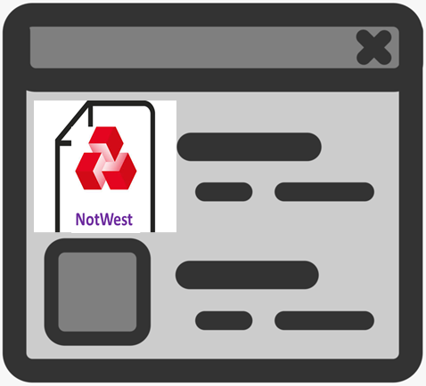
1.4 Security
Phishing
or
Pharming

Slide 70
1.4 Security
Phishing
or
Pharming

Slide 71
1.4 Security
Phishing
or
Pharming

Slide 72
1.4 Security
DDoS is an attempt by hackers to deny the service of a website.
It loads software onto a person’s computer, and that software loads up a webpage without the users knowledge.

Slide 73
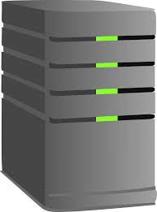
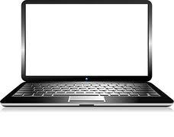

Slide 79
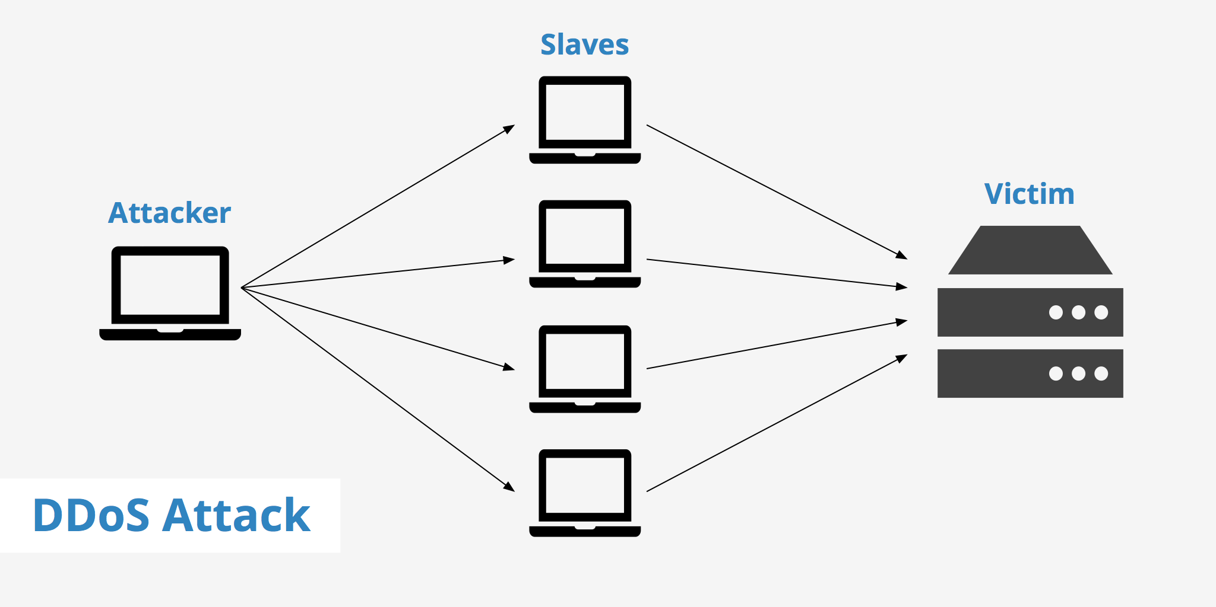
Zombie PC
Victim
Attacker

Slide 80
Zombie PC
1 million
Victim
Attacker
1 million
1 million
1 million

Slide 81
Zombie PC
1 million
Victim
Attacker
1 million
1 million
Bbc.co.uk
1 million

Slide 82
Zombie PC
1 million
Victim
Attacker
1 million
1 million
Bbc.co.uk
1 million

Slide 84
1 million
1 million
1 million

Slide 85
1.4 Security
This happens on millions of computers, and the traffic for the website becomes too high.
This makes the website crash as there is too much traffic.

Slide 86
1.4 Security
This happens on millions of computers, and the traffic for the website becomes too high.
This makes the website crash as there is too much traffic.
Denies the service of the website!

Slide 87
1.4 Security
This happens on millions of computers, and the traffic for the website becomes too high.
This makes the website crash as there is too much traffic.
Denies the service of the website!

Slide 88
1.4 Security
An attack that just uses lots of attempts to gain access to your system.
It will keep trying different password combinations until the attempt is correct.

Slide 89
1.4 Security
An attack that just uses lots of attempts to gain access to your system.
It will keep trying different password combinations until the attempt is correct.

Slide 90
1.4 Security
An attack that just uses lots of attempts to gain access to your system.
It will keep trying different password combinations until the attempt is correct.

Slide 91
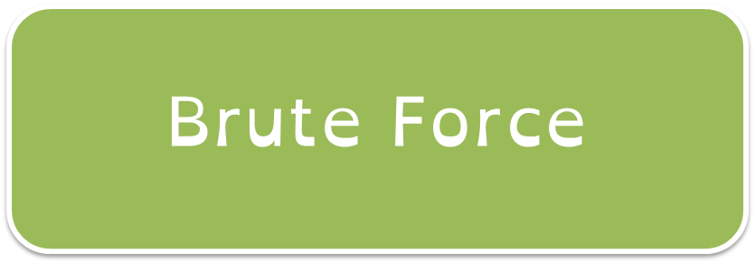
1.4 Security
An attack that just uses lots of attempts to gain access to your system.
It will keep trying different password combinations until the attempt is correct.

Slide 92
1.4 Security

Slide 93
1.4 Security
Virus
Worms
Trojan
Spyware
Root Kits
Back doors

Slide 94
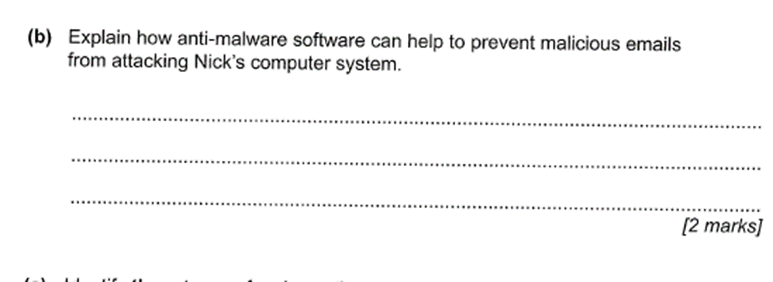
1.4 Security

Slide 95
1.4 Security
Anti-malware software scans the device and removes any malicious software.

Slide 96
1.4 Security

Slide 97
1.4 Security
Phishing

Slide 98
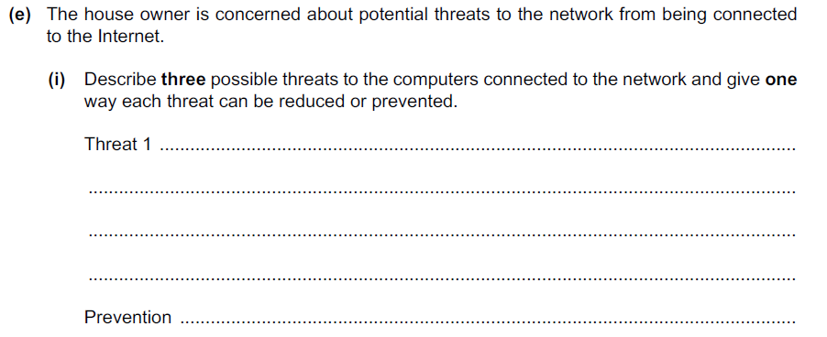
1.4 Security
How many marks do you think this question is worth?

Slide 99
1.4 Security
9 marks

Slide 100
1.4 Security
9 marks

Slide 101
1.4 Security
3 threats – 1 mark for threat name, 1 for description and 1 for preventing threat.

Slide 102
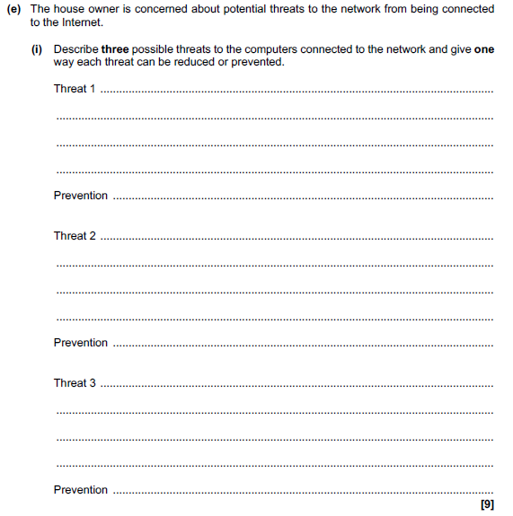
1.4 Security

Slide 103
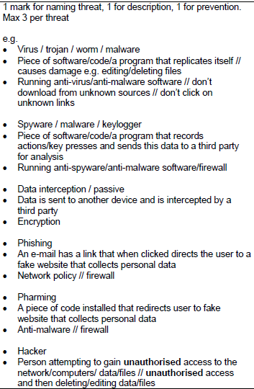
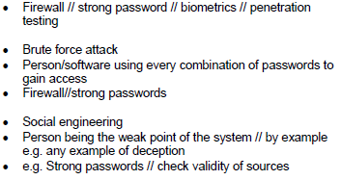
1.4 Security

Slide 104
1.4 Security

Slide 105
1.4 Security

Slide 106
1.4 Security
Threat name – this is where…
You can prevent this by…

Slide 107
1.4 Security
1
2
Threat name – this is where…
You can prevent this by…
3

Slide 108
1.4 Security
Virus
1
2
Threat name – this is where…
You can prevent this by…
3

Slide 109
1.4 Security
Virus – this is a piece of software that replicates itself and causes damage to the computer.
1
2
Threat name – this is where…
You can prevent this by…
3

Slide 110
1.4 Security
Virus – this is a piece of software that replicates itself and causes damage to the computer.
Anti-virus software.
1
2
Threat name – this is where…
You can prevent this by…
3

Slide 111
1.4 Security
Virus – this is a piece of software that replicates itself and causes damage to the computer.
Anti-virus software.
1
1
2
Threat name – this is where…
You can prevent this by…
3

Slide 112
1.4 Security
Virus – this is a piece of software that replicates itself and causes damage to the computer.
Anti-virus software.
1
1
1
2
Threat name – this is where…
You can prevent this by…
3

Slide 113
1.4 Security
Virus – this is a piece of software that replicates itself and causes damage to the computer.
Anti-virus software.
1
1
1
2
Threat name – this is where…
You can prevent this by…
1
3

Slide 114
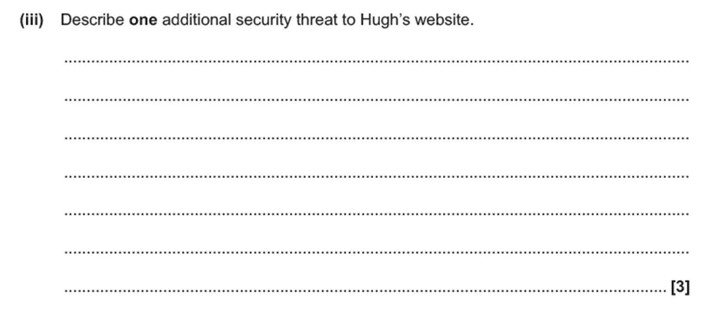
1.4 Security

Slide 115
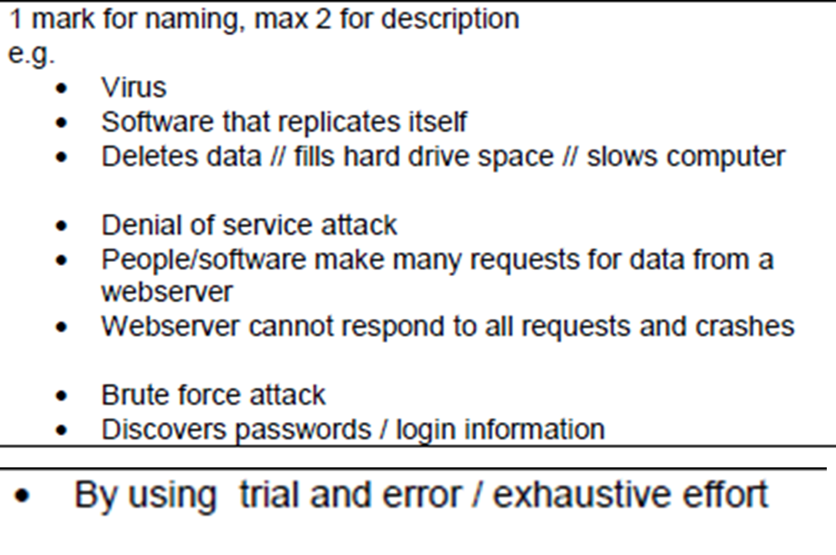
1.4 Security

Slide 116
1.4 Security
Brute force attack –

Slide 117
1.4 Security
Brute force attack – Password is attempted over and over again, until the successful password is given.

Slide 118
1.4 Security
Brute force attack – Password is attempted over and over again, until the successful password is given. Gives the user access to the network/data.

Slide 119
1.4 Security
Discuss the difference between phishing and pharming. [2]

Slide 120
1.4 Security
Discuss the difference between phishing and pharming. [2]
Fake / Website / Software / Email

Slide 121
1.4 Security
Discuss the difference between phishing and pharming. [2]
Phishing is…
Pharming is…

Slide 122
1.4 Security
Discuss the difference between phishing and pharming. [2]
Phishing is an email that directs you to a fake website in order to get sensitive information.
Pharming is…

Slide 123
1.4 Security
Discuss the difference between phishing and pharming. [2]
Phishing is an email that directs you to a fake website in order to get sensitive information.
Pharming is a piece of software installed on your computer that sends you to a fake website.

