Slide 1
OCR GCSE (9–1) in Computer Science (J277)
Computer Networks, Connections and Protocols
This pack is intended for students to use once they have covered the GCSE content, either in preparation for their L1 & L2 exam, or more likely alongside year 2 of the course to improve fluency, recall and pace on GCSE topics. It could be used as lesson starters, or supplied to students for independent use.

Slide 2
Bell Work
State the benefits of cloud computing.
Explain the role of the DNS.

Slide 3
1.3 Learn about network topologies.
1.3 Learn about network topologies.
State what a network topology is.
Explain the two main types of network topologies.
Compare the two main types of topologies.

Slide 4
1.3 Networks
A DNS (Domain Name Server) is a special server on the internet.
Their job is to convert URL’s the user types in into IP Addresses, so the locations of web pages can be found

Slide 5
1.3 Networks
Data / Accessible / Security / Server
In order for a website to be accessible over the internet, it must be hosted
This is when all the data for websites is stored on dedicated servers for users to access
Hosts offer 24/7 access to your website, security for your website, and access for multiple users without crashing.
However, if the hosts server goes down, so does your website!

Slide 6
1.3 Networks
Cloud Computing is when your data and applications are stored on the internet, rather than locally (actually on your device).
People store large amounts of data on the cloud, such as photos, word documents and presentations.
Cloud storage is basically storing information on another companies computer and accessing your data over the internet.

Slide 7
1.3 Networks

Slide 8
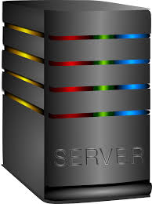
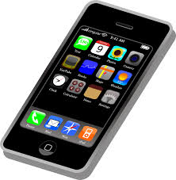
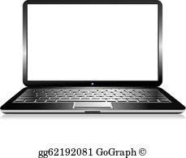
1.3 Networks

Slide 9
1.3 Networks

Slide 10
1.3 Networks

Slide 11
1.3 Networks
Positives
Work on the go, wherever you go, as long as you have internet connection.
Data is backed up and can be recovered if device breaks.
Apps update automatically – you don’t need to update.
Apps are usually free.

Slide 12
1.3 Networks
Negatives
Small amount of storage is free, then need to pay.
Can lose copyrights over work.
Data can be hacked easily.
No internet = no access to files.

Slide 13
1.3 Networks
Wired v wireless – which is best?
Range – wireless – why?
Security – wired – why?
Cost – wireless – why?

Slide 14
1.3 Networks
A network topology is the arrangements of nodes of a network.
What is a node?

Slide 15
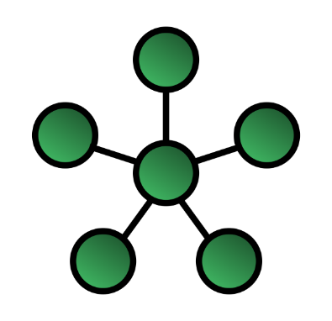
1.3 Networks

Slide 16
1.3 Networks
Switch / Hub

Slide 17
1.3 Networks
What is a switch and hub?
Are they nodes?
Switch / Hub

Slide 18
1.3 Networks
Hubs and switches connect devices together.
Are they nodes?
Switch / Hub

Slide 19
1.3 Networks
Hubs and switches connect devices together.
Yes.
Switch / Hub

Slide 20
1.3 Networks
This is called a star topology.
Switch / Hub

Slide 21
1.3 Networks
The nodes connect to a central hub or switch.
Switch / Hub

Slide 22
1.3 Networks
What is best to use, a hub or switch?
Why?
Switch / Hub

Slide 23
1.3 Networks
Hub – sends data to all nodes.
Switch – sends data to intended nodes.
Switch / Hub

Slide 24
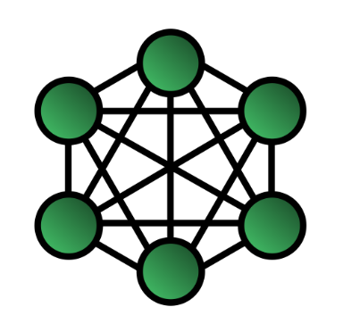
1.3 Networks

Slide 25
1.3 Networks
In a Mesh topology, each device (node) is connected to as many other devices (nodes) as possible.

Slide 26
1.3 Networks
This means data can travel in multiple different directions via the quickest route.

Slide 27
1.3 Networks
What are the positives of each type of network topology we have looked at so far?

Slide 28
1.3 Networks
What are the positives of each type of network topology we have looked at so far?
What if one device fails in either network?

Slide 29
1.3 Networks
What are the positives of each type of network topology we have looked at so far?
Can we add additional nodes easily?

Slide 30
1.3 Networks
What are the positives of each type of network topology we have looked at so far?
Data collisions?

Slide 31
1.3 Networks
What about negatives?

Slide 32
1.3 Networks
What about negatives?
Cost of setting up this network?

Slide 33
1.3 Networks
What about negatives?
Additional cost of central hub/switch?

Slide 34
1.3 Networks
What about negatives?
Central hub or switch fails?

Slide 35
1.3 Networks
Compare the positives and negatives of the star and mesh network topologies.

Slide 36
1.3 Networks
Compare the positives and negatives of the star and mesh network topologies.
Cost
Data traffic
Node failure
Hub/switch failure

Slide 37
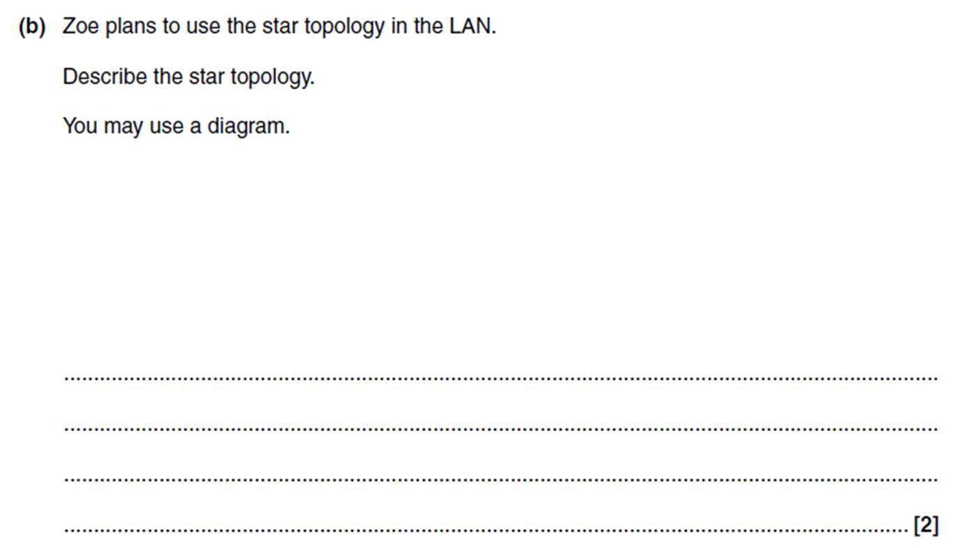
1.3 Networks

