Slide 1
OCR GCSE (9–1) in Computer Science (J277)
Computer Networks, Connections and Protocols
This pack is intended for students to use once they have covered the GCSE content, either in preparation for their L1 & L2 exam, or more likely alongside year 2 of the course to improve fluency, recall and pace on GCSE topics. It could be used as lesson starters, or supplied to students for independent use.

Slide 2
Bell Work
What is transmission media?
What are the different methods of transmitting data?
What factors can affect the performance of a network?

Slide 3
1.3 Learn about the different network hardware.
1.3 Learn about the different network hardware.
State the different types of network hardware.
Explain the features of network hardware.
Compare network hardware components.

Slide 4
1.3 Networks
What is a network?
A computer network is two or more devices connected together so they can communicate

Slide 5
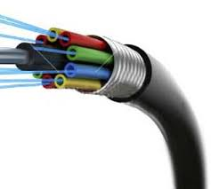
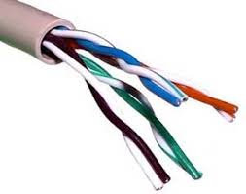
1.3 Networks

Slide 6
1.3 Networks
Bandwidth
The number of errors that occur when data is transferred. The higher this is, the more frequently data has to be resent before arriving safely
Number of Users
The amount of data that can be sent and received successfully in a given time. Measured in Mbps
Transmission Media
This is the delay between sending data and receiving data. This can be increased by not having sufficient hardware to direct traffic around the network correctly
Error Rate
This is the number of people using the network at one time. The higher this is, the more traffic on the network and the more bandwidth being used, the slower the network will be
Latency
This is the media/hardware you choose to use on your network. The better this is, the better your network will perform

Slide 7
1.3 Networks
We can create networks using a variety of different hardware combinations.
What is hardware?

Slide 8
1.3 Networks
We can create networks using a variety of different hardware combinations.
What is hardware?
Hardware is a piece of the computer that you can physically touch.

Slide 9
1.3 Networks
What hardware can be used to connect you to a network?

Slide 10
1.3 Networks
What hardware can be used to connect you to a network?
Router
Switch
Hub
NIC
WAP
Cable

Slide 11
1.3 Networks
What hardware can be used to connect you to a network?
Router
Switch
Hub
NIC – Network Interface Card
WAP – Wireless Access Point
Cable

Slide 12
1.3 Networks
What do you know about the 3 devices below?
Router
Switch
Hub

Slide 13
1.3 Networks
Router
Switch
Hub
Used to send data around a network. It sends data to all devices on the network, not just to the correct recipient
Used to send data between multiple networks. You cannot access the internet without one of these. Uses IP Addresses to direct data
Used to send data around a network. It sends data to just the correct recipient, not all devices on the network

Slide 14
1.3 Networks
Router
Switch
Hub
Used to send data around a network. It sends data to all devices on the network, not just to the correct recipient
Used to send data between multiple networks. You cannot access the internet without one of these. Uses IP Addresses to direct data
Used to send data around a network. It sends data to just the correct recipient, not all devices on the network

Slide 15
1.3 Networks
Router
Switch
Hub
Used to send data around a network. It sends data to all devices on the network, not just to the correct recipient
Used to send data between multiple networks. You cannot access the internet without one of these. Uses IP Addresses to direct data
Used to send data around a network. It sends data to just the correct recipient, not all devices on the network

Slide 16
1.3 Networks
Router
Switch
Hub
Used to send data around a network. It sends data to all devices on the network, not just to the correct recipient
Used to send data between multiple networks. You cannot access the internet without one of these. Uses IP Addresses to direct data
Used to send data around a network. It sends data to just the correct recipient, not all devices on the network

Slide 17
1.3 Networks
Router
Switch
Hub
Used to send data around a network. It sends data to all devices on the network, not just to the correct recipient
Used to send data between multiple networks. You cannot access the internet without one of these. Uses IP Addresses to direct data
Used to send data around a network. It sends data to just the correct recipient, not all devices on the network

Slide 18
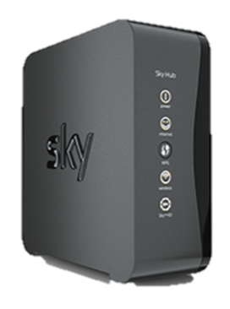
1.3 Networks
Router
Switch
Hub
Used to send data around a network. It sends data to all devices on the network, not just to the correct recipient
Used to send data between multiple networks. You cannot access the internet without one of these. Uses IP Addresses to direct data
Used to send data around a network. It sends data to just the correct recipient, not all devices on the network

Slide 19
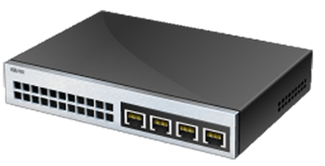
1.3 Networks
Router
Switch
Hub
Used to send data around a network. It sends data to all devices on the network, not just to the correct recipient
Used to send data between multiple networks. You cannot access the internet without one of these. Uses IP Addresses to direct data
Used to send data around a network. It sends data to just the correct recipient, not all devices on the network

Slide 20
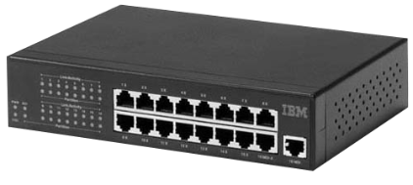
1.3 Networks
Router
Switch
Hub
Used to send data around a network. It sends data to all devices on the network, not just to the correct recipient
Used to send data between multiple networks. You cannot access the internet without one of these. Uses IP Addresses to direct data
Used to send data around a network. It sends data to just the correct recipient, not all devices on the network

Slide 21
1.3 Networks
What is the difference between a switch and a hub?
Which one is the best?
Why?

Slide 22
1.3 Networks
Switches discriminate between who to send the data to.
What does discriminate mean?
If humans discriminate is that good?

Slide 23
1.3 Networks
You are a small business with 3 employees and have a small network of computers.
Would a hub or switch be best?
Why?

Slide 24
1.3 Networks
You are a medium business and have 200 employees. You have a network in your business.
Would a hub or switch be best?
Why?

Slide 25
1.3 Networks
Hub or Switch?
1 benefit of each.
Explain why you would not have 1 of them.

Slide 26
1.3 Networks
Comparatively Expensive
Less technical
Comparatively cheap
Comparatively Faster
More technical
Comparatively Slower

Slide 27
1.3 Networks
What do you understand of the terms below.
NIC – Network Interface Card
WAP – Wireless Access Point
Cable

Slide 28
1.3 Networks
NIC
WAP
Cable
Connects a device to a wired or wireless network. It is built into the device. It uses protocols to ensure communication is consistent
Used to create a wired network. There are two main types: Copper Cables, and Fibre Optic
Used to connect a device to a network wirelessly, without any cables

Slide 29
1.3 Networks
NIC
WAP
Cable
Connects a device to a wired or wireless network. It is built into the device. It uses protocols to ensure communication is consistent
Used to create a wired network. There are two main types: Copper Cables, and Fibre Optic
Used to connect a device to a network wirelessly, without any cables

Slide 30
1.3 Networks
NIC
WAP
Cable
Connects a device to a wired or wireless network. It is built into the device. It uses protocols to ensure communication is consistent
Used to create a wired network. There are two main types: Copper Cables, and Fibre Optic
Used to connect a device to a network wirelessly, without any cables

Slide 31
1.3 Networks
NIC
WAP
Cable
Connects a device to a wired or wireless network. It is built into the device. It uses protocols to ensure communication is consistent
Used to create a wired network. There are two main types: Copper Cables, and Fibre Optic
Used to connect a device to a network wirelessly, without any cables

Slide 32
1.3 Networks
NIC
WAP
Cable
Connects a device to a wired or wireless network. It is built into the device. It uses protocols to ensure communication is consistent
Used to create a wired network. There are two main types: Copper Cables, and Fibre Optic
Used to connect a device to a network wirelessly, without any cables

Slide 33
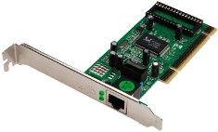
1.3 Networks
NIC
WAP
Cable
Connects a device to a wired or wireless network. It is built into the device. It uses protocols to ensure communication is consistent
Used to create a wired network. There are two main types: Copper Cables, and Fibre Optic
Used to connect a device to a network wirelessly, without any cables

Slide 34
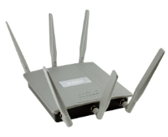
1.3 Networks
NIC
WAP
Cable
Connects a device to a wired or wireless network. It is built into the device. It uses protocols to ensure communication is consistent
Used to create a wired network. There are two main types: Copper Cables, and Fibre Optic
Used to connect a device to a network wirelessly, without any cables

Slide 35
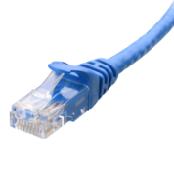
1.3 Networks
NIC
WAP
Cable
Connects a device to a wired or wireless network. It is built into the device. It uses protocols to ensure communication is consistent
Used to create a wired network. There are two main types: Copper Cables, and Fibre Optic
Used to connect a device to a network wirelessly, without any cables

Slide 36
1.3 Networks
John is a network manager and has just been hired by a new firm. They want him to set up a fast and powerful network for their new head office.
John needs to buy some hardware for the network.
State 2 pieces of hardware John could use in his network. [2]

Slide 37
1.3 Networks
John is a network manager and has just been hired by a new firm. They want him to set up a fast and powerful network for their new head office.
John needs to buy some hardware for the network.
State 2 pieces of hardware John could use in his network. [2]

Slide 38
1.3 Networks
John is unsure whether to buy a hub or a switch. Explain to John the positives and negatives of using a hub and switch. [4]

Slide 39
1.3 Networks
Comparatively Expensive
Less technical
Comparatively cheap
Comparatively Faster
More technical
Comparatively Slower

