Slide 1
4.1.5 Productive and allocative efficiency
For more help, please visit www.exampaperspractice.co.uk
© 2025 Exams Papers Practice. All Rights Reserved

Slide 2
Learning Objectives
Are you able to explain the distinction between allocative efficiency and productive efficiency?
Are you able to explain the significance of the margin; opportunity costs, trade-offs and allocative efficiency?
Are you able to explain how increasing productivity to reduce average cost through greater efficiency?
For more help, please visit www.exampaperspractice.co.uk
© 2025 Exams Papers Practice. All Rights Reserved

Slide 3
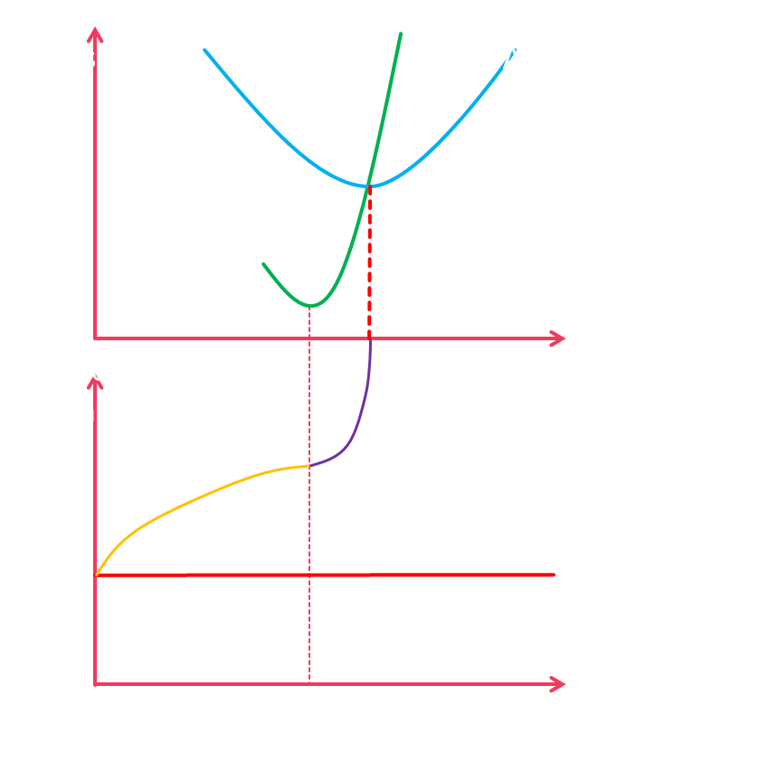
Recall
Explain the diagram on the right.
Explain the difference between normal and supernormal profit.
Describe three different things you learnt in the last topic.
For more help, please visit www.exampaperspractice.co.uk
© 2025 Exams Papers Practice. All Rights Reserved

Slide 4
Starter
Distinguish between productive and allocative efficiency.
Distinguish between opportunity cost and trade-offs.
For more help, please visit www.exampaperspractice.co.uk
© 2025 Exams Papers Practice. All Rights Reserved

Slide 5
Economic efficiency
Allocative efficiency occurs where consumer satisfaction is maximised in the production of goods and services
At this point quantity supplied will equal quantity demanded
Productive efficiency occurs where no additional (or maximum) output can be produced from the factor inputs available at the lowest possible average or unit cost
Average cost = total cost/output
Economic efficiency occurs where we have allocative and productive efficiency at the same time
Both productive and allocative efficiency can be illustrated using a PPC
Efficiency is important for economists and there are a variety of efficiencies that come under the umbrella heading economic efficiency.
Economic efficiency occurs when the maximum amount of products are produced at their minimum cost whilst maximising their benefit to society.
Productive efficiency occurs when an economy uses the minimum inputs to produce the maximum output at lowest cost.
Allocative efficiency occurs when society is producing goods to match the needs of consumers.
For more help, please visit www.exampaperspractice.co.uk
© 2025 Exams Papers Practice. All Rights Reserved

Slide 6
Activity
Task 1: For the three types of efficiency link them to real world examples.
Task 2: Think of the diagrams that could be drawn and explain how they would look.
Task 3: Difference between short run and long run and why is it important for this topic?
For more help, please visit www.exampaperspractice.co.uk
© 2025 Exams Papers Practice. All Rights Reserved
For more help, please visit www.exampaperspractice.co.uk
© 2025 Exams Papers Practice. All Rights Reserved

Slide 7
Productive efficiency
Productive efficiency can be shown using an average cost curve diagram
Average total cost (ATC) is total cost divided by output.
As output increases costs per unit fall. This occurs because fixed costs (those costs that do not vary with output e.g. rent) are spread over the higher output.
Productive efficiency occurs at output Q where average total costs are at their minimum.
Costs of production
Average Total Cost
Q
Output
For more help, please visit www.exampaperspractice.co.uk
© 2025 Exams Papers Practice. All Rights Reserved

Slide 8
The significance of the margin
The margin is fundamental when firms make production choices
They will only choose an option if marginal revenue is greater than marginal cost
This will contribute to profits
If the marginal cost is greater than the marginal revenue then profits will actually fall
The firm will produce up to the point where marginal cost equals marginal revenue

Slide 9
Productive and allocative efficiency
Any point on the PPC is said to be productively efficient. On the curve we are producing at maximum production i.e. we cannot produce any more. At point C we can produce more goods (under production). Point D is unobtainable given our current factor inputs.
The PPC also shows the trade-off between two variables, here good X and good Y. There is an opportunity cost as producing more of good X means producing less of good Y.
Allocative efficiency takes into account the desires of consumers. If good Y is in greater demand than good X then production at point A will be more allocatively efficient than that of point B. Therefore, allocative efficiency can be found somewhere on the PPC but at what point depends upon consumer preference.
Good Y
D
A
C
B
Good X
For more help, please visit www.exampaperspractice.co.uk
© 2025 Exams Papers Practice. All Rights Reserved

Slide 10
When is allocative efficiency achieved?
Allocative efficiency is difficult to identify as we need to match consumer preferences to producer output
Put another way, we need to match demand and supply
Markets do not always operate at the market clearing price due to:
Excess supply (S>D)
Excess demand (D>S)
Market forces do push prices towards equilibrium where quantity demanded will equal quantity supplied
Therefore, it is likely that competitive markets help in achieving allocative efficiency
For more help, please visit www.exampaperspractice.co.uk
© 2025 Exams Papers Practice. All Rights Reserved
Notes:
http://www.bbc.co.uk/news/business-23702264

Slide 11
Activity
Task 1: Draw the excess supply/excess demand diagram (Recall)
Task 2: Is this realistic in the real world?
Task 3: Examples of excess supply?
For more help, please visit www.exampaperspractice.co.uk
© 2025 Exams Papers Practice. All Rights Reserved

Slide 12
Green Pen
For more help, please visit www.exampaperspractice.co.uk
© 2025 Exams Papers Practice. All Rights Reserved

Slide 13
Check your learning
Society prefers good X to good Y. At which point(s) is the business operative at allocative efficiency?
A and B
C only
D only
B only
Good Y
D
A
C
B
Good X
For more help, please visit www.exampaperspractice.co.uk
© 2025 Exams Papers Practice. All Rights Reserved
Notes:
D

Slide 14
Increasing productivity to reduce average cost through greater efficiency
Efficiency is influenced by:
Increased use of technology e.g. automation and technological change can help to reduce average costs of production. Innovation, new product and new process development are likely to occur if supernormal profits are available for investment
Investment in human capital will reduce costs as labour is better trained and better educated workers are employed. A better understanding of the job role will mean that output will improve, increasing productivity
Improved quality of management will lead to better decision making, reducing waste and bureaucracy and lowering costs through more efficient decisions being made
For more help, please visit www.exampaperspractice.co.uk
© 2025 Exams Papers Practice. All Rights Reserved

Slide 15
Increasing productivity to reduce average cost through greater efficiency: minimum efficient scale
The minimum efficient scale (MES) is that scale of production where the long run average cost curve is at its lowest point
If the MES occurs at low levels of output in relationship to the size of the market there is likely to be a large number of firms
As the MES increases there will be fewer firms in the market as those firms operating on a larger scale will have much lower long run average costs
This creates a barrier to entry for new firms wishing to enter the market as smaller businesses do not have the finance to increase their scale of production
Productive efficiency occurs where no additional output can be produced from the factor inputs available at the lowest possible average or unit cost.
In essence, this means that a firm operating at the lowest point on the LRAC curve cannot produce in a more efficient manner – if it decreases or increases the scale of production its average costs will increase.
For more help, please visit www.exampaperspractice.co.uk
© 2025 Exams Papers Practice. All Rights Reserved

Slide 16
Minimum efficient scale
The Minimum Efficient Scale (MES) is that point where the LRAC curve is at its lowest point.
The MES of a firm will have implications as to the degree of competition in the market.
MES is low for firms in certain industries e.g. hairdressing.
In other industries the MES can occur at high levels of output. Therefore, firms in some industries will operate on a large scale.
Costs
LRAC
Increasing Returns to Scale
Decreasing Returns to Scale
Constant Returns to Scale
Output
For more help, please visit www.exampaperspractice.co.uk
© 2025 Exams Papers Practice. All Rights Reserved

Slide 17
Matching the structure of production to the pattern of consumer preferences
Matching production to meet consumer preferences is also known as market orientation
Market orientation is an outward looking approach to new product development where the key focus is on what products the consumer wants
It is heavily informed by market research
Firms will concentrate on understanding the needs of the consumer and then adapting or producing products to meet these needs
This reduces, but does not eliminate, the risk of new product development
For more help, please visit www.exampaperspractice.co.uk
© 2025 Exams Papers Practice. All Rights Reserved
Notes:
http://www.bbc.co.uk/news
Non-stick mayonnaise packaging being developed
/technology-33344955

Slide 18
How markets interact with one another
Apples and pears
Price
A
S
Price
B
S
In diagram A current output of apples is Q2, above the equilibrium price.
In diagram B current output of pears is Q2, below the equilibrium price.
In both markets we have allocative inefficiency.
By reallocating resources from the production of apples to that of pears we can increase allocative efficiency.
If apples were produced at Q1 and pears were produced at Q1 we have allocative efficiency.
P2
P1
P1
P2
D
D
0
Q1
Q2
0
Q2
Q1
Quantity
Quantity
In diagram A suppose the market price is P2. Consumers value the last unit produced at Q1, where price is P1. However, firms produce at Q2.
Consumers are not willing to pay the higher price so price will fall, and firms will reduce supply.
This might lead to a reallocation of a firms’ resources to another use e.g. from apples to pears.
In diagram B suppose the market price is P2. Consumers value the last unit produced at Q1, where price is P1. However, firms produce at Q2.
Consumers are willing to pay the higher price so price will rise to P2, and firms will increase supply.
This might lead to a reallocation of a firms’ resources from another use e.g. from apples to pears.
For more help, please visit www.exampaperspractice.co.uk
© 2025 Exams Papers Practice. All Rights Reserved

Slide 19
Plenary
1. Define the term allocative efficiency.
For a number of years the supply of organic produce grew at a rate just enough to meet its demand. In the recession consumers started to cut back on organic produce but supply continued to increase at the same rate.
2. Explain whether the market for organic produce is working efficiently.
3. In the diagram below the price of a product is P2 and output is Q2. Explain why this combination of price and output is allocatively inefficient.
Price
S
P2
P1
D
For more help, please visit www.exampaperspractice.co.uk
0
Q1
Q2
Quantity
© 2025 Exams Papers Practice. All Rights Reserved

