Slide 1
3.6.1 Poverty and Inequality 3.6 Inequality and re-distribution
For more help, please visit www.exampaperspractice.co.uk
© 2025 Exams Papers Practice. All Rights Reserved

Slide 2
Recall Activity
Explain why minimum wages are introduced to economies
1
Explain why introducing a minimum wage could actually be a bad thing for workers
2
Explain the difference between a monopsony and a monopoly
3
For more help, please visit www.exampaperspractice.co.uk
© 2025 Exams Papers Practice. All Rights Reserved

Slide 3
Starter Activity
Define the term poverty
Define the term inequality
Distinguish between absolute and relative poverty.
For more help, please visit www.exampaperspractice.co.uk
© 2025 Exams Papers Practice. All Rights Reserved

Slide 4
Learning Objectives
Are you able to explain how absolute and relative poverty differ?
Are you able to analyse the different measures of poverty?
Are you able to evaluate the Gini coefficient and Lorenz curve?
For more help, please visit www.exampaperspractice.co.uk
© 2025 Exams Papers Practice. All Rights Reserved

Slide 5
Poverty
Poverty occurs when individuals or households are deprived of material possessions and income which stops them from having a decent standard of living
Absolute poverty means that individuals or households are deprived of basic human needs
Relative poverty occurs when individuals or households are poor in comparison to the rest of the population
Inequalities in the distribution of income and wealth are a main reason for poverty
For more help, please visit www.exampaperspractice.co.uk
© 2025 Exams Papers Practice. All Rights Reserved

Slide 6
Causes of poverty
Age
As the economy grows each generation is richer than the previous one
Many retired people rely on the state pension
This is linked to inflation but has fallen behind the level of real earnings
Therefore, older people are more likely to suffer relative poverty
For more help, please visit www.exampaperspractice.co.uk
© 2025 Exams Papers Practice. All Rights Reserved

Slide 7
Causes of poverty
Low wages and unwaged
Average earnings growth has outstripped that of unemployment benefit payments
Low skilled workers have found earnings are not enough to pay for basics such as heating
The national minimum wage was introduced in 1998 to help alleviate this and firms in London have signed up to a ‘living wage’
Supply of labour is elastic in low paid industries leading to low wage rates
For more help, please visit www.exampaperspractice.co.uk
© 2025 Exams Papers Practice. All Rights Reserved

Slide 8
Measures of poverty
Poverty can be measured in a number of ways, including:
Minimum income standards (MIS) – a measurement of what is required to achieve a minimum acceptable standard of living
Households Below Average Income (HBAI) – based on government statistics, the poverty line is said to be where household income is below 60% of median household incomes
Material deprivation – how affordable a basket of goods and services is in order for individuals to have an acceptable standard of living in their own country
For more help, please visit www.exampaperspractice.co.uk
© 2025 Exams Papers Practice. All Rights Reserved

Slide 9
Measures of poverty
Income is a main way of measuring poverty. Less equal distribution of income and wealth will lead to increased poverty as more people live below the poverty line leading to a less fair and less inclusive society
The poverty line is 60% of the median household income and is used as a measure in EU and OECD countries
The headcount ratio is the percentage of the population below the poverty line
This is seen as the minimum income required for a decent living standard
If people don’t feel a part of society and have enough means for a decent standard of living greater social problems are likely to occur leading to:
Increased crime
A less safe environment for all
Social tension
Reduced happiness
For more help, please visit www.exampaperspractice.co.uk
© 2025 Exams Papers Practice. All Rights Reserved

Slide 10
Measures of poverty
Consumption can be used to measure poverty
This is more likely to take into account the ability to purchase goods and services
Income is often measured pre-tax and therefore does not give an accurate measurement of purchasing power
For example, an individual working on a low income might have less disposable income than an individual claiming welfare benefits and not working
For more help, please visit www.exampaperspractice.co.uk
© 2025 Exams Papers Practice. All Rights Reserved

Slide 11
Measures of poverty
Material deprivation looks at measuring poverty over the long-term
It looks at the impact on households over a long period of time
These are less likely to be able to build up any wealth or possess assets that individuals often take for granted e.g. house and car
Other measures can be used but are often difficult to measure e.g. poor family environment, poor health, poor schooling and bad household debt
For more help, please visit www.exampaperspractice.co.uk
© 2025 Exams Papers Practice. All Rights Reserved

Slide 12
Measures of international poverty
The international poverty line is a global measurement of poverty
It looks at the purchasing power of individuals within a country in dollar terms
This uses purchasing power parity to take into account the cost of living in each country
In 2022 the World Bank used an income of $2.15 a day, below which an individual lived in extreme poverty
The poverty gap index measures how far, on average, individuals are from the poverty line
This takes into account the depth of poverty in a country
For more help, please visit www.exampaperspractice.co.uk
© 2025 Exams Papers Practice. All Rights Reserved

Slide 13
Effects of poverty
Income will be redistributed back to higher earners with increased saving and wealth
There may be increased investment as the returns for entrepreneurs improve e.g. lower tax rates
Capitalism can exacerbate levels of inequality as the capitalist owns the means of production
The ownership of assets will lead to higher income leading to even greater inequality in the future
For more help, please visit www.exampaperspractice.co.uk
© 2025 Exams Papers Practice. All Rights Reserved

Slide 14
Lorenz Curve and Gini Coefficient
100
The Lorenz Curve shows the distribution of income or wealth within a country
The red 45° line shows perfect income equality in an economy.
At this point the bottom 20% of people earn 20% of income, the bottom 40% earn 40% of income and so on.
The green line shows the divergence from perfect income equality.
% of income
A
B
0
100
% of population
For more help, please visit www.exampaperspractice.co.uk
© 2025 Exams Papers Practice. All Rights Reserved

Slide 15
Lorenz Curve and Gini Coefficient
100
0 population have 0% of the income. 100% of the population have 100% of the income.
The diagram shows that the bottom 20% of the population only has 3% of the income.
The top 20% of the population has 57% of the income. (100% - 43%).
% of income
43%
A
B
3%
0
Bottom 20%
% of population
Top 20%
100
For more help, please visit www.exampaperspractice.co.uk
© 2025 Exams Papers Practice. All Rights Reserved

Slide 16
Lorenz Curve and Gini Coefficient
100
The Gini Coefficient is a figure between 0 and 1 that provides a numerical measure of the level of inequality in a country:
A/A+B
A is the area between the 45° line and the Lorenz Curve.
A+B shows all of the income within an economy.
The closer to 0 the more equal is the income distribution within an economy
% of income
A
B
0
100
% of population
For more help, please visit www.exampaperspractice.co.uk
© 2025 Exams Papers Practice. All Rights Reserved

Slide 17
Lorenz Curve and Gini Coefficient
The further away from the 45° line of perfect income equality we are the more unequal is society.
100
% of income
0
% of population
100
For more help, please visit www.exampaperspractice.co.uk
© 2025 Exams Papers Practice. All Rights Reserved

Slide 18
Activity - Lorenz Curve and Gini definitions
Match up the definitions on the worksheet
For more help, please visit www.exampaperspractice.co.uk
© 2025 Exams Papers Practice. All Rights Reserved

Slide 19
Activity – Draw the Lorenz Curve
Draw the curves on the worksheet
For more help, please visit www.exampaperspractice.co.uk
© 2025 Exams Papers Practice. All Rights Reserved

Slide 20
Home Learning
UK food price inflation and poverty
Inequality in the UK
For more help, please visit www.exampaperspractice.co.uk
© 2025 Exams Papers Practice. All Rights Reserved

Slide 21
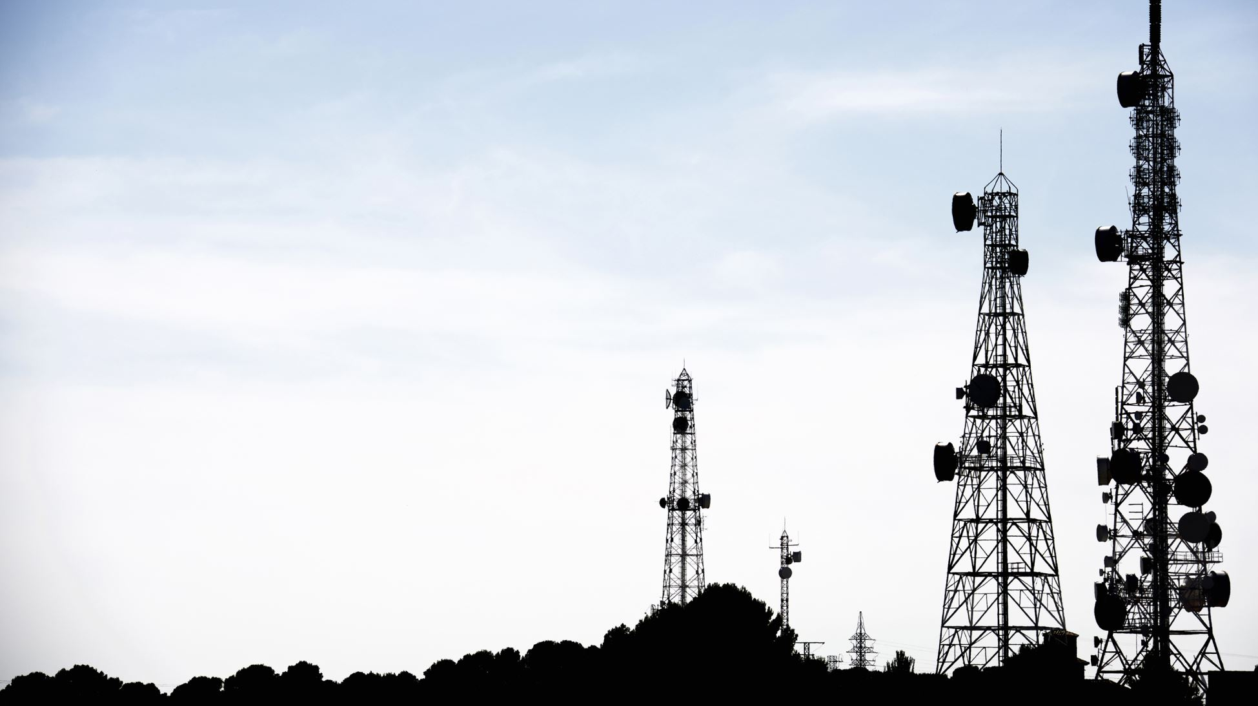
Plenary
What is meant by the Gini coefficient?
What is the Lorenz curve used for?
Name one thing you need to revise.
For more help, please visit www.exampaperspractice.co.uk
© 2025 Exams Papers Practice. All Rights Reserved

Slide 22
Questions
How can government policies and programs reduce poverty in the UK?
What role do market failure and income inequality play in poverty, and how can they be addressed?
How can economic growth be promoted in a way that also reduces poverty and income inequality?
How do globalization and international trade affect poverty levels in the UK and other countries?
What are the benefits and drawbacks of implementing a basic income policy as a means of reducing poverty?
How does the welfare state in the UK impact poverty levels and how could it be improved?
How does poverty affect individuals and communities in the UK, and what are the long-term consequences of poverty?
How does poverty intersect with other social issues, such as education and healthcare, and how can these issues be addressed together?
How can private sector and civil society organizations work with the government to reduce poverty in the UK?
What are the impact of Brexit on poverty in the UK and how can it be mitigated?
For more help, please visit www.exampaperspractice.co.uk
© 2025 Exams Papers Practice. All Rights Reserved

