Slide 1
3.4.2 Ethical issues 3.4 Impact of globalisation on local and national economies
For more help, please visit www.exampaperspractice.co.uk
© 2025 Exams Papers Practice. All Rights Reserved

Slide 2
Recall Activity
What is an MNC?
Explain one advantage an MNC might have on a national economy
For more help, please visit www.exampaperspractice.co.uk
© 2025 Exams Papers Practice. All Rights Reserved

Slide 3
Starter
What do we mean by the term ethics?
Who are the stakeholders at Yavneh College?
Is the shareholder the most important stakeholder? Justify your answer.
For more help, please visit www.exampaperspractice.co.uk
© 2025 Exams Papers Practice. All Rights Reserved

Slide 4
Learning Objectives
Are you able to explain what the stakeholder conflict is?
Are you able to explain environmental and supply chain issues?
For more help, please visit www.exampaperspractice.co.uk
© 2025 Exams Papers Practice. All Rights Reserved

Slide 5
Economics in Context
https://www.itv.com/news/2023-01-30/uk-economy-set-for-sharp-contraction-in-weakest-performance-among-g7-imf
What is the IMF predicting for the UK economy?
Why is the UK economy likely to go into recession?
For more help, please visit www.exampaperspractice.co.uk
© 2025 Exams Papers Practice. All Rights Reserved

Slide 6
Corporate Social Responsibility
After watching the video below;
Define CSR in your own words
Identify why a company would use CSR business model
https://www.investopedia.com/terms/c/corp-social-responsibility.asp
For more help, please visit www.exampaperspractice.co.uk
© 2025 Exams Papers Practice. All Rights Reserved

Slide 7
Ethical issues
Stakeholder conflict
Profit motive (shareholder concept) v. wider motives of other stakeholders (stakeholder concept)
Stakeholders are often protected by Corporate Social Responsibility (CSR) standards
The stakeholder model leads to ethical decision making
For more help, please visit www.exampaperspractice.co.uk
© 2025 Exams Papers Practice. All Rights Reserved

Slide 8
Activity 1
1
2
3
Explain the difference between the stakeholder and shareholder model
Explain why the stakeholder model involves ethics.
Name some companies which should follow each model.
For more help, please visit www.exampaperspractice.co.uk
© 2025 Exams Papers Practice. All Rights Reserved

Slide 9
Activity 2
Explain the link between
- ethics
pressure groups
social media.
For more help, please visit www.exampaperspractice.co.uk
© 2025 Exams Papers Practice. All Rights Reserved

Slide 10
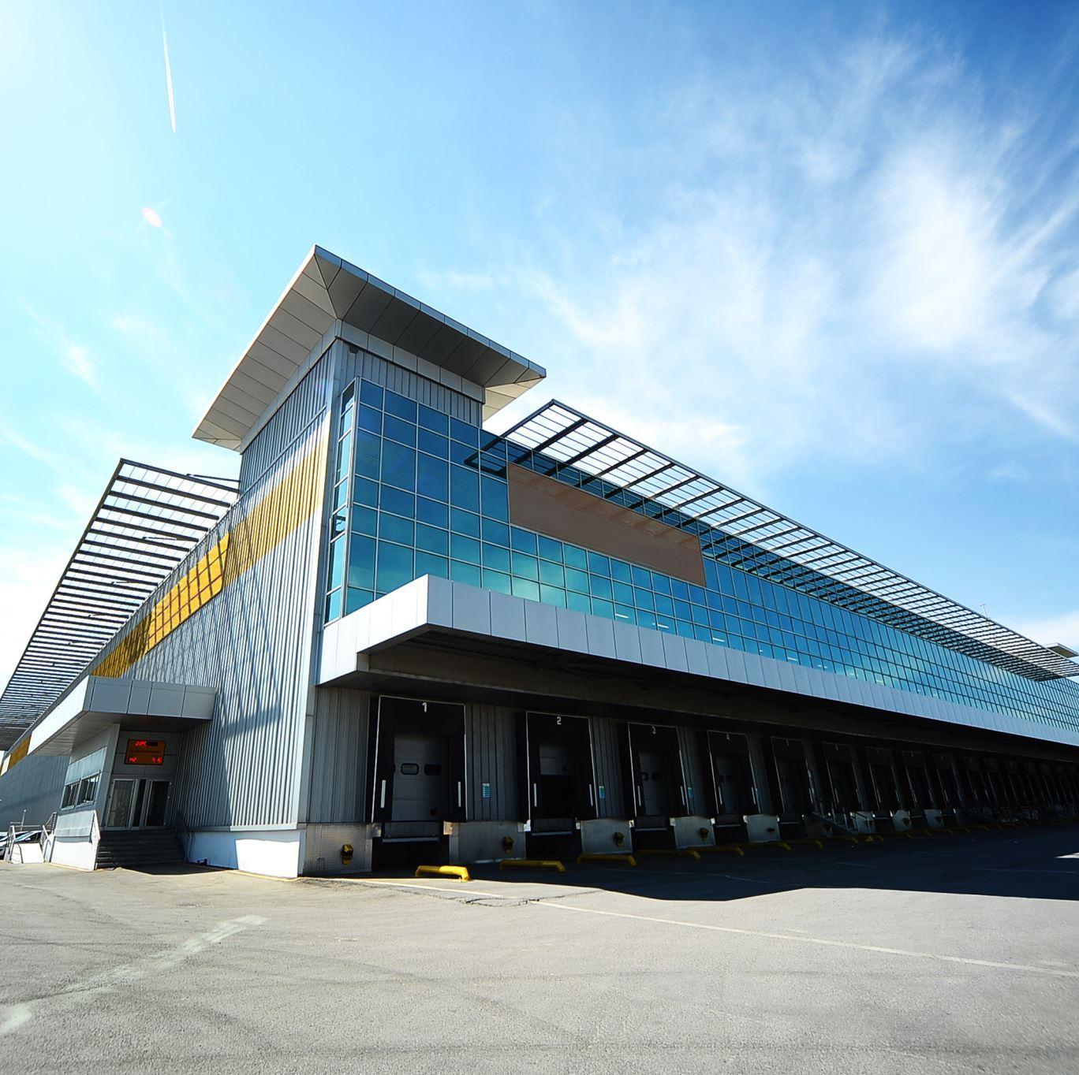
Ethical issues
Pay and working conditions
Opportunity for MNCs to exploit local workers with low pay and poor working conditions
However …
Introduce western standards
Create jobs
For more help, please visit www.exampaperspractice.co.uk
© 2025 Exams Papers Practice. All Rights Reserved

Slide 11
Ethical issues
Environmental considerations
Emissions and waste disposal
UK legislation is strict e.g. all publically listed companies have to report their greenhouse gas emissions and abide by laws on how waste is disposed – but is this true in all countries?
Global impact of industrialization
Growth of e-waste
For more help, please visit www.exampaperspractice.co.uk
© 2025 Exams Papers Practice. All Rights Reserved

Slide 12
Activity 3
01
02
03
Explain an advantage to pay and working conditions that an MNC could bring.
Explain a disadvantage to pay and working conditions that an MNC could bring.
Research a scenario where an MNC has improved working conditions and pay.
For more help, please visit www.exampaperspractice.co.uk
© 2025 Exams Papers Practice. All Rights Reserved

Slide 13
Activity 4
DOES EVERY BUSINESS HAVE AN ENVIRONMENTAL IMPACT. WHY?
EXPLAIN WHY A BUSINESS WOULDN’T CARE ABOUT PROTECTING THE ENVIRONMENT?
RESEARCH A SCENARIO WHERE AN MNC HAS FAVOURED SAVING THE ENVIRONMENT OVER PROFITS.
For more help, please visit www.exampaperspractice.co.uk
© 2025 Exams Papers Practice. All Rights Reserved

Slide 14
Activity 5
State 3 reasons why treating employees in emerging markets in an ethical manner can lead to a competitive advantage.
State 3 reasons why looking after the environment can lead to a competitive advantage.
For more help, please visit www.exampaperspractice.co.uk
© 2025 Exams Papers Practice. All Rights Reserved

Slide 15
Activity 6
Explain why it is difficult to reduce carbon emissions quickly.
Some of the energy used to manufacture Apple products in China will come from coal fired power stations. If China decided to ban the use of coal, how would Apple react and how would customers be affected?
For more help, please visit www.exampaperspractice.co.uk
© 2025 Exams Papers Practice. All Rights Reserved

Slide 16
Ethical issues
Supply chain considerations:
Exploitation of labour
The International Labour Organisation (ILO) promotes fair and decent work for workers across society
Pay, choice and working conditions – to achieve social justice
Responsibility of MNCs throughout the whole supply chain
For more help, please visit www.exampaperspractice.co.uk
© 2025 Exams Papers Practice. All Rights Reserved

Slide 17
Ethical issues
Supply chain considerations:
Child labour
Exploitation of children who have no power
Low wages
Unacceptable conditions
No education
Kidnapping from families
Slavery
For more help, please visit www.exampaperspractice.co.uk
© 2025 Exams Papers Practice. All Rights Reserved

Slide 18
Activity 7
01
02
03
Explain why an MNC might choose to exploit labour.
Explain the impacts of an MNC choosing to exploit labour.
Research an example of where an MNC has exploited labour. Explain the consequences that occurred.
For more help, please visit www.exampaperspractice.co.uk
© 2025 Exams Papers Practice. All Rights Reserved

Slide 19
Activity 8
1
2
3
Explain who the ILO are.
Research who are the worst countries currently for child labour.
Explain the impacts to the children that end up in work.
For more help, please visit www.exampaperspractice.co.uk
© 2025 Exams Papers Practice. All Rights Reserved

Slide 20
Ethical issues
Marketing considerations:
Misleading product labelling
In the UK this is governed by the Trade Descriptions Act – but not applicable in other countries
UK legislation includes labelling such as size/quantity, price, ingredients, endorsements, how, where and when made, health claims
Stricter in certain industries e.g. food and pharmaceuticals
Often pursued by pressure groups and consumer organisations such as watchdogs
For more help, please visit www.exampaperspractice.co.uk
© 2025 Exams Papers Practice. All Rights Reserved

Slide 21
Ethical issues
Inappropriate promotional activities
Promoting directly to children
Cultural difference e.g. the culture of gift giving in China
Promoting a life style that goes against cultural or religious difference
For more help, please visit www.exampaperspractice.co.uk
© 2025 Exams Papers Practice. All Rights Reserved

Slide 22
Activity 9
EXPLAIN WHAT THE TRADE DESCRIPTIONS ACT IS.
LIST SOME OF THE IMPACTS THE ACT HAS ON LABELLING.
RESEARCH AN EXAMPLE OF WHERE AN MNC HAS BROKEN THE TRADE DESCRIPTION ACT.
For more help, please visit www.exampaperspractice.co.uk
© 2025 Exams Papers Practice. All Rights Reserved

Slide 23
Activity 10
Explain why promotional activities should be regulated.
Explain why cultural differences are important in promotion.
Who is the watchdog in charge of inappropriate promotion in the UK? What sort of things are deemed inappropriate by them?
For more help, please visit www.exampaperspractice.co.uk
© 2025 Exams Papers Practice. All Rights Reserved

Slide 24
Activity 11
For | Against
List some arguments that you could use for both for and against the following statement.
Consumers benefit from greater choice or are they exploited!
For more help, please visit www.exampaperspractice.co.uk
© 2025 Exams Papers Practice. All Rights Reserved

Slide 25
Activity 12
For | Against
List some arguments that you could use for both for and against the following statement.
MNCs reduce the impact on the environment by producing closer to markets or worsen it due to food miles!
For more help, please visit www.exampaperspractice.co.uk
© 2025 Exams Papers Practice. All Rights Reserved

Slide 26
Activity 13
For | Against
List some arguments that you could use for both for and against the following statement.
Employees benefit from greater training and working conditions or are they exploited by powerful businesses!
For more help, please visit www.exampaperspractice.co.uk
© 2025 Exams Papers Practice. All Rights Reserved

Slide 27
Activity 14
For | Against
List some arguments that you could use for both for and against the following statement.
Global industries too powerful!
For more help, please visit www.exampaperspractice.co.uk
© 2025 Exams Papers Practice. All Rights Reserved

Slide 28
Homework
For | Against
List some arguments that you could use for both for and against the following statement.
MNCs uphold standards regardless of the country in which they operate in order to preserve the brand!
For more help, please visit www.exampaperspractice.co.uk
© 2025 Exams Papers Practice. All Rights Reserved

Slide 29
Activity
For | Against
List some arguments that you could use for both for and against the following statement.
Primark is an ethical company!
For more help, please visit www.exampaperspractice.co.uk
© 2025 Exams Papers Practice. All Rights Reserved

Slide 30
Plenary
Consideration | Ethical behaviour
Environmental
Supply chain
Marketing
Complete the table below to show examples of ethical behavior by category.
For more help, please visit www.exampaperspractice.co.uk
© 2025 Exams Papers Practice. All Rights Reserved

