Slide 1
3.1.1 Growing economies
3.1 Globalisation
For more help, please visit www.exampaperspractice.co.uk
© 2025 Exams Papers Practice. All Rights Reserved

Slide 2
Recall
What is an indicator of a developing country?
Name one developing country and give a brief overview of their economy.
For more help, please visit www.exampaperspractice.co.uk
© 2025 Exams Papers Practice. All Rights Reserved
Notes:
https://www.nasdaq.com/articles/the-fastest-growing-economies-in-2021-2021-04-27

Slide 3
Starter
Write down three countries which you think are currently growing the fastest?
For one of these countries, what have they done to help them grow so significantly?
For more help, please visit www.exampaperspractice.co.uk
© 2025 Exams Papers Practice. All Rights Reserved
Notes:
https://www.nasdaq.com/articles/the-fastest-growing-economies-in-2021-2021-04-27

Slide 4
Lesson Objectives
Are you able to understand different growth indicators?
Can you analyse the implications of economic growth for individuals and firms?
Can you use index values and apply them to everyday problems
For more help, please visit www.exampaperspractice.co.uk
© 2025 Exams Papers Practice. All Rights Reserved

Slide 5
Activity 1
What is meant by the term growing economy?
What is meant by the term globalisation?
What is meant by the term economic growth?
State 3 parts of the world with growing economic power
For more help, please visit www.exampaperspractice.co.uk
© 2025 Exams Papers Practice. All Rights Reserved

Slide 6
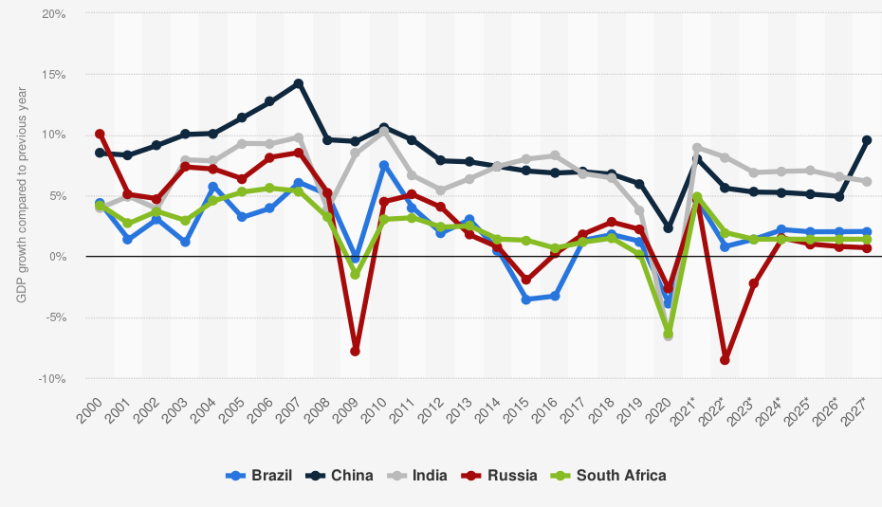
BRICS growth rates 2000 - 2027
How would you compare the growth rate of the UK to emerging economies?
For more help, please visit www.exampaperspractice.co.uk
© 2025 Exams Papers Practice. All Rights Reserved

Slide 7
Indicators of Growth
GDP
Human development Index
Life expectancy
Years spent in school
GDP
Literacy rates
Health indicators
Infant mortality rates
Incidence of diseases
Access to clean water
Mobile phone use
For more help, please visit www.exampaperspractice.co.uk
© 2025 Exams Papers Practice. All Rights Reserved

Slide 8
Research activity
What will be the World’s 10 largest countries by GDP in 2030?
How will this impact on the UK, EU and global markets?
For more help, please visit www.exampaperspractice.co.uk
© 2025 Exams Papers Practice. All Rights Reserved
Notes:
https://www.visualcapitalist.com/animation-the-biggest-economies-in-2030/

Slide 9
Growing economic power of countries within Asia, Africa and other emerging markets
The emergence of Middle-Income Countries (MIC’s) has led to significant changes in the world economy:
Countries such as Brazil, India and China have become significant global players in terms of all aspects of trade
The collapse of communism in Russia and other Eastern bloc states has opened up global markets
These countries have seen significant economic growth
They have utilised their abundant natural resources to help develop their economies
They have utilised their abundant human resources to help increase the supply of goods and services
For more help, please visit www.exampaperspractice.co.uk
© 2025 Exams Papers Practice. All Rights Reserved

Slide 10
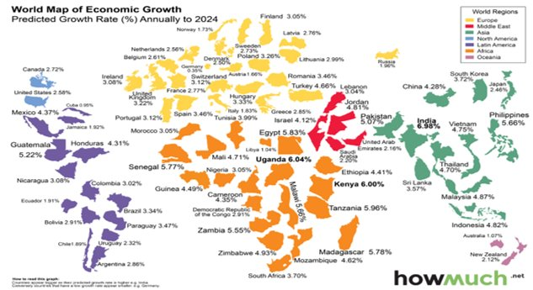
Discussion
For more help, please visit www.exampaperspractice.co.uk
© 2025 Exams Papers Practice. All Rights Reserved

Slide 11
Globalization
This is the process in which national economies have become increasing integrated and interdependent.
Causes of globalization; Trade liberalization, trading blocs, growth of MNC’s, technological advancements and mobility of labour and capital
Create a table discussing the impact for the pros and cons of globalization
For more help, please visit www.exampaperspractice.co.uk
© 2025 Exams Papers Practice. All Rights Reserved

Slide 12
Activity 2
How would you describe the growth rate of the UK economy compared to emerging markets? Justify your answer.
Explain how globalisation has led to rising income?
State 3 parts of the world with growing economic power
For more help, please visit www.exampaperspractice.co.uk
© 2025 Exams Papers Practice. All Rights Reserved

Slide 13
Activity 3 – Mind Map
Implications of economic growth for individuals and firms
For more help, please visit www.exampaperspractice.co.uk
© 2025 Exams Papers Practice. All Rights Reserved

Slide 14
Implications of economic growth for individuals and firms
Trade opportunities for firms
Opens up new markets
Increasing wealth in countries such as China who want Western brands
British provenance creates opportunities for individuals with the appropriate skills
Fashion
Finance
Cars
Arts
Education
Access to raw materials
Greater movement of goods and services between countries
Opportunities for cheaper production
Greater investment opportunities
For more help, please visit www.exampaperspractice.co.uk
© 2025 Exams Papers Practice. All Rights Reserved

Slide 15
Implications of economic growth for individuals and firms
Increased profits for firms
Trade opportunities will arise in new markets leading to an increase in demand and increased revenue and profit
The owners of businesses will see an increase in income e.g. through higher dividends
Businesses can use retained profits to reinvest into productive capacity e.g. new machinery
Access to growing economies will create business confidence benefiting the UK economy as a whole
As economies get wealthier the UK will start to produce even more highly differentiated products to meet global demand. This will lead to changes in employment patterns as businesses will demand highly skilled workers
For more help, please visit www.exampaperspractice.co.uk
© 2025 Exams Papers Practice. All Rights Reserved

Slide 16
Implications of economic growth for individuals and firms
Rationalisation opportunities for firms
Rationalisation is a reorganisation in the scale of a firm’s operations in order to increase efficiency
This can be through reducing or increasing the scale of production
Economic growth will impact on the firm by creating the demand that will lead it to increase in size
Firms have been able to rationalise operations by moving operations abroad. This has led to:
Economies of scale e.g. bulk buying
Restructuring to increase efficiency
Turning around poor performance
Focusing on core business opportunities globally
Selling off less profitable parts of the business to improve overall performance
Consolidating operations in certain countries, particularly ones that offer low cost labour and utilities, has enabled firms to benefit through lower costs and increased efficiency
For more help, please visit www.exampaperspractice.co.uk
© 2025 Exams Papers Practice. All Rights Reserved

Slide 17
Implications of economic growth for individuals and firms
Employment patterns
Increased economic growth leads to improvements in the standard of living for consumers
Increased income allows people to spend more on necessities at lower levels of income and more on luxuries at higher income levels
As real wages increase labour can substitute work for leisure and see dramatic changes in their level of income
At some point, they might wish to substitute leisure for work as, at higher levels of income, they satisfy their financial requirements. This will change employment patterns
Increased incomes allow workers more free time and the ability to retire, and enjoy the quality of their life, at an earlier age
There will also be a shift in the type of employment, moving from more agricultural or low skilled jobs to more technological and high skills jobs
For more help, please visit www.exampaperspractice.co.uk
© 2025 Exams Papers Practice. All Rights Reserved

Slide 18
Activity 4
What is meant by the term GDP per capita?
What are the implications of economic growth for individuals and businesses in the UK and Asia? Complete the table below. Try to include both positive and negative implications.
Is steady economic growth better than fast economic growth?
 | Individuals | Businesses
UK
Asia
For more help, please visit www.exampaperspractice.co.uk
© 2025 Exams Papers Practice. All Rights Reserved

Slide 19
Activity – Indicators of Growth
Choose 3 countries (one of them must be from BRICS)
1
Compare them on different indicators of growth
2
Prepare a presentation summarising your findings
3
For more help, please visit www.exampaperspractice.co.uk
© 2025 Exams Papers Practice. All Rights Reserved

Slide 20
Rising incomes
The main measure used is Gross Domestic Product (GDP) per capita
It is calculated by:
National income
Population
This is the most commonly used method to measure a country’s living standards. As GDP per capita rises, it is assumed that living standards in that country also rise
It is common for GDP per capita to be expressed in US$’s, which allows for direct comparison between nations
For more help, please visit www.exampaperspractice.co.uk
© 2025 Exams Papers Practice. All Rights Reserved

Slide 21
Rising incomes – GDP per capita
For more help, please visit www.exampaperspractice.co.uk
© 2025 Exams Papers Practice. All Rights Reserved

Slide 22
Conversion of nominal to real values
Nominal value is expressed in monetary terms
It does not take into account inflation (the average level of prices)
Real value takes into account inflation
Real national output = Nominal national output
Average price level
Short-run economic growth is measured by the annual percentage change in real national output, real national income or real GDP
For more help, please visit www.exampaperspractice.co.uk
© 2025 Exams Papers Practice. All Rights Reserved

Slide 23
Conversion of nominal to real values
Constant prices are prices that have been adjusted for inflation. They are real values.
Current prices are prices that have not been adjusted for inflation. They are nominal values.
For more help, please visit www.exampaperspractice.co.uk
© 2025 Exams Papers Practice. All Rights Reserved

Slide 24
Index numbers
An index measures changes in a representative group of data.
Indices are commonly used in economics and business in order to analyse raw data.
Common examples are the CPI, the RPI and the FTSE 100.
For more help, please visit www.exampaperspractice.co.uk
© 2025 Exams Papers Practice. All Rights Reserved

Slide 25
Index numbers
Business leaders and economists frequently use index numbers when making comparisons over time
An index starts on a given number e.g. year, the base number or base year, at an index number of 100
This is called the base period
In subsequent years, percentage increases may push the index number above 100 and percentage decreases push the figure below 100
An index number of 102 means a 2% rise from the base year, and an index number of 98 means a 2% fall from the base year
For more help, please visit www.exampaperspractice.co.uk
© 2025 Exams Papers Practice. All Rights Reserved

Slide 26
Index numbers
Index numbers help to understand the significance of a change
They are easier to interpret than large numbers
Percentage change = change/original x 100
We always compare with a base number or year
Year | Population of country x | % change | Index number
1 (base year) | 1 147 569 |  | 100
2 | 1 846 227 | 61 | 161
3 | 2 213 904 | 93 | 193
For more help, please visit www.exampaperspractice.co.uk
© 2025 Exams Papers Practice. All Rights Reserved

Slide 27
Activity 5
Look at the table showing the index of UK house prices from 2010 – 2014 for selected regions. Base Year 1983 = 100.
Using the table, calculate the following percentage change in house prices:
Scotland from 2010 to 2014
Greater London from 2013 to 2014
All UK from 1983 to 2014
Year | North | Scotland | Greater London | South East | All UK
2010 | 511.5 | 421.4 | 659.9 | 561.4 | 539.6
2011 | 483.1 | 406.8 | 659.6 | 553.1 | 525.4
2012 | 478.1 | 384.3 | 674.4 | 558.8 | 522.1
2013 | 496.8 | 400.5 | 737.2 | 591.0 | 547.0
2014 | 507.7 | 430.2 | 855.2 | 654.6 | 593.5
For more help, please visit www.exampaperspractice.co.uk
© 2025 Exams Papers Practice. All Rights Reserved

Slide 28
Activity 6
What is the difference between nominal and real values?
What is an index number?
What is meant by the term base year?
Why are index numbers useful?

Slide 29
Index numbers – Activity 7
Question: Find the price index for 2016 relative to 2015
Answer:
Current price x 100 = Index number
Base year price
2016: £17.00/£10.00 x 100 = 170
Question: A firm spent £5400 on a good in 2015. How much would it have to spend on the same good in 2016?
Answer: £5400 x 1.70 = £9180
To do:
Question: Find the price index for 2017 relative to 2015
Question: A firm spent £5400 on the good in 2015. How much would it have to spend in 2017?
Year | 2015 | 2016 | 2017
Price of a good | £10.00 | £17.00 | £15.00
Price index | 100
For more help, please visit www.exampaperspractice.co.uk
© 2025 Exams Papers Practice. All Rights Reserved

Slide 30
Real world use of index numbers
By how much did CPI change between 2005 and May 2015?
By how much did CPI change between May 2014 and May 2015?
What happened to CPI between December 2014 and January 2015? Can you provide any arguments as to why this occurred?
For more help, please visit www.exampaperspractice.co.uk
© 2025 Exams Papers Practice. All Rights Reserved

Slide 31
Index numbers
Using 2012 as a base year produce a table showing index numbers based on the above population figures.
Identify two significant points of comparison between the changes shown in your index of population changes.
For more help, please visit www.exampaperspractice.co.uk
© 2025 Exams Papers Practice. All Rights Reserved

Slide 32
Activity 8
What is meant by the term base year?
Which of the following best defines globalisation?
An increased number of multinational companies
Increased prosperity in economies with low but growing GDP
Elimination of protectionist measures
Greater reliance and interrelationship between economies
Explain 2 reasons why globalisation is important to UK businesses.
For more help, please visit www.exampaperspractice.co.uk
© 2025 Exams Papers Practice. All Rights Reserved

Slide 33
Activity 9
What is meant by the term emerging economies?
Identify the following emerging economies.
Which of the following are a feature of a customs union, Single European Market (SEM) and the World Trade Organisation (WTO)?
B​ | R​ | I​ | C​ | S​
M​ | I​ | N​ | T​ | ​
For more help, please visit www.exampaperspractice.co.uk
© 2025 Exams Papers Practice. All Rights Reserved
Feature​ | Group​
Settling trade disputes​ | Customs Union / SEM / WTO​
Common external tariffs​ | Customs Union / SEM / WTO​
Market liberalisation​ | Customs Union / SEM / WTO​
Free movement of labour​ | Customs Union / SEM / WTO​
Promoting free trade​ | Customs Union / SEM / WTO​
Free movement of capital​ | Customs Union / SEM / WTO​
Quota-free movement of tradable goods​ | Customs Union / SEM / WTO​
Common trade policy​ | Customs Union / SEM / WTO​

Slide 34
Homework
Discuss the possible benefits to Ford of manufacturing cars in India.
8 Marks (Use your own research)
For more help, please visit www.exampaperspractice.co.uk
© 2025 Exams Papers Practice. All Rights Reserved

Slide 35
Questions
Explain the difference between GDP and GDP per capita as measures of economic growth.
Describe the relationship between investment and economic growth, and provide an example of a country where investment has been a major contributor to growth.
Discuss the role of technological progress in economic growth and give an example of a technological advancement that has had a significant impact on economic growth.
Analyze the relationship between population growth and economic growth.
Explain how the Human Development Index (HDI) is used to measure a country's overall well-being and its relationship to economic growth.
Explain the relationship between trade and economic growth, and provide an example of a country that has benefited from increased trade.
Analyze the impact of government spending on economic growth, and explain how fiscal policy can be used to influence economic growth.
Explain how labor productivity is measured and its relationship to economic growth.
Analyze the role of inflation in economic growth and explain the impact of high inflation on an economy.
Explain the relationship between foreign investment and economic growth, and provide an example of a country that has attracted significant foreign investment.
For more help, please visit www.exampaperspractice.co.uk
© 2025 Exams Papers Practice. All Rights Reserved

