Slide 1
2.6.3 Potential policy conflicts and trade-offs
For more help, please visit www.exampaperspractice.co.uk
© 2025 Exams Papers Practice. All Rights Reserved

Slide 2
Starter
Draw a mind map to summarise your understanding of macroeconomic policies and objectives.
Why might there be conflicts?
For more help, please visit www.exampaperspractice.co.uk
© 2025 Exams Papers Practice. All Rights Reserved

Slide 3
Recall
Give a definition of unemployment.
Draw a diagram to show inflation occurring.
Draw a diagram showing how an increase in interest rates will impact the economy.
Give a supply side policy to reduce inflation.
For more help, please visit www.exampaperspractice.co.uk
© 2025 Exams Papers Practice. All Rights Reserved

Slide 4
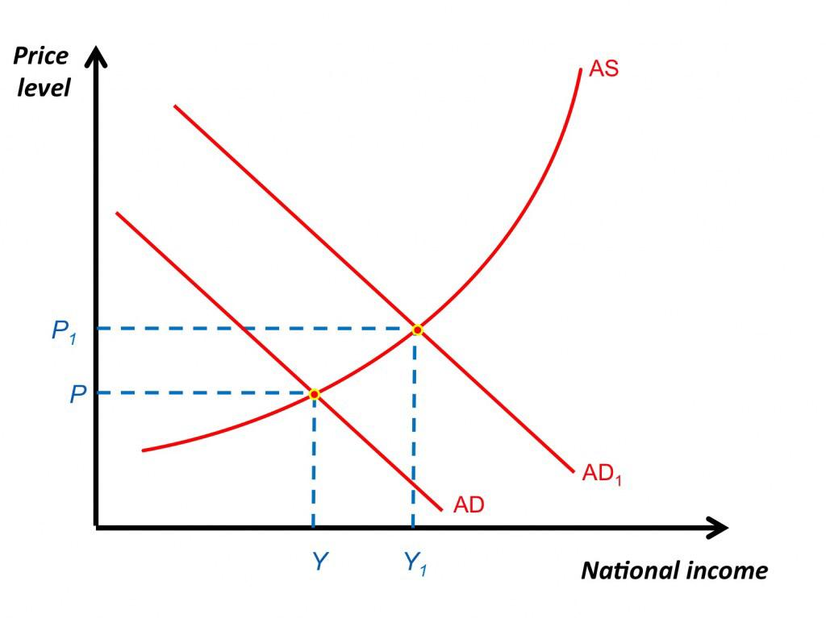
Definition
Unemployment - a situation when a person who is actively searching for employment is unable to find work
For more help, please visit www.exampaperspractice.co.uk
© 2025 Exams Papers Practice. All Rights Reserved

Slide 5
Learning Objectives
Are you able to explain how inflation and unemployment objectives can conflict with each other?
Do you understand the issues governments face in managing the macroeconomy?
Are you able to explain why economic growth and negative externalities coincide with each other?
Do you understand how different macroeconomic perspectives influence policy decisions?
Do you understand the likely effects of individual policy instruments on specific problems; possible unintended consequences?
For more help, please visit www.exampaperspractice.co.uk
© 2025 Exams Papers Practice. All Rights Reserved

Slide 6
Activity 1
Explain what will happen as a result of these two objectives?
Example 1
If the government invests in education and training… this may result in more skilled workers who can be more productive and produce higher quality goods and services. These can then be exported potentially at more competitive prices, which may improve the balance of payments. As this is a component of aggregate demand, greater economic growth will occur, which may in turn create more jobs and lower unemployment.
Example 2
If the Bank of England consistently meets its inflation target…, this may give firms more confidence to invest. Higher capital spending will boost long term productive potential, again assisting unemployment and enhancing the competitiveness of UK exports and the balance of payments as a consequence.
For more help, please visit www.exampaperspractice.co.uk
© 2025 Exams Papers Practice. All Rights Reserved

Slide 7
Possible conflicts
In summary, there are a number of possible conflicts that arise through economic decision-making:
Unemployment v inflation – by creating unemployment e.g. through less government spending demand will fall leading to lower inflation
Economic growth v the balance of payments – a policy of growth e.g. expansionary fiscal policy will lead to higher employment and greater demand. Higher income will increase consumption, part of which will be spent on exports. This will lead to a deterioration in the balance of payments
Economic growth v inflation - a positive output gap will lead to increased demand and resultant inflationary pressures
Therefore, policy decision- makers will have to bear in mind the side effects of any policy choices
For more help, please visit www.exampaperspractice.co.uk
© 2025 Exams Papers Practice. All Rights Reserved
Notes:
http://www.theguardian.com/commentisfree/2011/nov/25/george-osborne-unemployment-norman-lamont

Slide 8
Negative output gaps: inflation and unemployment
A negative output gap occurs when actual output is below the trend rate. This indicates low demand so there will be a reduction in inflationary pressures. As a result of lower demand cyclical unemployment will occur.
GDP
GDP
GDP
Actual GDP
Actual GDP
Actual GDP
Trend line
Trend line
Trend line
Negative Output Gap
Negative Output Gap
Negative Output Gap
X
X
X
Time
Time
Time
For more help, please visit www.exampaperspractice.co.uk
© 2025 Exams Papers Practice. All Rights Reserved

Slide 9
Positive output gaps: inflation and unemployment
A positive output gap occurs when actual output is above the trend rate. This indicates high demand so there will be an increase in inflationary pressures. As a result of higher demand cyclical unemployment will fall.
Actual GDP
GDP
Trend line
Positive Output Gap
Y
Time
For more help, please visit www.exampaperspractice.co.uk
© 2025 Exams Papers Practice. All Rights Reserved

Slide 10
Economic growth and negative externalities
Negative externalities
the costs and benefits to a third party created by economic agents when undertaking their activities e.g. pollution
Long term impact on the environment e.g. global warming
Overuse of scarce resources
Potential increase in the consumption of demerit goods
Income and wealth inequality
Work life balance
What is the opportunity cost of growth?
For more help, please visit www.exampaperspractice.co.uk
© 2025 Exams Papers Practice. All Rights Reserved

Slide 11
Issues facing government: conflicts between fiscal and supply-side policies
The Government can increase government spending in order to pay for merit goods in areas such as education and health. This can impact on private sector supply
The crowding-out of the private sector as:
Public sector spending takes the place of the private sector
Public sector borrowing reduces the supply of funds available to the private sector, pushing up interest rates
Bottlenecks occur in the production process as firms cannot cope with the increased demand brought about by government expenditure, effectively slowing down supply
Nevertheless, spending in areas such as education are likely to boost the productive potential of the economy in the long run as the LRAS curve shifts to the right
For more help, please visit www.exampaperspractice.co.uk
© 2025 Exams Papers Practice. All Rights Reserved

Slide 12
Issues facing government: conflicts between fiscal policy and inflation targets
The Government can increase government taxation in order to reduce demand in the economy, therefore reducing inflationary pressure
In the short run this might have the opposite impact e.g. raising VAT on goods and services will see an initial increase in prices and therefore inflation
However, in the long-run price rises will mean that there is likely to be a fall in demand for goods and services in general
Hopefully, this will see a fall in the rate of inflation to justify the government’s policy
It will be difficult to measure the exact impact in the short-run and long-run as information is based on forecasts
The government would be expected to prioritise the good of the economy in the long-run. However, short term decision-making might occur due to political pressures e.g. an upcoming general election
For more help, please visit www.exampaperspractice.co.uk
© 2025 Exams Papers Practice. All Rights Reserved

Slide 13
Different perspectives: monetary Policy
Key recent changes/events in monetary policy include:
In 1999/2000 interest rates were around 6% in response to high levels of aggregate demand and the potential risk to inflation
Interest rates fell up to 2003 to stimulate aggregate demand
Interest rates fell further after a rise in 2006-7 and have been at a historic low of 0.5% since March 2009
Quantitative Easing through the Bank of England has totalled £375bn in response to the recession which began in 2008. With interest rates so low, the BoE has had to look for other measures to stimulate the economy as interest rates have limited or zero movement downwards at the current time
The Governor of the Bank of England has announced a policy of “forward guidance” – a policy designed to indicate to the government, firms and consumers what level interest rates will be in the future. This seeks to reduce speculation and stabilise expectations. For example, the BoE indicated it would not increase interest rates until the rate of unemployment fell below 7%
For more help, please visit www.exampaperspractice.co.uk
© 2025 Exams Papers Practice. All Rights Reserved
Notes:
http://www.bbc.co.uk/news/business-23145755
What is forward guidance?

Slide 14
Different perspectives: fiscal Policy
Key recent changes/events in fiscal policy include:
Through the early 2000’s, government spending as a % of GDP increased, although within fiscal rules as laid down by the Chancellor of the day, Gordon Brown. These included only borrowing to fund capital projects and the budget should balance over the course of the economic cycle
The government ran a modest budget deficit until 2007, however the recession that began in 2008 placed huge strain on government tax revenues and expenditures, with the deficit reaching a peak of 7.5% of GDP
The fiscal rules created under the previous government have since been abandoned and the Office of Budgetary Responsibility (OBR) was created in 2010 to provide independent analysis, and therefore hopefully greater credibility, of the UK’s public finances
In 2012/13 the UK’s public sector net debt was £1,185bn, equivalent to £18,606 per person in the UK
The current government has more recently focused on reducing the budget deficit and tightened government spending
For more help, please visit www.exampaperspractice.co.uk
© 2025 Exams Papers Practice. All Rights Reserved

Slide 15
Unintended consequences of government intervention
Activity Complete the table
Should the Covid Bounce back loans have been given?
Arguments for: | Arguments against:
https://www.ft.com/content/37dad961-6582-45bf-8bc6-4dd5f934cba8
https://www.bbc.co.uk/news/business-59761294
https://www.bbc.co.uk/news/business-59504943
https://www.facebook.com/watch/?v=758634898389450
For more help, please visit www.exampaperspractice.co.uk
© 2025 Exams Papers Practice. All Rights Reserved
Notes:
http://www.bbc.co.uk/news/science-environment-23025973
http://www.bbc.co.uk/news/world-europe-23062284
http://www.bbc.co.uk/news/world-europe-22986953
http://www.independent.co.uk/life-style/food-and-drink/news/the-16320bn-food-mountain-britons-throw-away-half-of-the-food-produced-each-year-790318.html
http://www.standard.co.uk/news/move-to-slash-food-mountains-6303694.html
http://swaminomics.org/a-return-to-food-mountains/
http://www.theguardian.com/commentisfree/2013/jul/01/farm-subsidies-blatant-transfer-of-cash-to-rich

Slide 16
Unintended consequences of government intervention
Activity Complete the table
Should the national minimum wage be increased?
Arguments for: | Arguments against:
Encourages people to supply labour Reduces inequalities Reduces welfare burden Increase aggregate demand Improves standards of living | May create unemployment Interferes with the workings of the market mechanism leading to the misallocation of resources Reduces UK competitiveness Lowers aggregate supply
https://www.gov.uk/national-minimum-wage-rates
For more help, please visit www.exampaperspractice.co.uk
© 2025 Exams Papers Practice. All Rights Reserved

Slide 17
Who is to blame for soaring prices?
https://www.bbc.co.uk/news/business-61466136
Activity
Write five things you learnt.
Write three questions you have.
How would you reduce inflation?
For more help, please visit www.exampaperspractice.co.uk
© 2025 Exams Papers Practice. All Rights Reserved

Slide 18
Activity
Using your understanding of economics consider:
How a rise in the interest rate impacts on:
The exchange rate
Competitiveness
Inflation
Unemployment
The supply-side of the economy
For more help, please visit www.exampaperspractice.co.uk
© 2025 Exams Papers Practice. All Rights Reserved

Slide 19
Activity
Using your understanding of economics consider:
An increase in the level of government spending impacts on:
The amount of money in the economy
The interest rate
Competitiveness
Inflation
Unemployment
For more help, please visit www.exampaperspractice.co.uk
© 2025 Exams Papers Practice. All Rights Reserved

Slide 20
Plenary
For more help, please visit www.exampaperspractice.co.uk
© 2025 Exams Papers Practice. All Rights Reserved

