Slide 1
2.5.1 The economic cycle (1)
For more help, please visit www.exampaperspractice.co.uk
© 2025 Exams Papers Practice. All Rights Reserved

Slide 2
Recall
What is the definition of Aggregate demand and how is it calculated?
What % is each factor?
Draw a diagram for economic growth.
For more help, please visit www.exampaperspractice.co.uk
© 2025 Exams Papers Practice. All Rights Reserved

Slide 3
Starter
How is a recession characterised?
When did we last have a recession?
What is likely to happen to the exchange rate when we are in a recession?
For more help, please visit www.exampaperspractice.co.uk
© 2025 Exams Papers Practice. All Rights Reserved

Slide 4
Learning Objectives
Do you understand what the economic cycle is?
Do you understand the characteristics of a boom?
Do you understand the characteristics of a recession?
Do you understand the implications for firms of fluctuations in economic activity?
For more help, please visit www.exampaperspractice.co.uk
© 2025 Exams Papers Practice. All Rights Reserved

Slide 5
Economic cycle and implications for firms - Boom
Characterised by:
High rate of economic growth
High demand
Low unemployment
Inflationary pressure
Labour skills shortages
High confidence in the economy
Capital Investment is high
For more help, please visit www.exampaperspractice.co.uk
© 2025 Exams Papers Practice. All Rights Reserved

Slide 6
Economic cycle and implications for firms - Recession
The rate of economic growth starts to fall in a downturn
If real GDP falls for 6 months then this is known as a recession
Characterised by:
Demand falls
Unemployment begins to rise
Some firms will go out of business
Confidence in the economy is low and most firms will reduce investment
For more help, please visit www.exampaperspractice.co.uk
© 2025 Exams Papers Practice. All Rights Reserved

Slide 7
Economic cycle and implications for firms - Slump
The bottom of the business cycle which represents a period of serious economic decline
Characterised by:
Low or negative growth
Demand and inflation are low
Unemployment is high
Confidence in the economy is low
High rate of bankruptcy
For more help, please visit www.exampaperspractice.co.uk
© 2025 Exams Papers Practice. All Rights Reserved

Slide 8
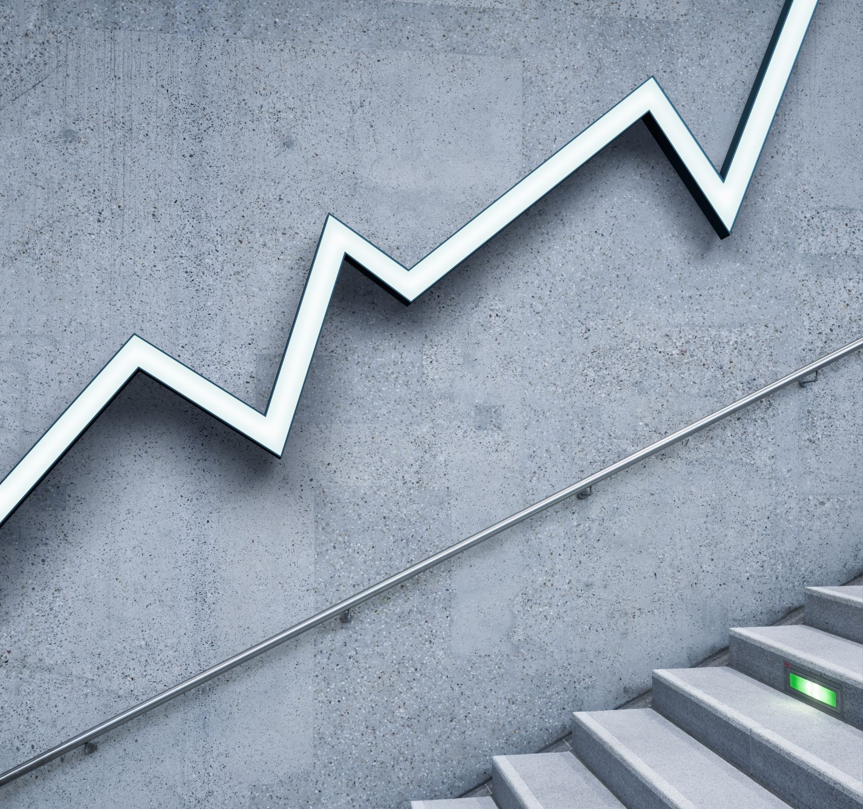
Economic cycle and implications for firms - Recovery
When there are signs that economic growth is starting to rise, often referred to as the ‘green shoots of recovery’
Characterised by:
Economic growth starts to rise
Demand increases
Unemployment falls
Inflation starts to rise
Confidence in the economy increases
Capital Investment increases
For more help, please visit www.exampaperspractice.co.uk
© 2025 Exams Papers Practice. All Rights Reserved

Slide 9
Economic Indicators over the Cycle
Indicator | Positive Output Gap | Negative Output Gap
Unemployment | Rising or Falling | Rising or Falling
Inflation | Rising or Falling | Rising or Falling
Investment | Rising or Falling | Rising or Falling
Wage Rates | Rising or Falling | Rising or Falling
Consumption | Rising or Falling | Rising or Falling
House Prices | Rising or Falling | Rising or Falling
What do you think is likely to be happening to the following indicators during a positive and negative output gap?
For more help, please visit www.exampaperspractice.co.uk
© 2025 Exams Papers Practice. All Rights Reserved

Slide 10
Impact | Demand-Side or Supply Side? | Improvement or Worsening of Economic Cycle?
The Bank of England raise interest rates
Larger budgets given to schools for education
A cut in the main rate of income tax
Tax given to businesses to encourage investment
An unexpected 10% increase in the price of oil
Consumer confidence rises
Activity
For each of the following, decide whether the impact is demand-side or supply-side AND if the impact might improve or worsen the economic cycle
For more help, please visit www.exampaperspractice.co.uk
© 2025 Exams Papers Practice. All Rights Reserved

Slide 11
Activity
What happened to the UK economy between 2008 and 2012?
Look at various factors such as:
Interest rates
Exchange rates
Money supply
Exports and imports
Any other indicators
For more help, please visit www.exampaperspractice.co.uk
© 2025 Exams Papers Practice. All Rights Reserved

Slide 12
Plenary
Where is the UK based on the economic cycle?
How do the government try to push us on the right track towards growth?
What is likely to happen during a boom?
For more help, please visit www.exampaperspractice.co.uk
© 2025 Exams Papers Practice. All Rights Reserved

