Slide 1
Positive externalities
For more help, please visit www.exampaperspractice.co.uk
© 2025 Exams Papers Practice. All Rights Reserved

Slide 2
Recall
What is a negative externality
What is the socially optimum, compared to the free market optimum?
For more help, please visit www.exampaperspractice.co.uk
© 2025 Exams Papers Practice. All Rights Reserved

Slide 3
Starter
Why do free markets fail?
What are externalities?
What is MPC?
What is MPB?
What are MSC?
MSC = _______ + ________
For more help, please visit www.exampaperspractice.co.uk
© 2025 Exams Papers Practice. All Rights Reserved

Slide 4
Learning Objectives
Can you distinguish between private, external, social costs/benefits?
Can you illustrate on a diagram externalities?
Can you explain the impact of externalities?
For more help, please visit www.exampaperspractice.co.uk
© 2025 Exams Papers Practice. All Rights Reserved

Slide 5
Recap definition
Externality is the cost or benefit a third party receives from an economic transaction.
In other words, it is the spill over effect of the production or consumption of a good or service.
Externalities can be: positive (external benefits) Or negative (external costs)
For more help, please visit www.exampaperspractice.co.uk
© 2025 Exams Papers Practice. All Rights Reserved

Slide 6
Welfare diagram
For more help, please visit www.exampaperspractice.co.uk
© 2025 Exams Papers Practice. All Rights Reserved

Slide 7
Continued
For more help, please visit www.exampaperspractice.co.uk
© 2025 Exams Papers Practice. All Rights Reserved

Slide 8
Positive externalities examples
For more help, please visit www.exampaperspractice.co.uk
© 2025 Exams Papers Practice. All Rights Reserved

Slide 9
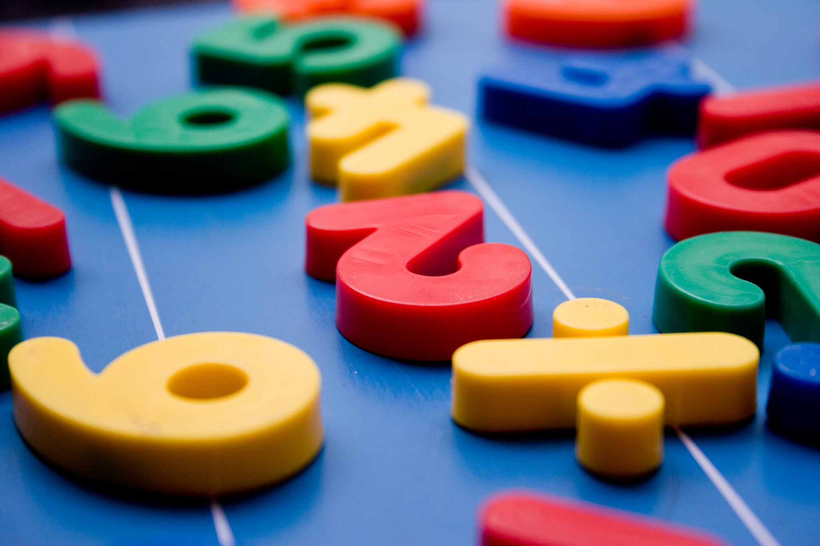
Kahoot 1
Students to log on to Kahoot.IT
Teacher to host game from the following link:
https://create.kahoot.it/details/4177f34d-57c5-43c7-9780-5cbc8c961d8f
For more help, please visit www.exampaperspractice.co.uk
© 2025 Exams Papers Practice. All Rights Reserved

Slide 10
Kahoot 2
Students to log on to Kahoot.IT
Teacher to host game from the following link:
https://create.kahoot.it/details/c898fa0e-c222-4e61-9a50-eba946b0c456
For more help, please visit www.exampaperspractice.co.uk
© 2025 Exams Papers Practice. All Rights Reserved

Slide 11
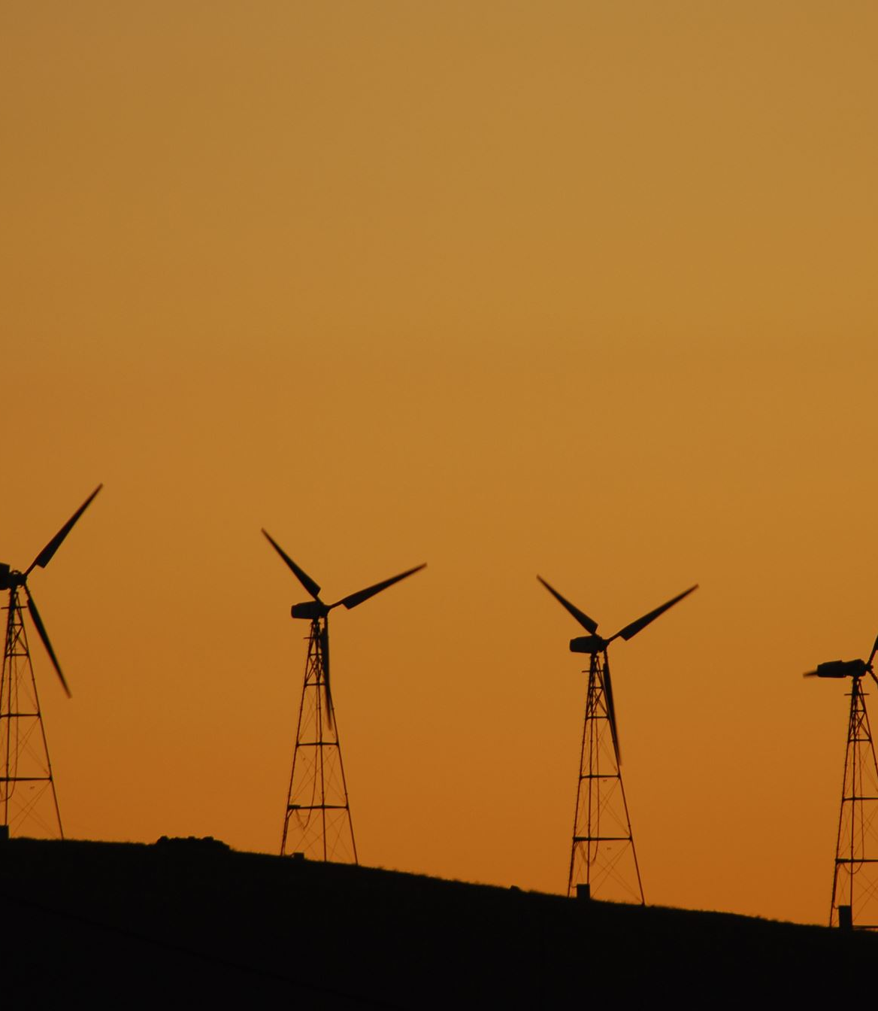
Plenary
What are private costs/benefits | Ask someone a question based on today’s lesson | Lucky box You get to choose someone else to pick a box
Illustrate a negative externality in consumption | What are social benefits and costs | Something you’re not sure about?
Very lucky box You get to choose someone else to pick a box and you can’t be picked again | What is negative externality | A govt policy for negative externality?
1
2
3
4
5
6
7
8
9
For more help, please visit www.exampaperspractice.co.uk
© 2025 Exams Papers Practice. All Rights Reserved

