Slide 1
1.4.3 Types and sources of credit
For more help, please visit www.exampaperspractice.co.uk
© 2025 Exams Papers Practice. All Rights Reserved

Slide 2
Recall
Define the following terms
Equilibrium
Market Forces
Explain a limitation in the supply and demand model
For more help, please visit www.exampaperspractice.co.uk
© 2025 Exams Papers Practice. All Rights Reserved

Slide 3
Starter
What sources of finance can you think of to start a business?
How many sources of finance can you think of for an existing business?
For more help, please visit www.exampaperspractice.co.uk
© 2025 Exams Papers Practice. All Rights Reserved

Slide 4
Learning Objectives
Are you able to explain the different types of credit available?
Are you able to analyse the different types of finance available?
Are you able to evaluate the advantages and disadvantages of different sources of finance?
For more help, please visit www.exampaperspractice.co.uk
© 2025 Exams Papers Practice. All Rights Reserved

Slide 5
Credit
Credit is a legal agreement between a borrower and a lender
A business, the borrower, receives something of value now e.g. stock or finance and agrees to repay the provider, the lender, at an agreed point in time in the future
Types of credit include:
Loans
Overdrafts
Trade credit
Sources of credit include:
Banks
Other firms
For more help, please visit www.exampaperspractice.co.uk
© 2025 Exams Papers Practice. All Rights Reserved

Slide 6
Types of credit- Loans
A set amount of money provided for a specific purpose, to be repaid with interest, over a set period of time
May be secured against an asset and if there is a default on repayments the asset can be taken
Financial institutions can vary interest rates depending upon the amount of risk placed on the loan
An external source of finance generally considered to be more suitable for longer-term projects
However this will depend upon the size of the loan and the repayment period
For more help, please visit www.exampaperspractice.co.uk
© 2025 Exams Papers Practice. All Rights Reserved

Slide 7
Types of credit- Loans
Advantages | Disadvantages
Quick and easy to secure Fixed interest rates allow firms to budget Improved cash flow The borrower retains ownership of the company | Interest must be paid regardless of financial performance A firm that is highly geared i.e. has a high proportion of capital raised through debt, may be seen as high risk A firm normally provides security known as collateral Often more expensive than other forms of finance Can be charged a penalty for early payment
For more help, please visit www.exampaperspractice.co.uk
© 2025 Exams Papers Practice. All Rights Reserved

Slide 8
Types of credit- Overdrafts
An overdraft is the facility to overspend on a current account up to an agreed sum
The business in effect can withdraw money from the account that is not there meaning they go overdrawn or in the red
Interest is charged on the overdrawn amount
This is a good short-term source of finance
An external source of finance provided by banks and building societies
For more help, please visit www.exampaperspractice.co.uk
© 2025 Exams Papers Practice. All Rights Reserved

Slide 9
Types of credit- Overdrafts
Advantages | Disadvantages
Only borrowed when required allowing flexibility Only pay for the money borrowed Quick and easy to arrange No charges for paying off the overdraft | The bank can call it in at any time Only available from a current bank account Interest payments tend to be variable making it more difficult to budget Banks may secure the overdraft against the business’ assets
For more help, please visit www.exampaperspractice.co.uk
© 2025 Exams Papers Practice. All Rights Reserved

Slide 10
Types of credit- trade credit
Trade credit is paying suppliers a period of time after the goods or services have been received
In effect the supplier is providing the business with finance for the period of the trade credit e.g. 30 days
The business may lose out on discounts offered for immediate or quick payment increasing costs
For more help, please visit www.exampaperspractice.co.uk
© 2025 Exams Papers Practice. All Rights Reserved

Slide 11
Sources of credit
Banks
Financial institutions that are licenced to take deposits, pay interest, make loans and act as an intermediary in financial transactions, as well as provide other financial services to their customers
Banks will have departments and employees who specialise in business banking including offering advice on topics such as methods of finance and business planning
Other firms
Suppliers may supply goods and services but allow the customer trade credit
For more help, please visit www.exampaperspractice.co.uk
© 2025 Exams Papers Practice. All Rights Reserved

Slide 12
Other types of finance - Venture capital
Investment from an established business into another business in return for a percentage equity in the business
Also known as private equity finance
Venture capitalists will normally look for a high rate of return in a specific time period
The business or entrepreneur may also benefit from expertise and mentoring from the venture capitalist
Often associated with high risk start-ups
For more help, please visit www.exampaperspractice.co.uk
© 2025 Exams Papers Practice. All Rights Reserved

Slide 13
Other types of finance - Venture capital
Advantages | Disadvantages
Potential for large sums of money for investment Expertise to help the business Makes it easier to attract other sources of finance Provides the required capital for expansion | A long and complex process Expert financial projections are likely to be required Initially expensive for the firm e.g. legal and accounting fees Partial loss of ownership Risk of conflict or perceived interference
For more help, please visit www.exampaperspractice.co.uk
© 2025 Exams Papers Practice. All Rights Reserved

Slide 14
Other types of finance -Share capital
Finance raised from the sale of shares
This is a form of equity capital i.e. the shareholder becomes a part owner of the business
Shareholders will be rewarded for their investment by the payment of dividends but may also benefit from an increase in share price increasing the value of their shares
Only an option for incorporated businesses i.e. a private or public limited company
Issuing shares is a complex and costly process so only really an option for raising large amounts of finance to fund long term projects
For more help, please visit www.exampaperspractice.co.uk
© 2025 Exams Papers Practice. All Rights Reserved

Slide 15
Other types of finance -Share capital
Other types of finance -Share capital
Advantages | Disadvantages
Only need to pay dividends if a profit is being made and the amount of dividend is not fixed Possible to raise large amounts of finance No interest repayments | Loss of ownership as shareholders are part owners Potential risk of loss of control for a Plc with a threat of hostile takeovers Complex and costly process of issuing shares, especially for a Plc
For more help, please visit www.exampaperspractice.co.uk
© 2025 Exams Papers Practice. All Rights Reserved

Slide 16
Other types of finance - leasing
Leasing allows a business to benefit from the use of an asset without owning it or buying it outright
The business pays a set amount in instalments to lease the asset for a pre determined period of time
The asset remains the property of the leasing company and at the end of the time period the asset is returned to the lease company and the business stops making the payments
Avoids the need to finance the asset but may be more costly in the long run
However the lease company is responsible for any repairs and maintenance
At the end of the lease period the business may start a new lease agreement for the latest model e.g. new spec photocopier!
For more help, please visit www.exampaperspractice.co.uk
© 2025 Exams Papers Practice. All Rights Reserved

Slide 17
Activity
Distinguish between:
An overdraft and a bank loan
Share capital and venture capital
For more help, please visit www.exampaperspractice.co.uk
© 2025 Exams Papers Practice. All Rights Reserved

Slide 18
Green Pen
An overdraft is a short term source of finance where interest is payable on the outstanding balance. A bank loan is a long term source of finance for a specific purpose. The loan is repayable in pre agreed instalments with a set amount of interest.
Both are external sources of finance where individuals or groups invest in a business in return for equity. Venture capital however will have the added advantage that the investor will be an experienced entrepreneur who can also provide advice and guidance.
For more help, please visit www.exampaperspractice.co.uk
© 2025 Exams Papers Practice. All Rights Reserved

Slide 19
Other sources of finance - Owner’s capital: personal savings
When an entrepreneur invests their own money in a business e.g. from personal savings
Owner’s capital is how much the owner has invested in the business
Owner’s capital shows the proportion of the business’ assets that are owned by the business owner rather than creditors
Assets are items owned by the business e.g. stock is a current assets that will stay in the business for less than a year and vehicles are long term assets
Creditors are people who the business owes money to e.g. the bank
For more help, please visit www.exampaperspractice.co.uk
© 2025 Exams Papers Practice. All Rights Reserved

Slide 20
Other sources of finance - Owner’s capital: personal savings
When an entrepreneur invests their own money in a business e.g. from personal savings
Owner’s capital is how much the owner has invested in the business
Owner’s capital shows the proportion of the business’ assets that are owned by the business owner rather than creditors
Assets are items owned by the business e.g. stock is a current assets that will stay in the business for less than a year and vehicles are long term assets
Creditors are people who the business owes money to e.g. the bank
For more help, please visit www.exampaperspractice.co.uk
© 2025 Exams Papers Practice. All Rights Reserved

Slide 21
Owner’s capital: personal savings
The benefits are:
Do not have to repay
No interest charges
Owner(s) maintain control
Risking own savings can be motivational
Do not have to go through any lengthy application procedures
However:
May only be limited amounts available
Threat to personal finances and family
For more help, please visit www.exampaperspractice.co.uk
© 2025 Exams Papers Practice. All Rights Reserved

Slide 22
Other sources of finance - Retained profit
Advantages | Disadvantages
Avoids interest repayments Does not dilute the business ownership | Only an option if sufficient retained profit exists within the business May cause shareholder dissatisfaction if this is at the expense of dividend payments Reduces the security blanket of keeping retained profits for unforeseen situations or to take advantage of new opportunities
Profit kept within a business from profit for the year to help finance future activities
For more help, please visit www.exampaperspractice.co.uk
© 2025 Exams Papers Practice. All Rights Reserved

Slide 23
Other sources of finance - Sale of assets
Assets are items of value owned by a business
Current assets are items owned that will change in value in the short run (within one year)
Stock for example is being bought and sold on a regular basis
Sale of assets refers more to the sale of a long term or fixed assets
Fixed assets will stay in the business for more than a year e.g. machinery and vehicles
These assets can be sold in order to get an immediate injection of cash in to a business and thereby provide finance
For more help, please visit www.exampaperspractice.co.uk
© 2025 Exams Papers Practice. All Rights Reserved

Slide 24
Sale of assets
The benefits are:
No interest charges or repayments
May be turning an obsolete asset into finance
Immediate lump sum cash injection
However:
May be expensive in the long run if need to lease the asset back
Loss of use of the asset and future value
Is only a one off option
For more help, please visit www.exampaperspractice.co.uk
© 2025 Exams Papers Practice. All Rights Reserved

Slide 25
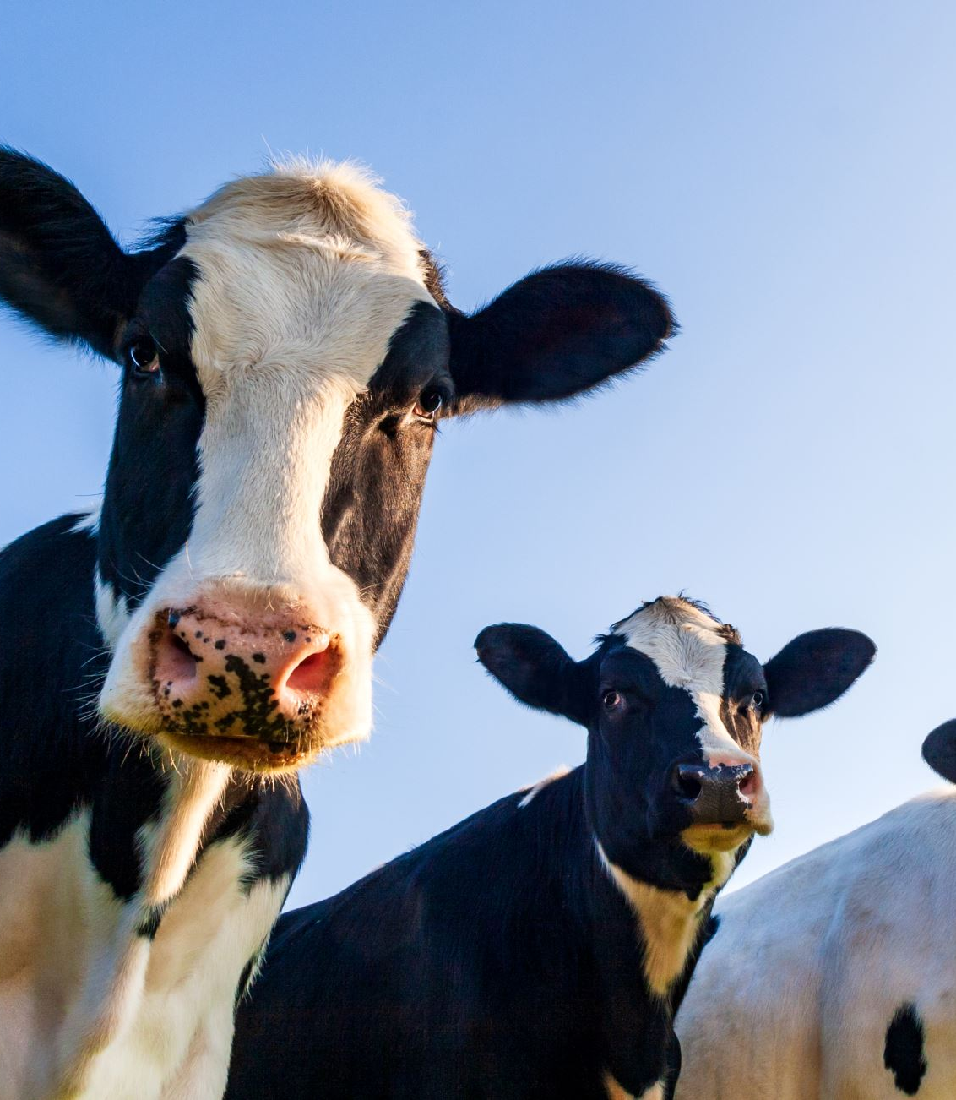
Activity
State three assets that a dairy farmer may be able to sell to raise finance. Try to give a range of different examples not similar ones.
For more help, please visit www.exampaperspractice.co.uk
© 2025 Exams Papers Practice. All Rights Reserved

Slide 26
Green Pen
Farm equipment e.g. tractor
Cows
Land
For more help, please visit www.exampaperspractice.co.uk
© 2025 Exams Papers Practice. All Rights Reserved

Slide 27
Other sources of finance – individual investors
Family and friends
Investment from people known to the entrepreneur
Amount may be limited
Repayment terms and conditions may be flexible
May place pressure on relationships
For more help, please visit www.exampaperspractice.co.uk
© 2025 Exams Papers Practice. All Rights Reserved

Slide 28
Other sources of finance – individual investors
Peer-to-peer funding (P2P)
The practise of an individual lending to other individuals (peers) with whom there is no relationship or contact
Borrowers are given a credit rating
Normally an unsecured personal loan although on some occasions collateral may be offered
Cuts out the use of traditional intermediaries e.g. banks
Lending is done online
Lenders decide who they want to lend to then compete to win the lending opportunity in a reverse auction i.e. the lender willing to offer the lowest interest rate wins
The lenders motive is profit
For more help, please visit www.exampaperspractice.co.uk
© 2025 Exams Papers Practice. All Rights Reserved

Slide 29
Other sources of finance – online collaborative funding
Crowdfunding involves raising finance from a large number of people each investing different, often small, amounts of money
The business uses the internet to explain how much money is required, how it will be used and the exit strategy stating predicted return on the investment
The investor is only tied into their promised contribution if the total amount is raised
For more help, please visit www.exampaperspractice.co.uk
© 2025 Exams Papers Practice. All Rights Reserved

Slide 30
Activity
Source of finance | Definition | Internal or external
Overdraft
Retained profit
Share capital
Loans
Venture capital
Collaborative funding
For more help, please visit www.exampaperspractice.co.uk
© 2025 Exams Papers Practice. All Rights Reserved

Slide 31
Green Pen
Source of finance​ | Definition​ | Internal or external​
Overdraft​ ​ | The facility to overspend on a current account up to a predetermined sum in order to provide a short term source of finance​ | External​
Retained profit​ ​ | Profit kept within a business from profit for the year to help finance future activities​ | Internal​
Share capital​ ​ | Finance raised from the sale of shares​ ​ | External​
Loans​ ​ | A set amount of money provided for a specific purpose, to be repaid with interest, over a set period of time​ | External​
Venture capital​ ​ | Investment from an established business into another business in return for percentage equity in the business​ | External​
Collaborative funding​ ​ | Raising finance from a large number of people each investing different, often small, amounts of money​ | External​
For more help, please visit www.exampaperspractice.co.uk
© 2025 Exams Papers Practice. All Rights Reserved

Slide 32
Challenges in obtaining credit
Accessing credit is not always easy
Individuals and firms have credit ratings which have been built up over time
These provide information to banks as to how risky the loan is
The greater the risk the higher the amount of interest that has to be repaid
Using collateral will make it easier to obtain a loan

Slide 33
Challenges in obtaining credit
Accessing credit is not always easy
Individuals and firms have credit ratings which have been built up over time
These provide information to banks as to how risky a loan is
The greater the risk the higher the amount of interest that has to be repaid
Using collateral will make it easier to obtain a loan
For more help, please visit www.exampaperspractice.co.uk
© 2025 Exams Papers Practice. All Rights Reserved

Slide 34
Plenary
Name three sources of finance.
Give one advantage and one disadvantage for each source.
Which is the most suitable type of finance for a PLC?
For more help, please visit www.exampaperspractice.co.uk
© 2025 Exams Papers Practice. All Rights Reserved

