Slide 1
1.2.4 Specialisation
Theme 1: Markets, consumers and firms
1.2 Enterprise, business and the economy
For more help, please visit www.exampaperspractice.co.uk
© 2025 Exams Papers Practice. All Rights Reserved

Slide 2
Starter
Explain why secondary school teachers only teach a specific subject?
What are the benefits of this to the students and school?
What are the drawbacks of this to a teacher?
Extension: Evaluate the impact of subject teachers to the wider economy.
For more help, please visit www.exampaperspractice.co.uk
© 2025 Exams Papers Practice. All Rights Reserved

Slide 3
Factors of production
Division of labour: advantages and disadvantages to employers and employees
B. Specialisation: advantages and disadvantages to the firm
For more help, please visit www.exampaperspractice.co.uk
© 2025 Exams Papers Practice. All Rights Reserved

Slide 4
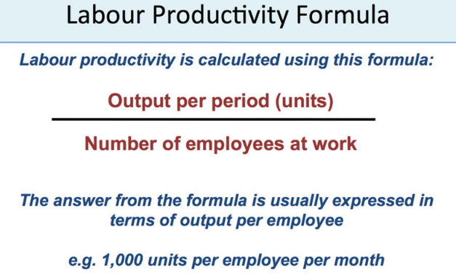
Labour productivity
Labour productivity is concerned with the amount (volume) of output that is obtained from each employee.
For more help, please visit www.exampaperspractice.co.uk
© 2025 Exams Papers Practice. All Rights Reserved

Slide 5
Labour productivity
How can a business improve its labour productivity?
Measure performance and set targets – it is often claimed that "what gets measured, gets done!“
Streamline production processes
Invest in capital equipment (automation + computerisation)
Invest in employee training
Make the workplace conducive to productive effort
For more help, please visit www.exampaperspractice.co.uk
© 2025 Exams Papers Practice. All Rights Reserved

Slide 6
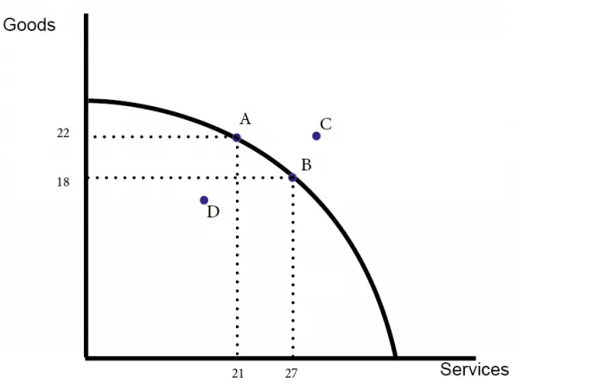
Production efficiency
When we produce goods and services at the lowest possible cost.
Productive efficiency is concerned with producing goods and services with the optimal combination of inputs to produce maximum output for the minimum cost.
To be productively efficient means the economy must be producing on its production possibility frontier. (i.e. it is impossible to produce more of one good without producing less of another).
For more help, please visit www.exampaperspractice.co.uk
© 2025 Exams Papers Practice. All Rights Reserved

Slide 7
Research task
Amazon and Toyota are examples of impressive productivity, investigate and list reasons for this.
Extension: Explain the reasons behind Toyota offering a five year warranty for their cars?
Further research
https://www.channel4.com/programmes/the-truth-about-amazon
https://www.toyota-europe.com/world-of-toyota/this-is-toyota/toyota-production-system
For more help, please visit www.exampaperspractice.co.uk
© 2025 Exams Papers Practice. All Rights Reserved

Slide 8
Specialisation
Specialisation occurs when economic units such as individuals, firms, regions or countries concentrate on producing specific goods or services
Specialised use of workers within an organisation is called the division of labour
Specialisation is likely to lead to increased output per worker (productivity) as the workforce have a better understanding of their job role
This will help to address the problem of scarcity as there will be a greater supply of goods and services to meet unlimited wants
For more help, please visit www.exampaperspractice.co.uk
© 2025 Exams Papers Practice. All Rights Reserved

Slide 9
The division of labour
The division of labour occurs when workers are assigned specific tasks to do in the workplace
Constantly doing the same job improves workforce performance and leads to increased efficiency
This cuts down on production costs creating a competitive advantage
Production or assembly lines can increase the speed and accuracy of the work even further
For more help, please visit www.exampaperspractice.co.uk
© 2025 Exams Papers Practice. All Rights Reserved

Slide 10
The division of labour
Problems occur with the division of labour, particularly in low skilled jobs
The work can become monotonous
This leads to issues with the workforce such as high absenteeism and labour turnover
The UK has higher wage rates than most countries so tends to be undercut by low cost foreign competition
Therefore, UK businesses often produce highly differentiated products where quality rather than price is the main issue
For more help, please visit www.exampaperspractice.co.uk
© 2025 Exams Papers Practice. All Rights Reserved

Slide 11
In pairs
Using the information presented in previous slides and your own ideas complete the grid below
Division of labour
 | Advantages | Disadvantages
Employer
Employee
For more help, please visit www.exampaperspractice.co.uk
© 2025 Exams Papers Practice. All Rights Reserved

Slide 12
Specialisation - advantages
Specialisation increases output as economic units become more effective and efficient in what they produce due to:
Greater understanding of the requirements of production
Each economic unit can specialise in what they are best at
Efficient use of time as there is no switching between tasks
Technical economies of scale as capital equipment is used to produce goods and services
The increased output can then be exchanged for other goods and services that the economic unit is not as good at producing
Specialisation allows for the exchange of goods and services between the economic units
For more help, please visit www.exampaperspractice.co.uk
© 2025 Exams Papers Practice. All Rights Reserved

Slide 13
Specialisation - disadvantages
There are also disadvantages to specialisation and division of labour
Work can become monotonous
This can affect quality and productivity
Can increase absenteeism
May be limited by the size of the market
Small firms can not afford to introduce specialisation
Threat of structural unemployment if an industry goes into decline
Reduces flexibility of the workforce
Production flows may be stopped affecting the ability to meet demand
For more help, please visit www.exampaperspractice.co.uk
© 2025 Exams Papers Practice. All Rights Reserved

Slide 14
Specialisation allows a firm to trade
Specialisation allows an economic agent such as a firm to:
Reduce unit costs e.g. through bulk buying
Improve quality e.g. through better training and skills
Use technology to increase speed and improve accuracy e.g. production lines
Create a unique selling point by producing better quality
Countries, regions , firms and individuals will specialise in order to benefit from specialisation
This enables them to trade with other economic agents that have specialised in different fields
The production possibility frontier will shift outwards
For more help, please visit www.exampaperspractice.co.uk
© 2025 Exams Papers Practice. All Rights Reserved

Slide 15
Specialisation allows a firm to trade
However, specialisation can have serious repercussions:
Economic agents that specialise are at the risk of losing their markets
In a competitive global market UK economic agents can quickly lose market share
This means that the UK must continually strive to improve production processes
A focus on highly differentiated products such as financial services and premium cars has allowed the UK to develop new industries whilst old ones such as textiles have declined
New technology allows us to reinvent ourselves and develop new products based on old industries
For more help, please visit www.exampaperspractice.co.uk
© 2025 Exams Papers Practice. All Rights Reserved

Slide 16
Benefits and costs of specialisation by countries
Benefits | Costs
Allows for trade Improved national income (GDP) Economies of scale leading to lower costs Greater choice for consumers Better quality goods Interdependence leading to better relations between countries | Over-reliance on a limited number of industries Risk of structural unemployment Reliance on other nations Threat of external factors e.g. political unrest or natural disasters can cut of supplies Less developed countries may be discouraged from moving into new industries or specialising in tertiary industries
For more help, please visit www.exampaperspractice.co.uk
© 2025 Exams Papers Practice. All Rights Reserved

Slide 17
Home learning - Deindustrialisation
The UK has experienced deindustrialisation. There has been a decrease in the amount of manufacturing taking place in the country and a growth in the tertiary and quaternary sectors.
:
A global shift in manufacturing to emerging and developing countries (EDCs), such as China, where wages are lower, working hours are longer and trade unions are sometimes banned.
An increase in the number of machines used to carry out work. This is called mechanisation.
For more help, please visit www.exampaperspractice.co.uk
© 2025 Exams Papers Practice. All Rights Reserved

