Slide 1
Cambridge International
AS Level Computer Science
(9618) – Revision Notes
Problem Solving Through Algorithm Design
This pack is intended for students to who are taking CIE AS Level in Computer Science, either in preparation for their AS exam, or more likely alongside year 2 of the course to improve fluency, recall and pace on AS topics. It could be used as lesson starters, or supplied to students for independent use.

Slide 2
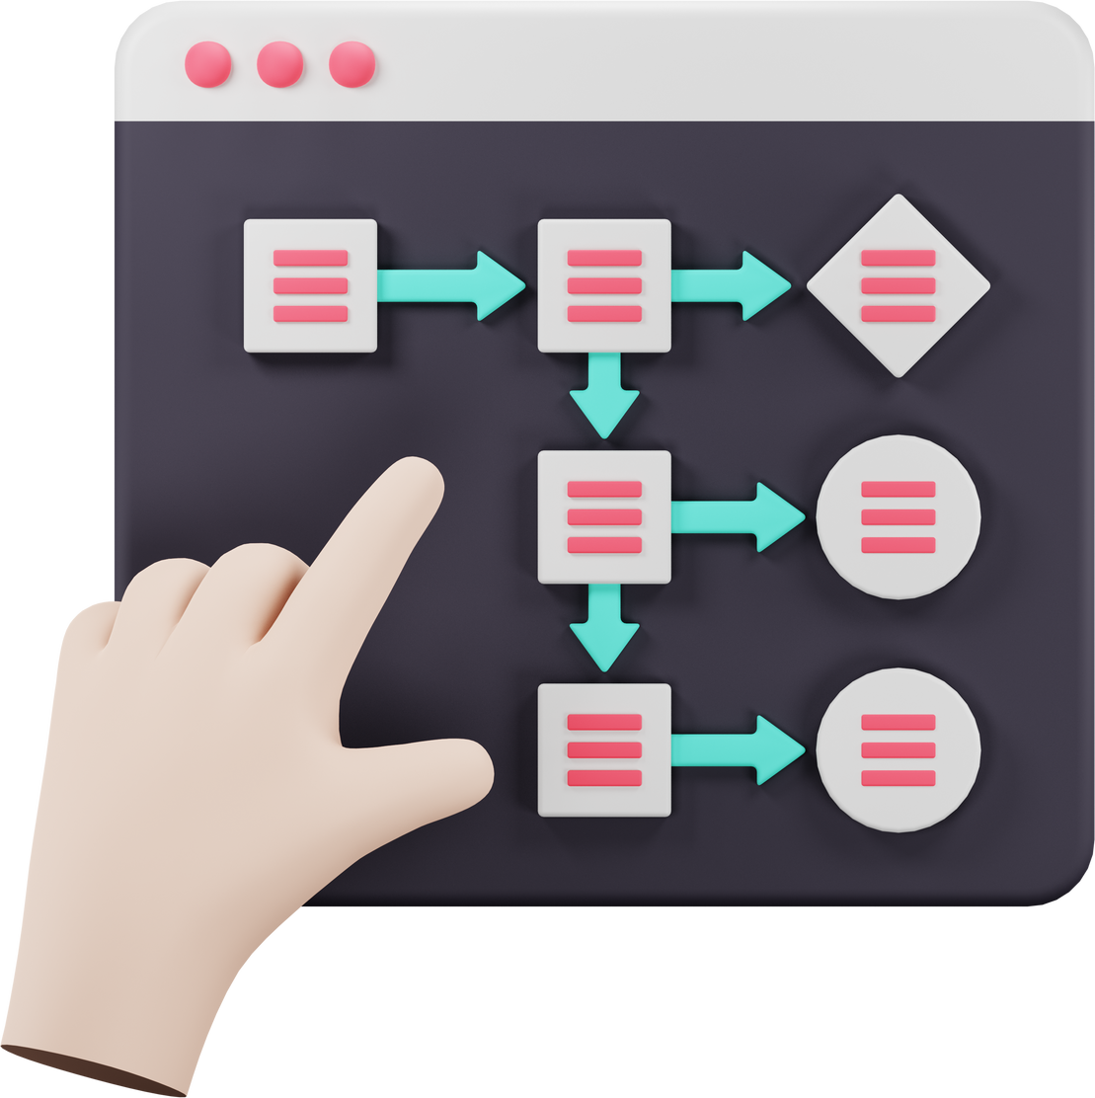

Chapter
12
Problem-Solving Through Algorithm Design
AS LEVEL COMPUTER SCIENCE 9618

Slide 3



12.3
12.1
12.2
Computational Thinking
Structured English, Pseudocode, & Flowchart
12.4
Algorithm
Variables
12.5
Assignment & Sequence
Chapter
Outline
12.6
Selection
12.8
12.7
12.9
Loops
Stepwise Refinement
Programming with Modules

Slide 4

12.1 Computational Thinking
Definition
Computational thinking is a problem-solving method that involves breaking down complex problems into smaller, more manageable parts in a way that a computer or human can understand and solve.
It encompasses a set of skills and thought processes used in computer science and involves several key elements:
Pattern Recognition
Algorithm Design
Abstraction
Decomposition
Data Modelling

Slide 5
12.1 Computational Thinking
Diving deeper into each skill / thought process
Abstraction
Focusing on the important information while ignoring unnecessary details, making the problem more manageable.

Slide 6
12.1 Computational Thinking
Diving deeper into each skill / thought process
Abstraction
Decomposition
Focusing on the important information while ignoring unnecessary details, making the problem more manageable.
Breaking down a complex problem into smaller, more manageable parts or steps.

Slide 7
12.1 Computational Thinking
Diving deeper into each skill / thought process
Abstraction
Decomposition
Data Modelling
Focusing on the important information while ignoring unnecessary details, making the problem more manageable.
Breaking down a complex problem into smaller, more manageable parts or steps.
Involves organising and analysing data.

Slide 8
12.1 Computational Thinking
Diving deeper into each skill / thought process
Abstraction
Decomposition
Data Modelling
Pattern Recognition
Focusing on the important information while ignoring unnecessary details, making the problem more manageable.
Breaking down a complex problem into smaller, more manageable parts or steps.
Involves organising and analysing data.
Identifying similarities or patterns within the problem to simplify understanding and find potential solutions.

Slide 9
12.1 Computational Thinking
Diving deeper into each skill / thought process
Abstraction
Decomposition
Data Modelling
Pattern Recognition
Algorithm Design
Focusing on the important information while ignoring unnecessary details, making the problem more manageable.
Breaking down a complex problem into smaller, more manageable parts or steps.
Involves organising and analysing data.
Identifying similarities or patterns within the problem to simplify understanding and find potential solutions.
Developing step-by-step instructions or algorithms to solve the problem or complete a task.

Slide 10

12.1 Computational Thinking
A problem that requires computational thinking
Abstraction
Pattern Recognition
Simplify user profiles with key attributes like user ID, purchase history, and product views. Abstract product data to include essential attributes.
Analyze user behavior for preferences based on past purchases, viewed items, and search history.
Designing a recommendation system for an
e-commerce platform
Algorithm Design
Develop algorithms to process user data and generate personalized recommendations based on preferences and interactions.
Decomposition
Identify tasks - data collection, user profiling, algorithm selection - to create a recommendation system.
Data Modelling
Design a database structure with tables for users, products, interactions, etc., and define relationships between them.

Slide 11


Subtopic 1
12.2 Algorithm
Definition
An algorithm is a set of well-defined instructions designed to solve a problem or accomplish a task. For example: Making a Peanut Butter and Jelly Sandwich.
Step 1
Step 2
Step 3
Step 4
Step 5
Step 6
Use the knife to spread peanut butter on one slice of bread.
Use a different knife to spread jelly on the other slice of bread.
Press the two slices of bread together, one with peanut butter and one with jelly, creating a sandwich.
Use the knife to cut the sandwich diagonally or straight down the middle.
Collect bread, peanut butter, jelly, a knife, and a plate.
Put two slices of bread on the plate.
Enjoy!

Slide 12
Subtopic 1
12.2 Algorithm
An algorithm within a step
Breaking down Step 3 ("Spread Peanut Butter") into another set of algorithms:
Step 1
Step 2
Step 3
Open Peanut Butter Jar
Dip Knife into Peanut Butter
Spread Peanut Butter on Bread

Slide 13
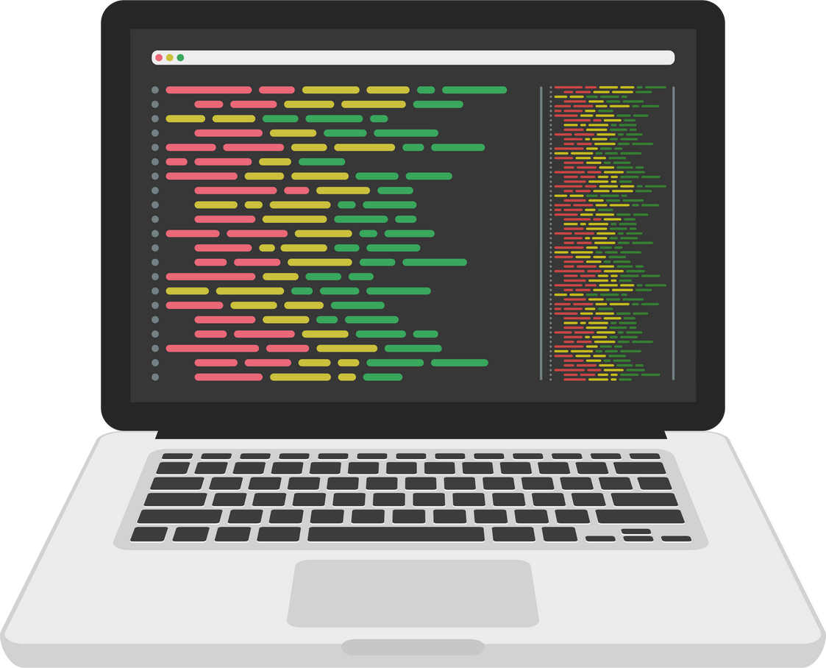
Subtopic 1
12.2 Algorithm
Why learn about algorithm?
Algorithms are essential in computer science as they are step-by-step procedures or instructions designed to solve problems or perform tasks efficiently and accurately. They serve as the fundamental building blocks for computer programs, enabling the development of software.
Step 1
Step 2
Step 3

Slide 14

12.3 Structured English, Pseudocode, & Flowchart
Ways of expressing an algorithm
When we design a solution to a problem we express the algorithm in the following ways:
Structured English
Pseudocode
Flowchart
Pseudocode is an informal, high-level description of a computer program or algorithm, using a mixture of natural language and basic programming concepts to convey the logic of the solution without adhering to specific syntax.
Structured English is a method of expressing algorithms using natural language with programming constructs to outline steps in a clear, readable, and structured format.
Flowchart is a visual representation showing the sequence and logic of an algorithm using symbols and arrows.

Slide 15
12.3 Structured English, Pseudocode, & Flowchart
Construct
When writing an algorithm, we use four basic types of construct:
Iteration
Assignment
Sequence
Selection
Iterating or looping through a set of instructions multiple times until a certain condition is met (e.g., for loops, while loops).
Assigning a value to a variable in a programming language.
Execution of instructions in a predetermined order, one after another.
Making decisions in a program based on conditions (e.g., if-else statements).
Data is involved in almost every problem we are trying to solve, hence we also need the input and output statements.
Input
Output

Slide 16
12.3 Structured English, Pseudocode, & Flowchart
Construct
Description
Structured English
Pseudocode
Flowchart

Slide 17
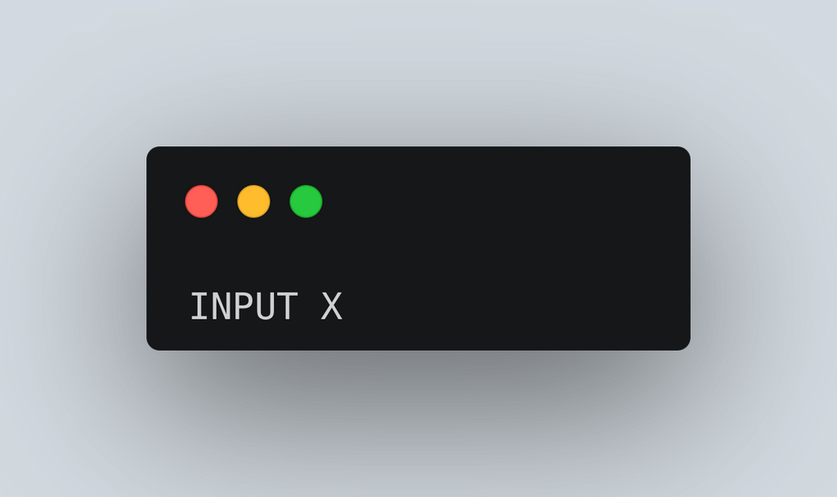
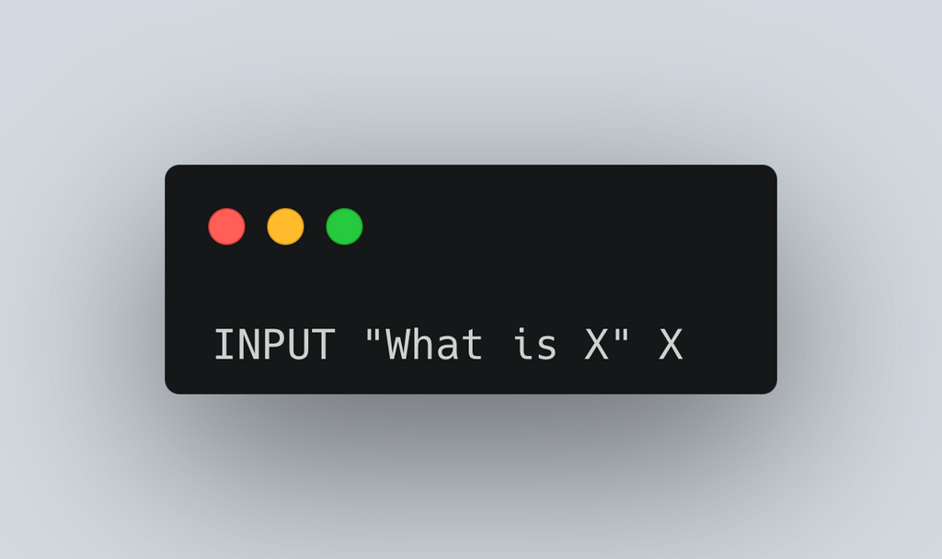
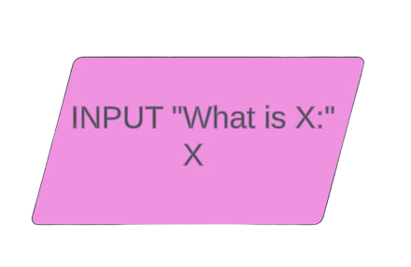
12.3 Structured English, Pseudocode, & Flowchart
Input
Taking data in into the program.
Structured English
Pseudocode
Flowchart
Variable
Variable

Slide 18
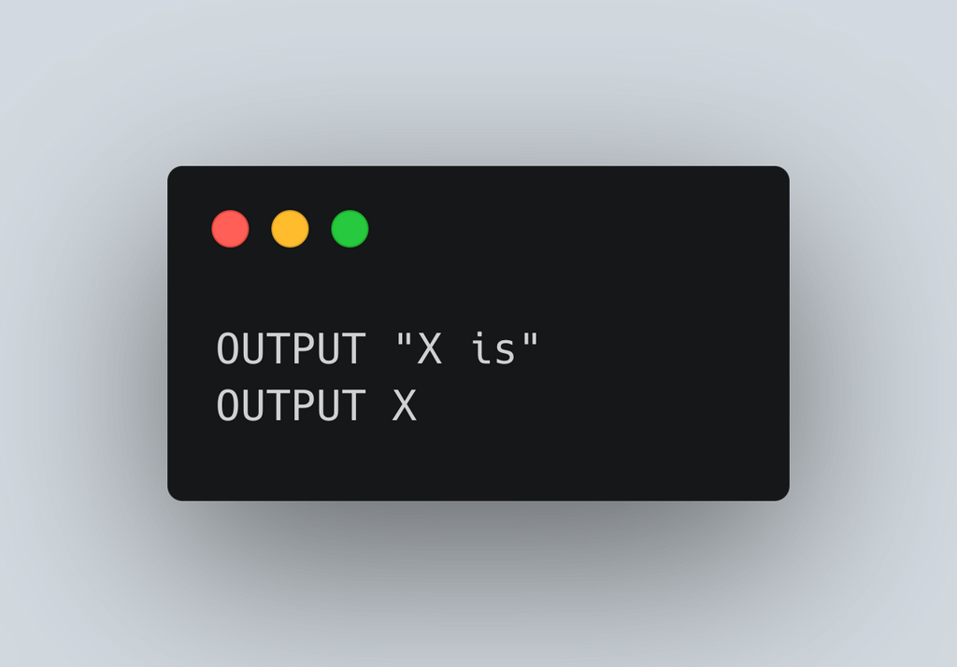
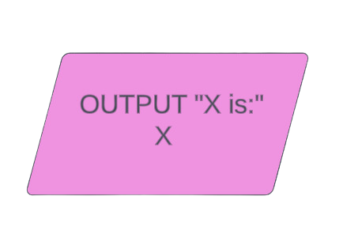
12.3 Structured English, Pseudocode, & Flowchart
Output
Output the data to the user.
Structured English
Pseudocode
Flowchart

Slide 19




12.4 Variables
Why are variables needed?
Variables are needed in programming to store and manipulate data, allowing for dynamic and flexible handling of information within a program.
Think of a variable like a box to store data:
X
5

Slide 20
12.4 Variables
Naming convention for a variable
Naming of a variable should reflect the variable’s use.
CamelCap naming convention: ThisScore, FirstName, etc.
Variable name should contain no spacing.
FirstName
“James”

Slide 21
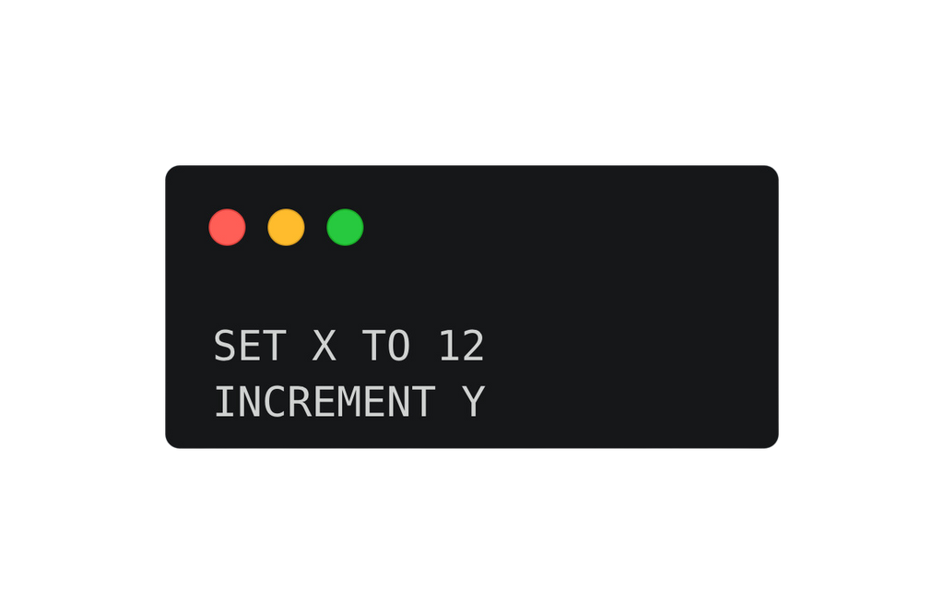
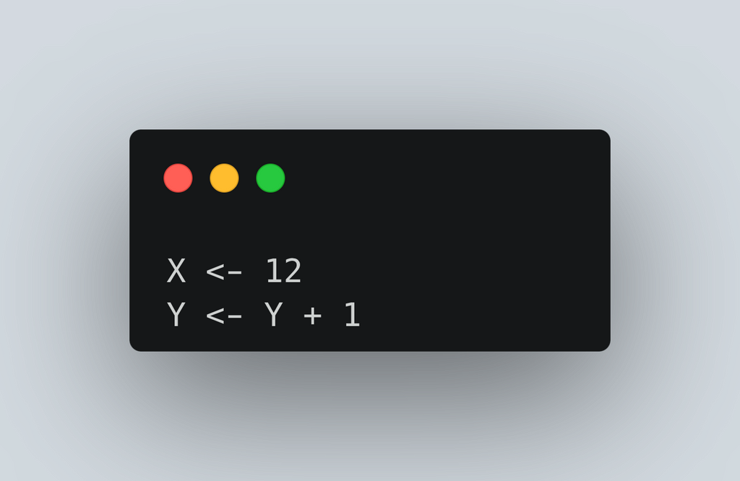
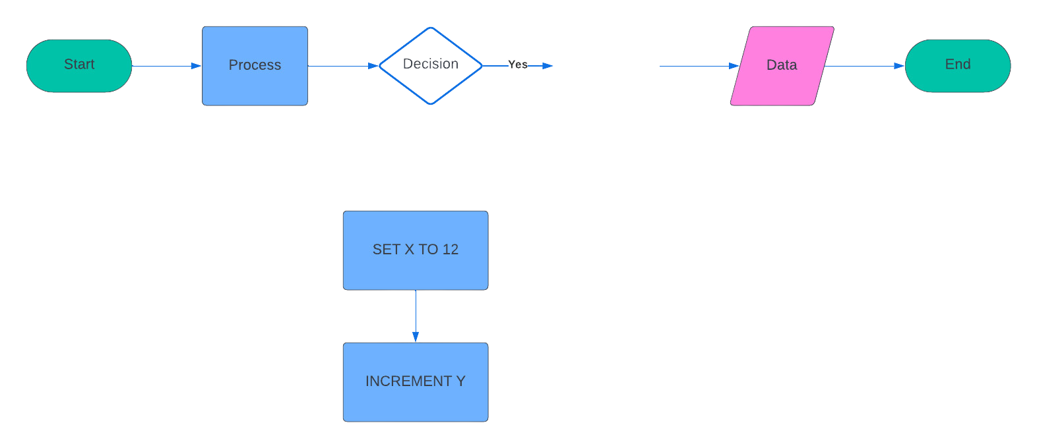
12.5 Assignment and Sequence
Assignment
Sequence
Assigning a value to a variable in a programming language.
Execution of instructions in a predetermined order, one after another.
Structured English
Pseudocode
Flowchart

Slide 22
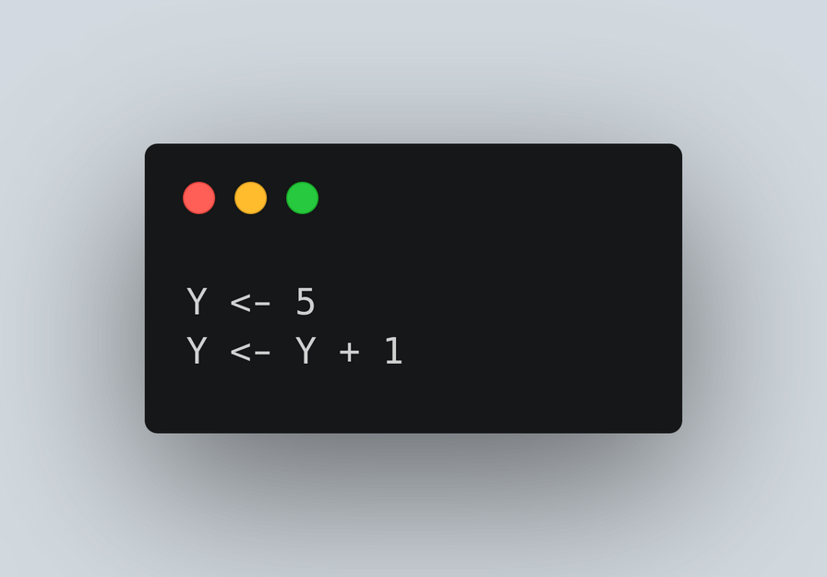


12.5 Assignment and Sequence
Updating a value
5 + 1
Y
5
6

Slide 23
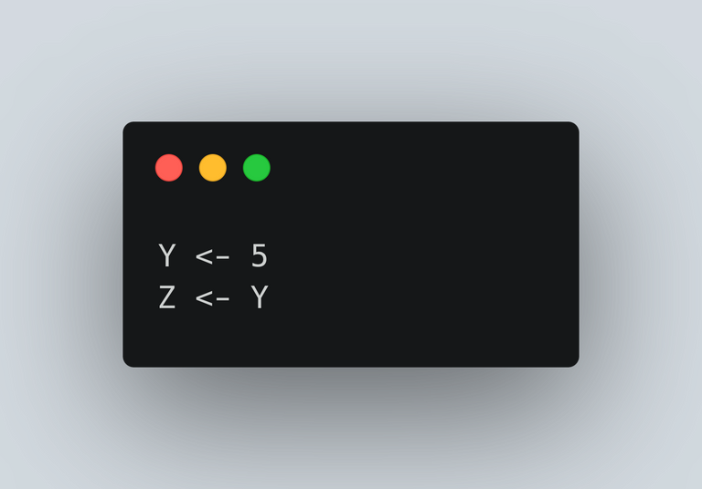
12.5 Assignment and Sequence
Copying a value
5
Y
5
Z
Z
5

Slide 24


12.5 Assignment and Sequence
Swapping two values
Y
5
Z
10

Slide 25
12.5 Assignment and Sequence
Swapping two values
Y
10
Z
10
The value of Y cannot be copied to Z as its initial value has been overwritten.

Slide 26
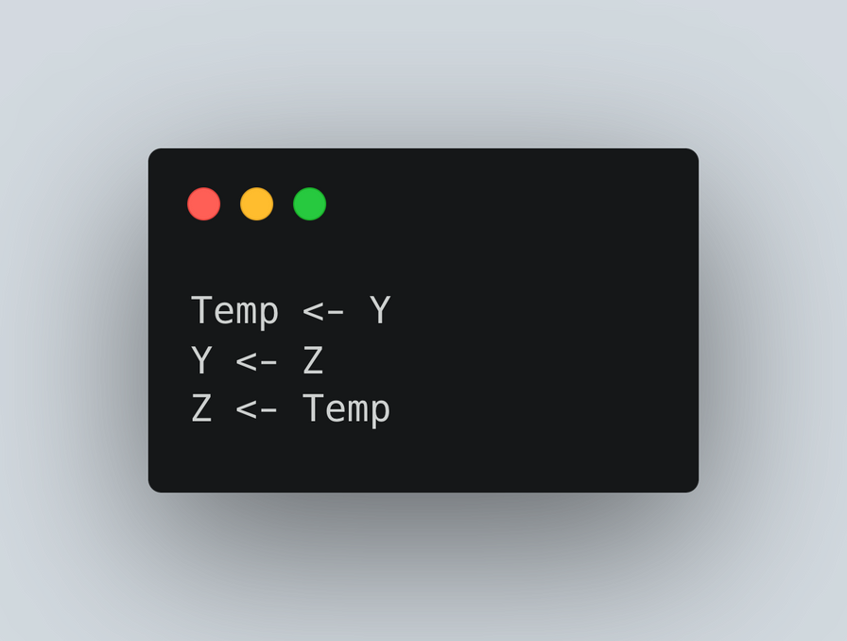
12.5 Assignment and Sequence
Swapping two values
Z
10
Y
5
Temp
5

Slide 27

12.5 Assignment and Sequence
Swapping two values
Z
5
Y
10
Temp
5

Slide 28
12.5 Assignment and Sequence
Worked Example
Write a program that asks the user for a Fahrenheit value. Convert that value to degree celsius and output it.
Formula:
Fahrenheit - 32 x (5/9) = Celsius
Variables needed:
Fahrenheit
Celsius

Slide 29
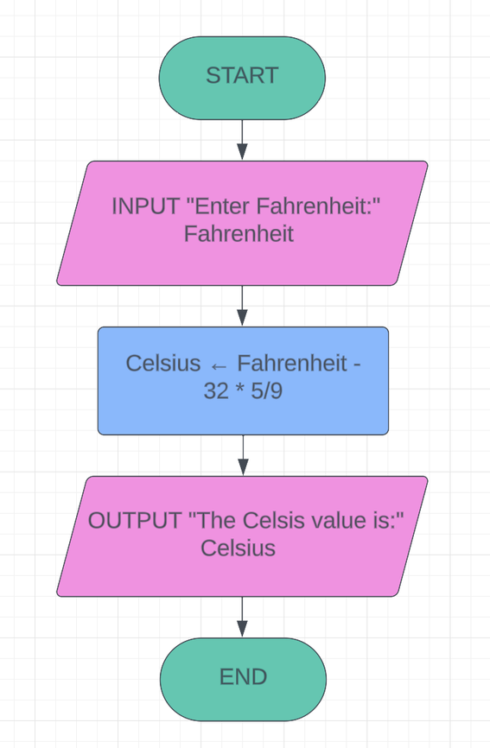
12.5 Assignment and Sequence
Worked Example
Write a program that asks the user for a Fahrenheit value. Convert that value to degree celsius and output it.
Flowchart:

Slide 30
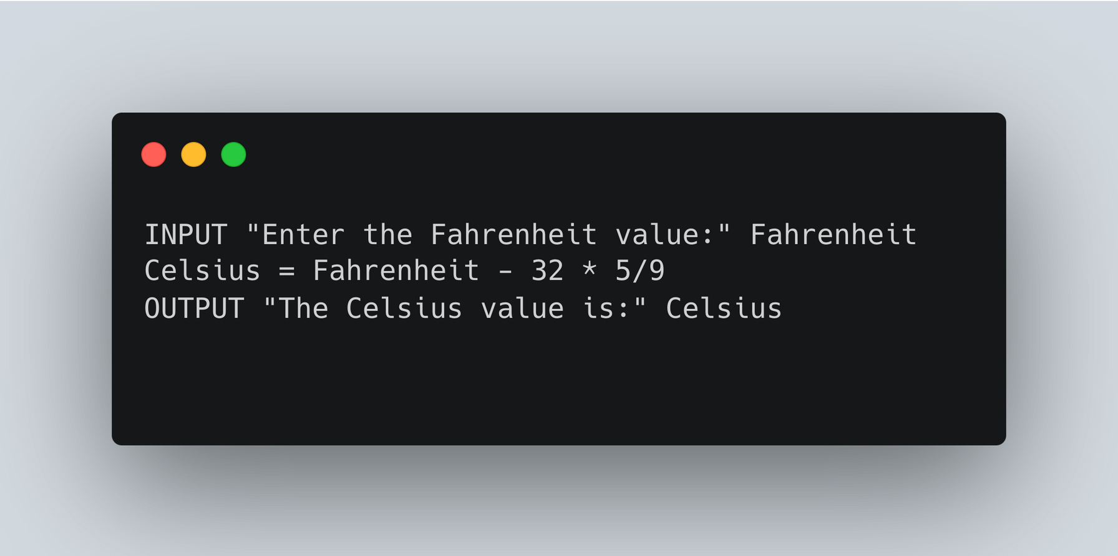
12.5 Assignment and Sequence
Worked Example
Write a program that asks the user for a Fahrenheit value. Convert that value to degree celsius and output it.
Pseudocode:

Slide 31
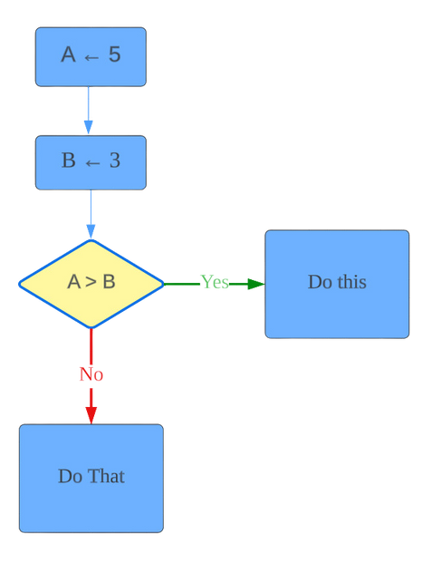
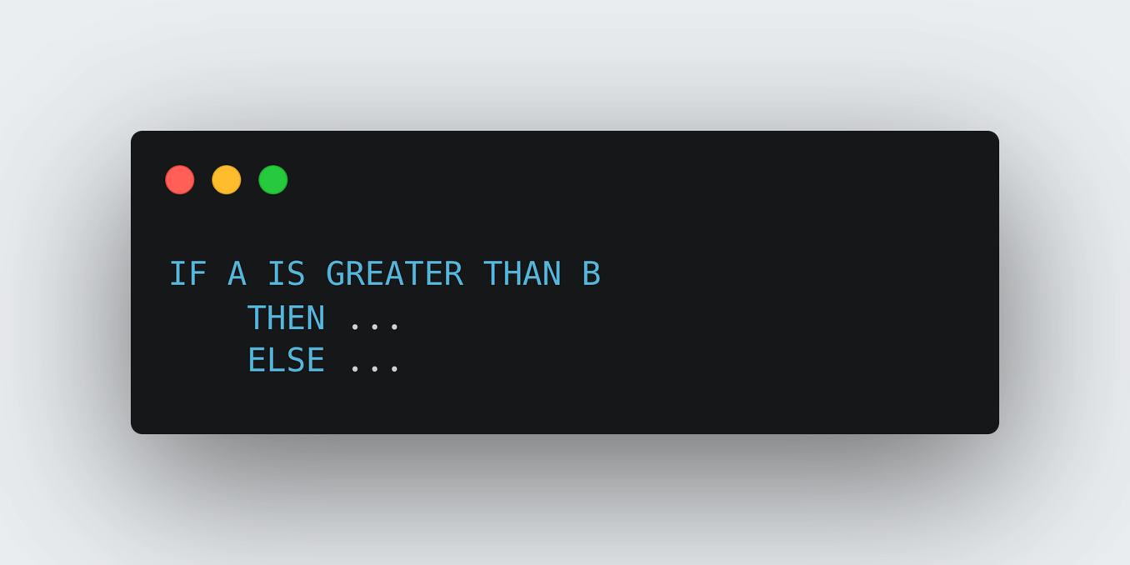
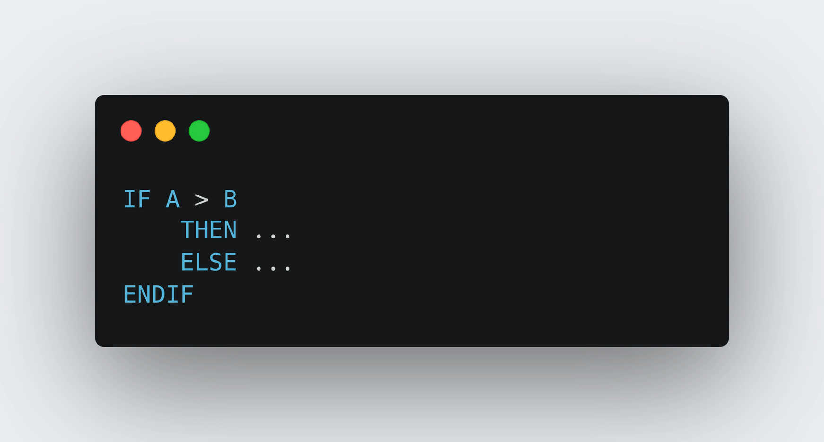
Subtopic 1
12.6 Selection
Selection
Making decisions in a program based on conditions (e.g., if-else statements).
Structured English
Pseudocode
Flowchart

Slide 32
Subtopic 1
12.6 Selection
Selection
Condition
A condition consists of at least one logic proposition.
A statement that can be either true or false.
Comparison operators
Operator
Pseudocode
More than
>
Less than
<
Equal
=
Greater than or equal to
>=
Less than or equal to
<=
Not Equal
<>

Slide 33
Subtopic 1
12.6 Selection
Selection
Worked Example 1:
Write a program that takes an input age from the user and outputs "You can vote" if the age is 18 or above, otherwise outputs "You cannot vote yet".

Slide 34
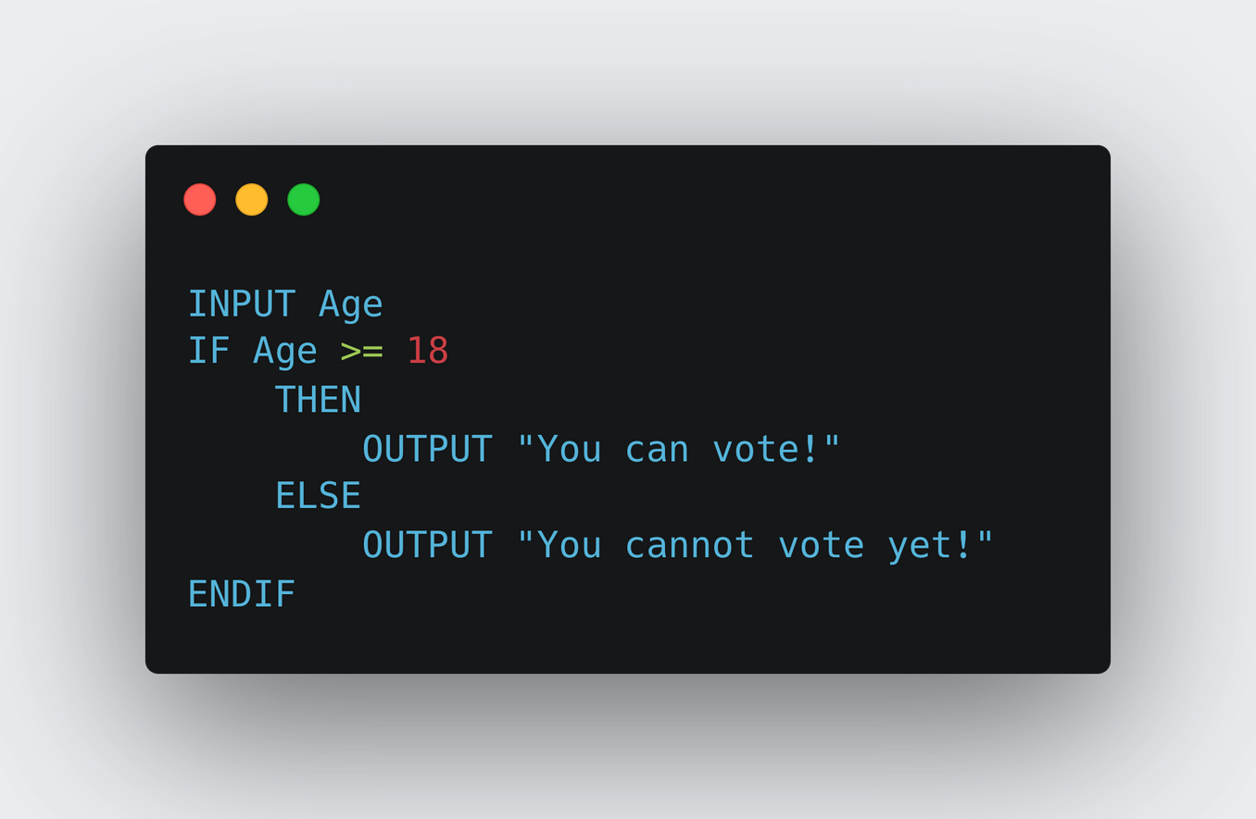
Subtopic 1
12.6 Selection
Selection
Worked Example 1:
Write a program that takes an input age from the user and outputs "You can vote" if the age is 18 or above, otherwise outputs "You cannot vote yet".

Slide 35
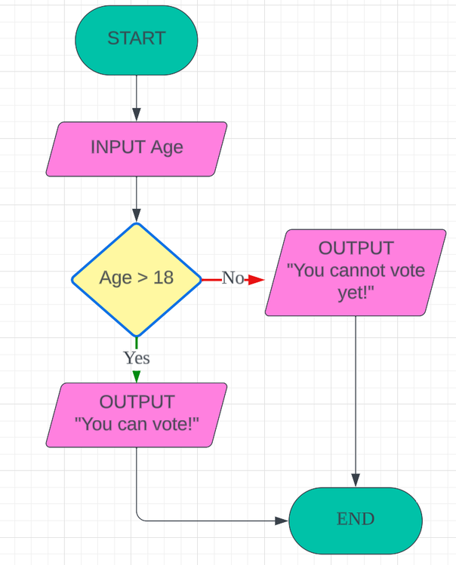
Subtopic 1
12.6 Selection
Selection
Worked Example 1:
Write a program that takes an input age from the user and outputs "You can vote" if the age is 18 or above, otherwise outputs "You cannot vote yet".

Slide 36
Subtopic 1
12.6 Selection
Selection
Worked Example 2:
Take three numbers as input and output the smallest number.
Eg.
N1
N2
N3
5
10
3

Slide 37
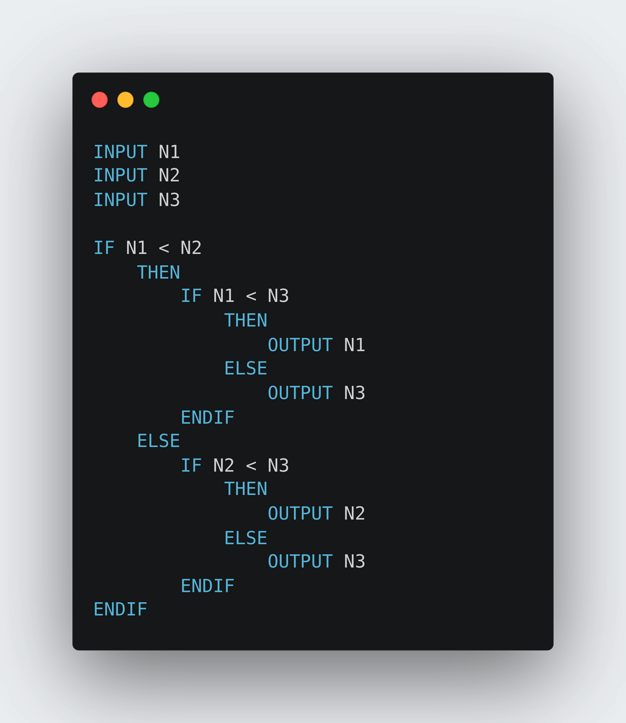
Subtopic 1
12.6 Selection
Selection
Worked Example 2:
Take three numbers as input and output the smallest number.
Eg.
N1
N2
N3
N3
5
10
3

Slide 38
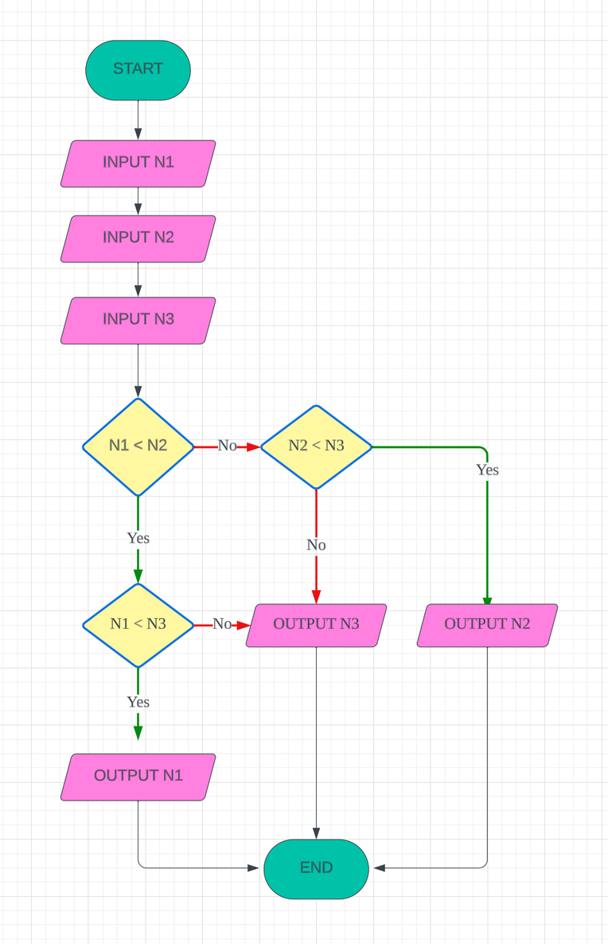
Subtopic 1
12.6 Selection
Selection

Slide 39
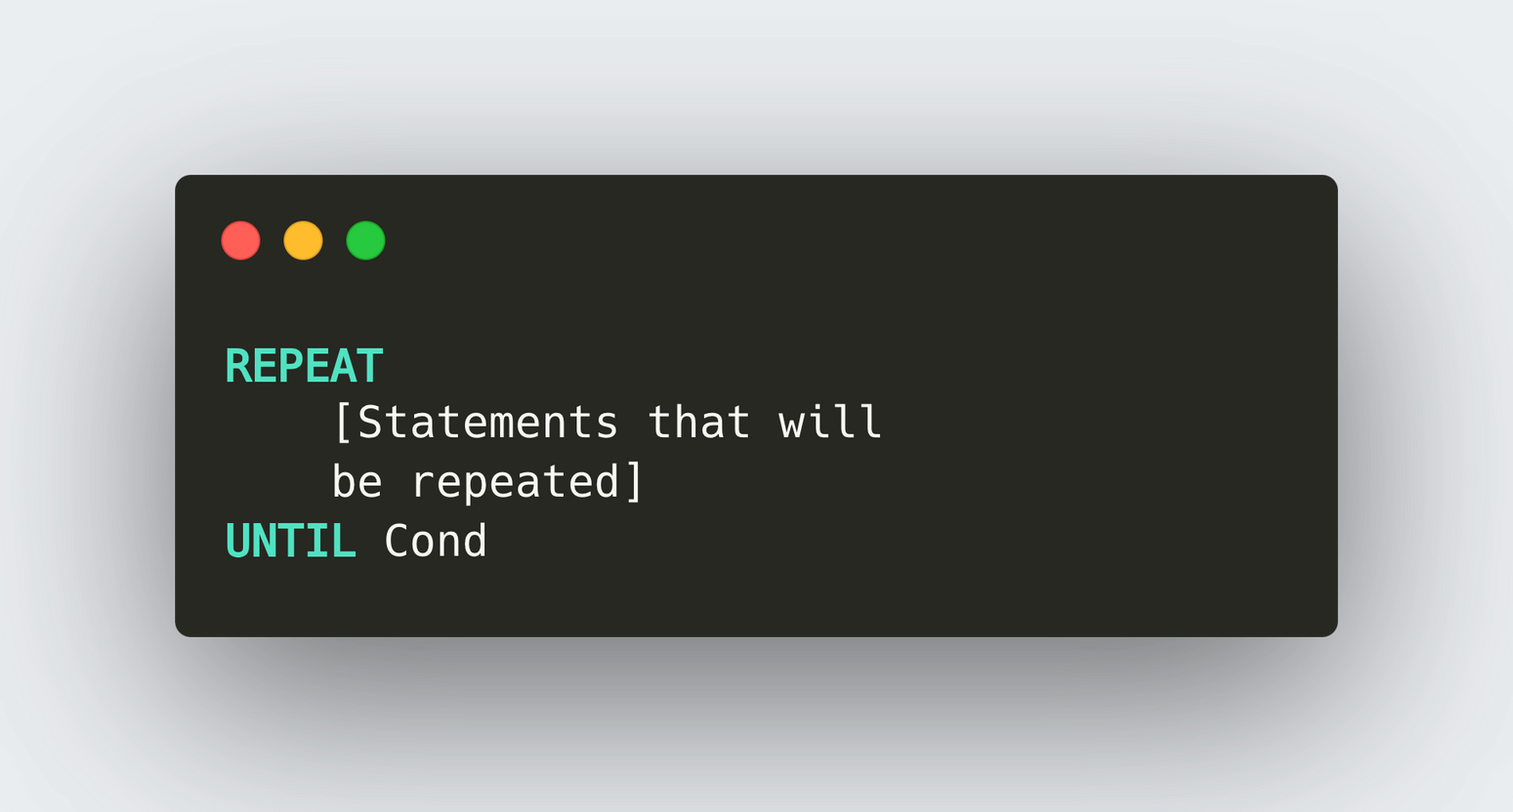
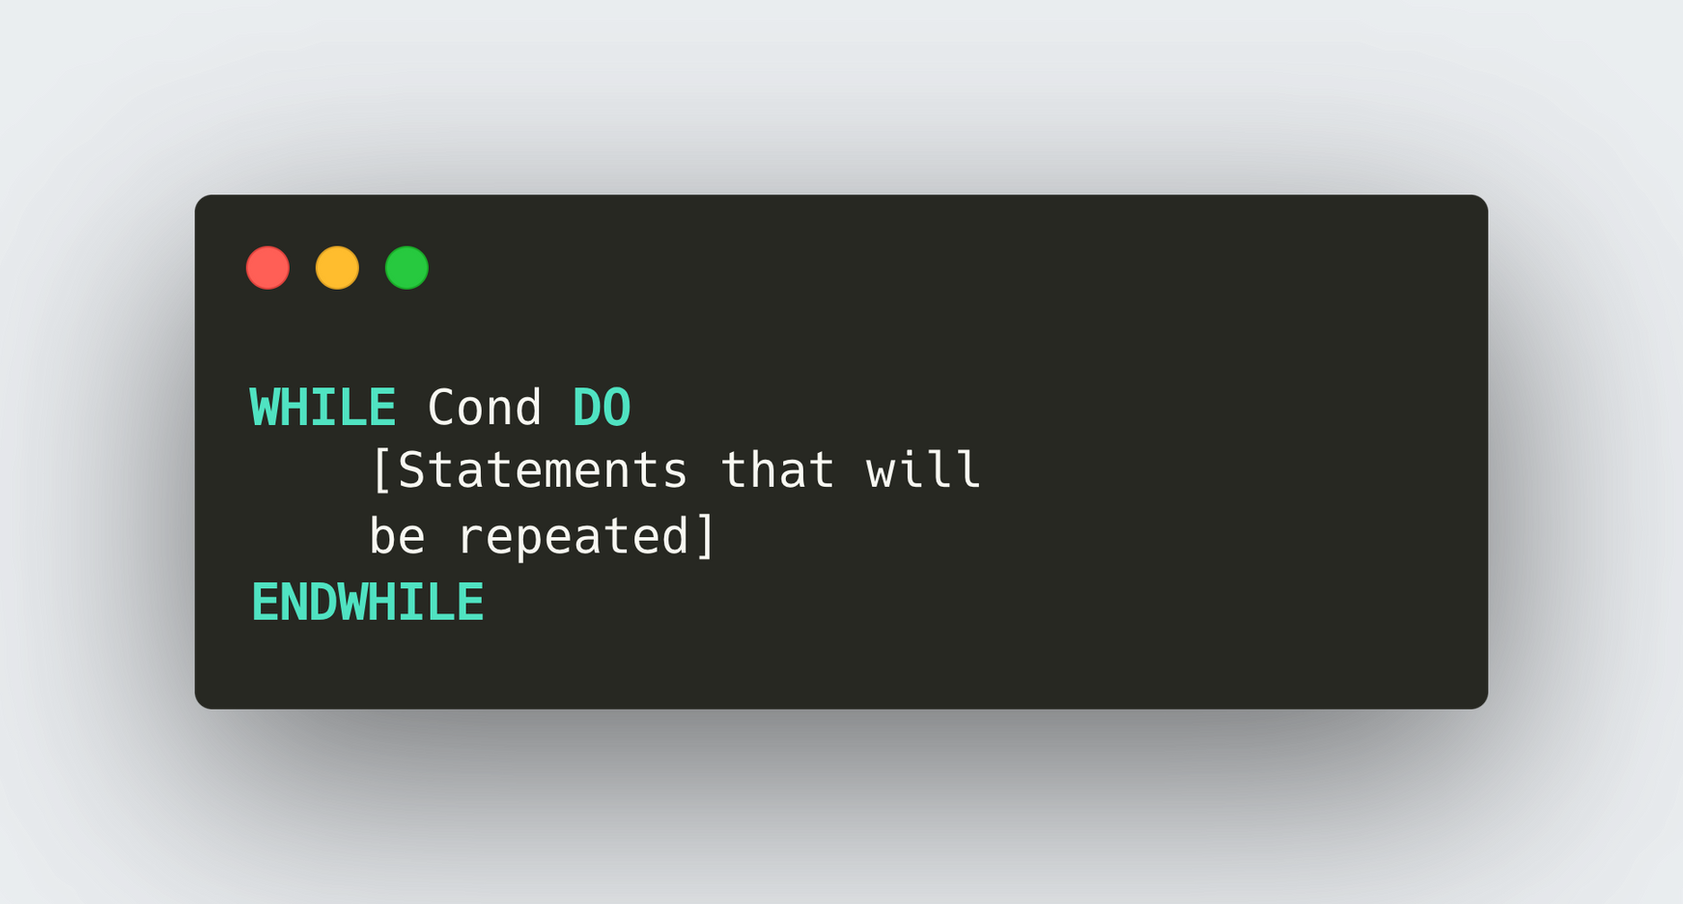
12.7 Loops
Why is loop needed?
A loop in programming allows the execution of a set of instructions repeatedly until
  A specified condition is met or
  For a defined number of iterations.

Slide 40
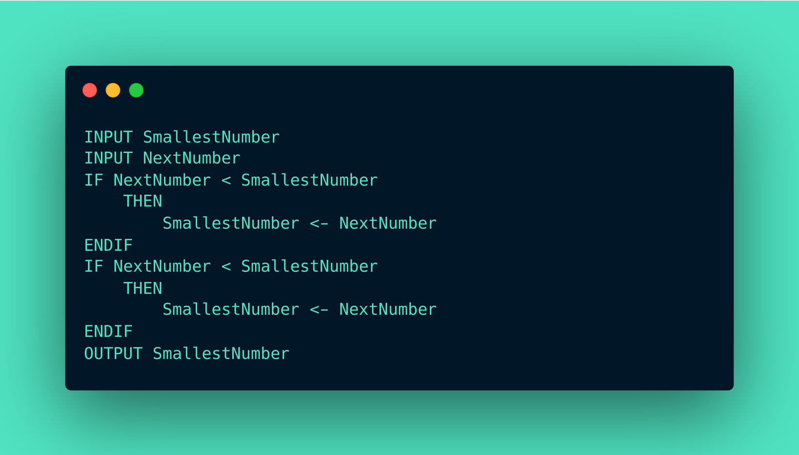

12.7 Loops
Worked Example
Take three numbers as input and output the smallest number (Alternative Solution).
Repeated!
Repeated!

Slide 41
12.7 Loops
Worked Example
Take three numbers as input and output the smallest number (Alternative Solution).
How can we repeat this part of the code as many time as we want?

Slide 42
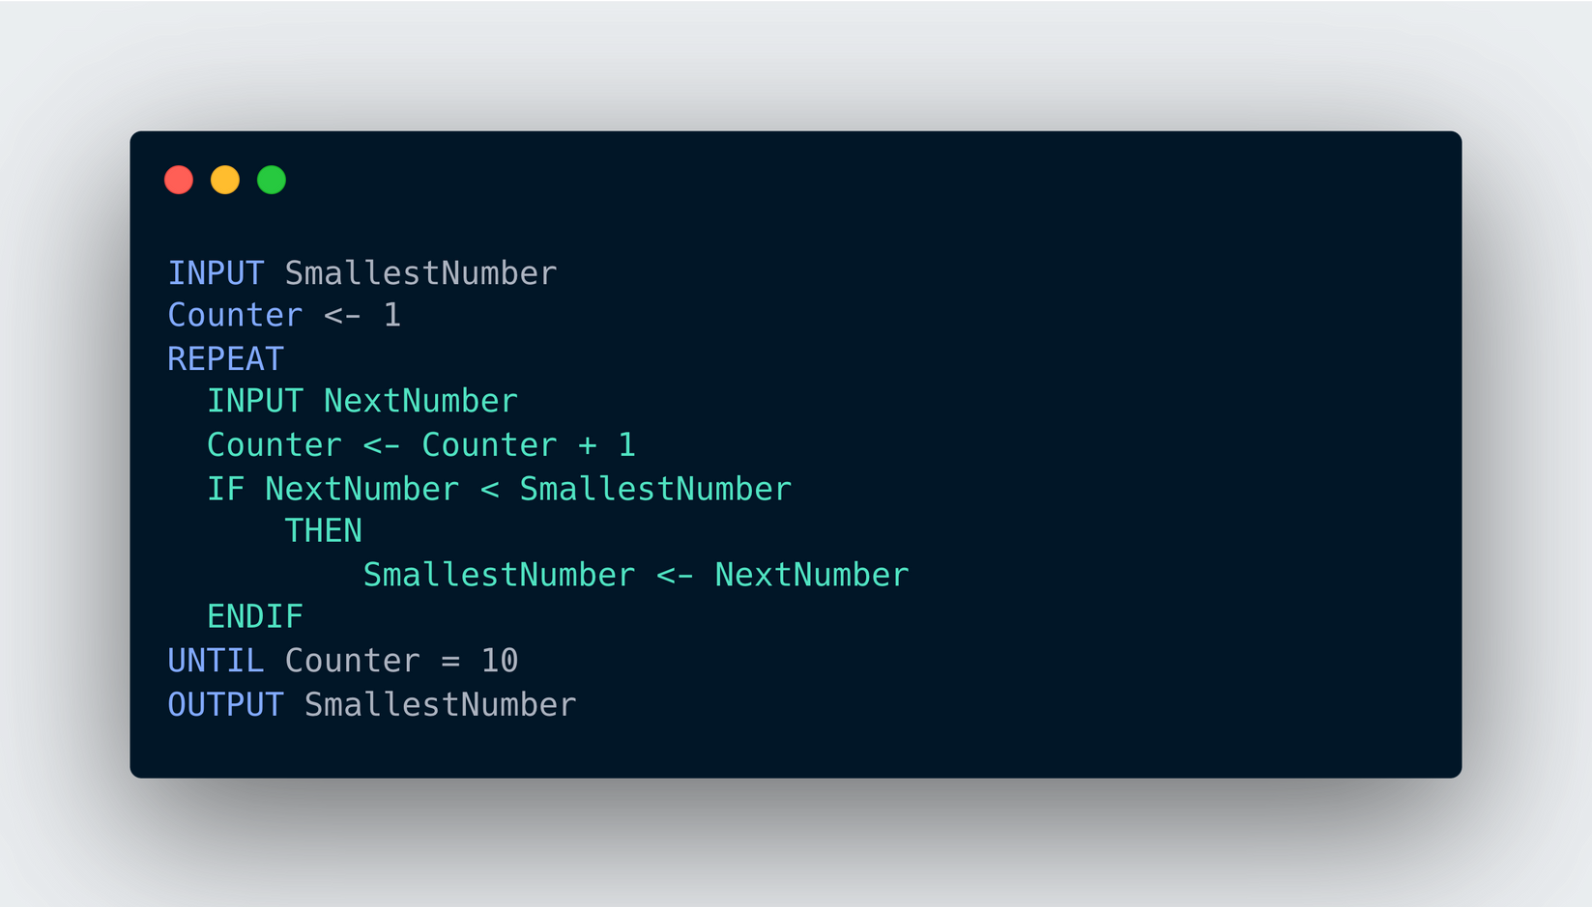
12.7 Loops
Worked Example
Take three numbers as input and output the smallest number.
Use a REPEAT ... UNTIL statement.
Statements that will be repeated

Slide 43
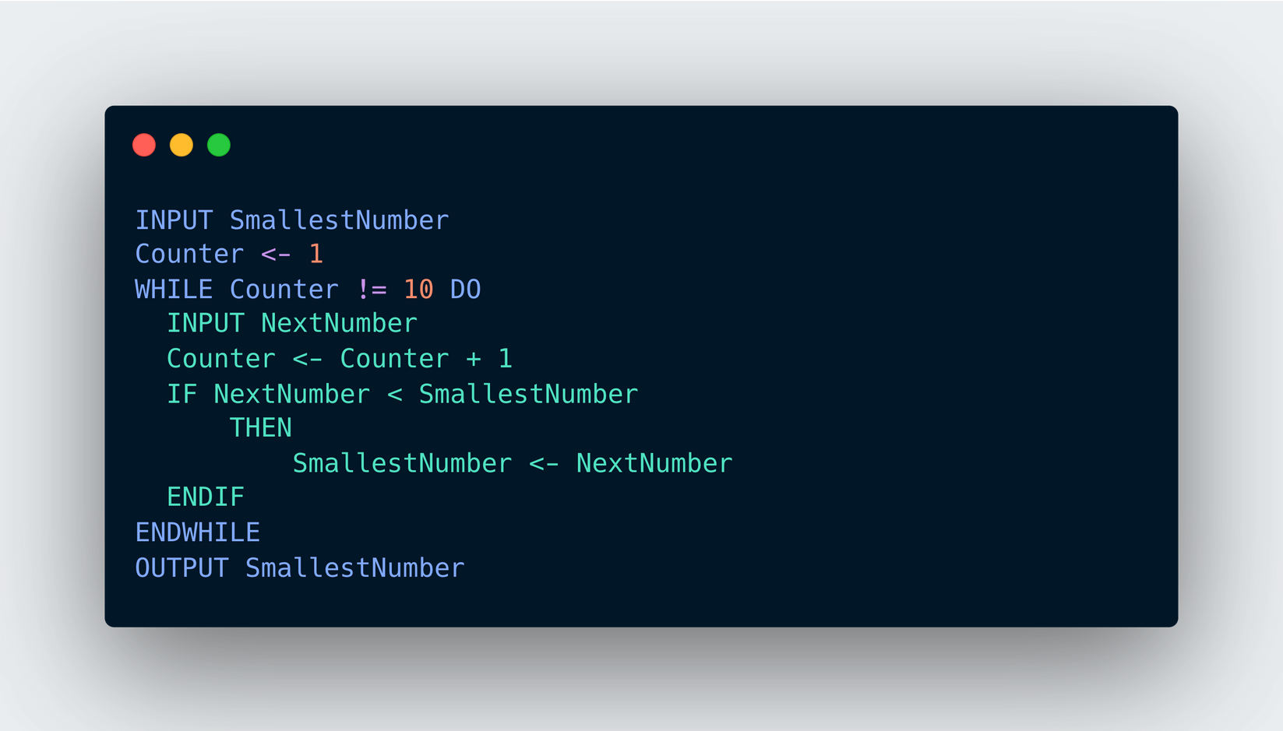
12.7 Loops
Worked Example
Take three numbers as input and output the smallest number.
Use a WHILE ... DO statement.
Statements that will be repeated

Slide 44
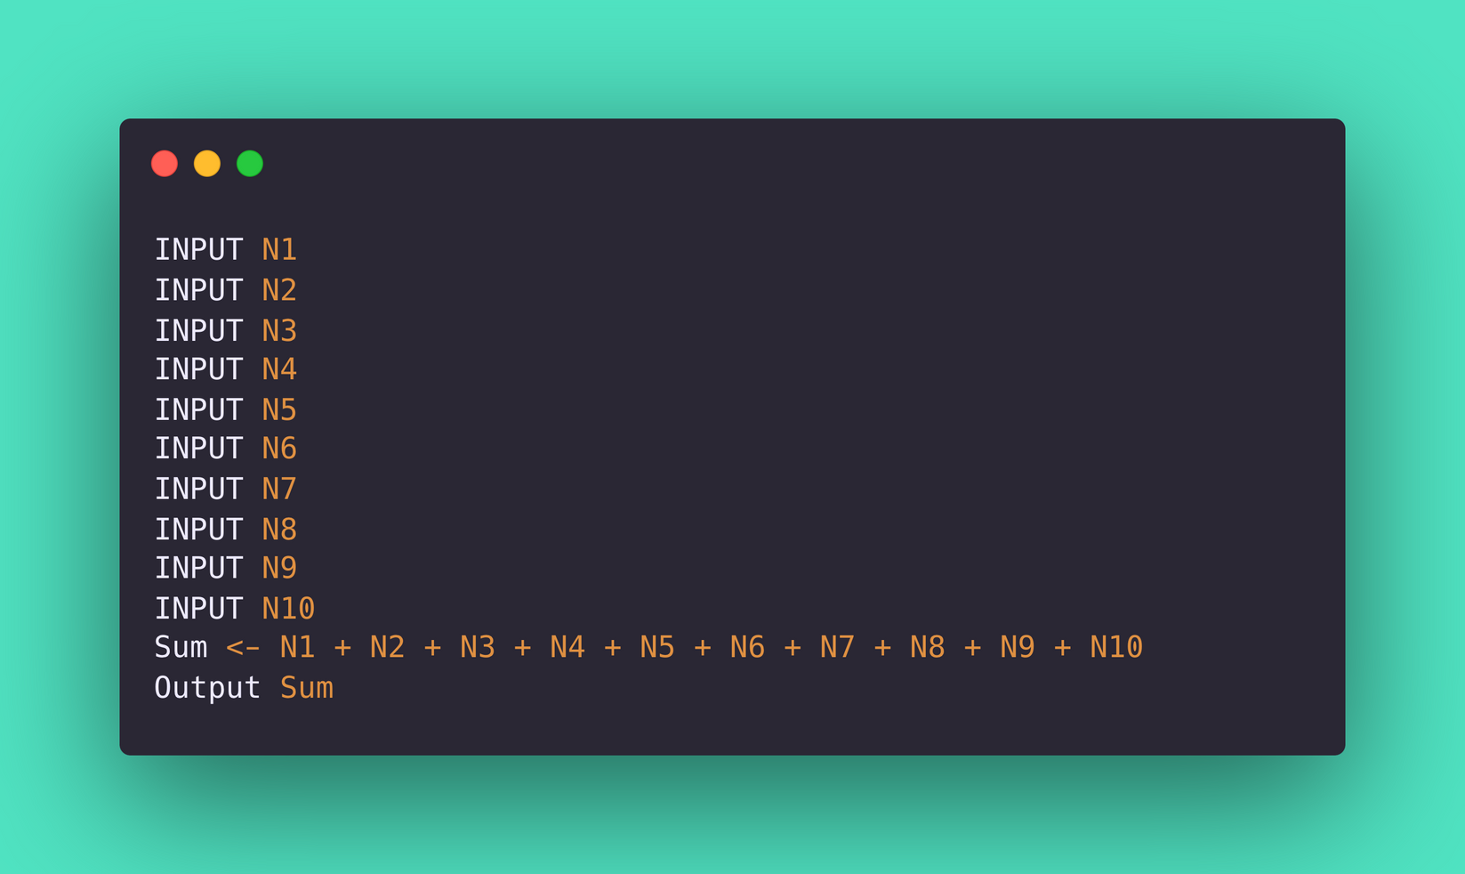
12.7 Loops
Worked Example
Take 10 inputs from the user and sum them up!
[Without using a loop]

Slide 45
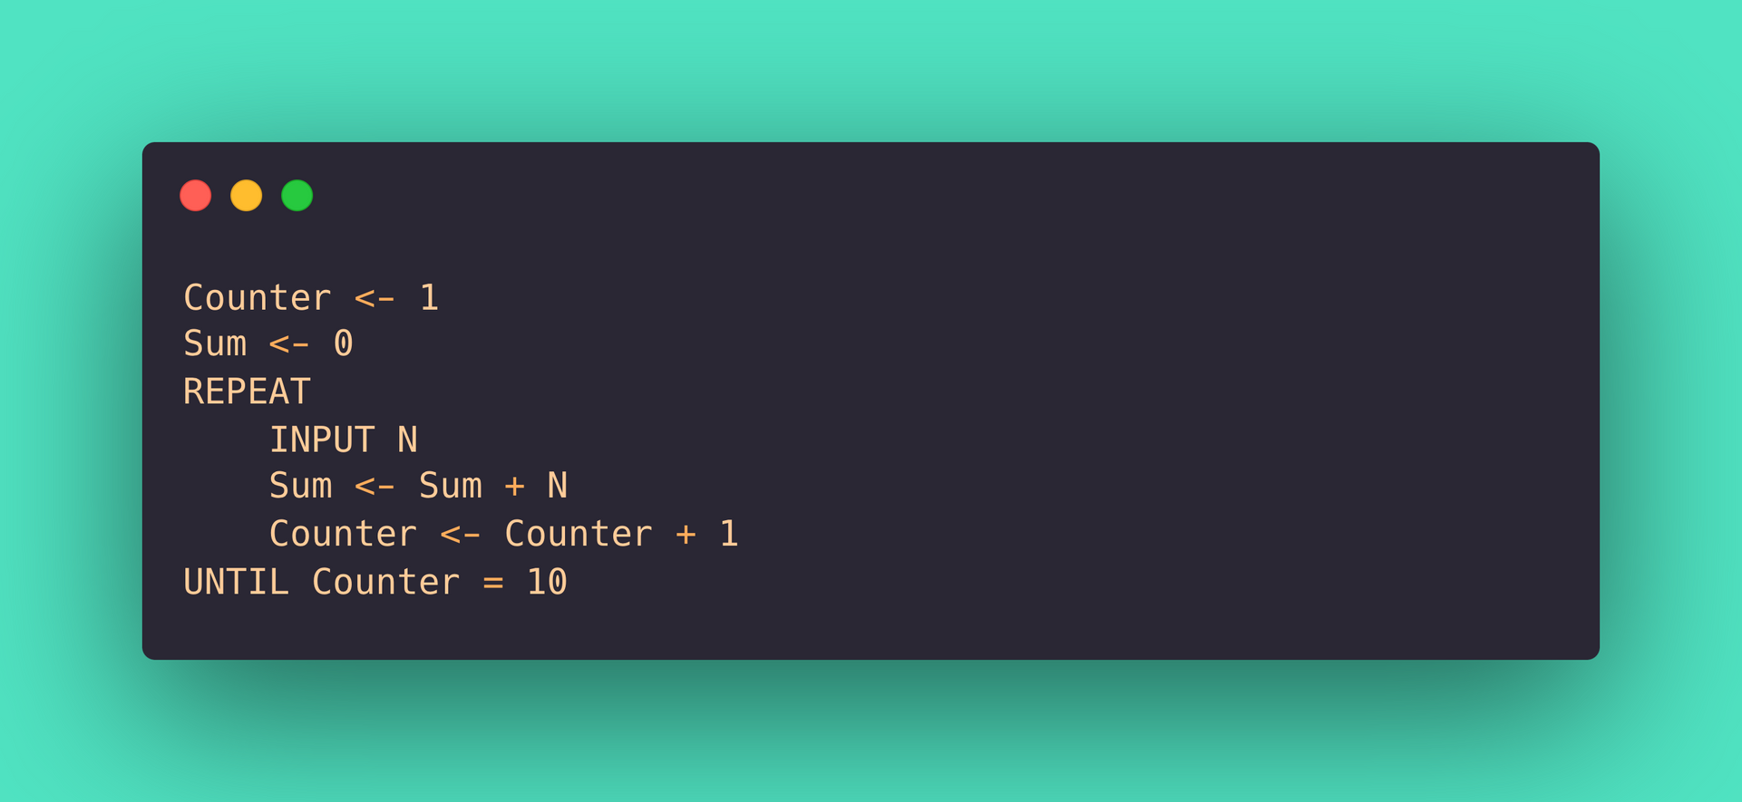
12.7 Loops
Worked Example
Take 10 inputs from the user and sum them up!
Using a REPEAT ... UNTIL loop.
Statements that will be repeated

Slide 46
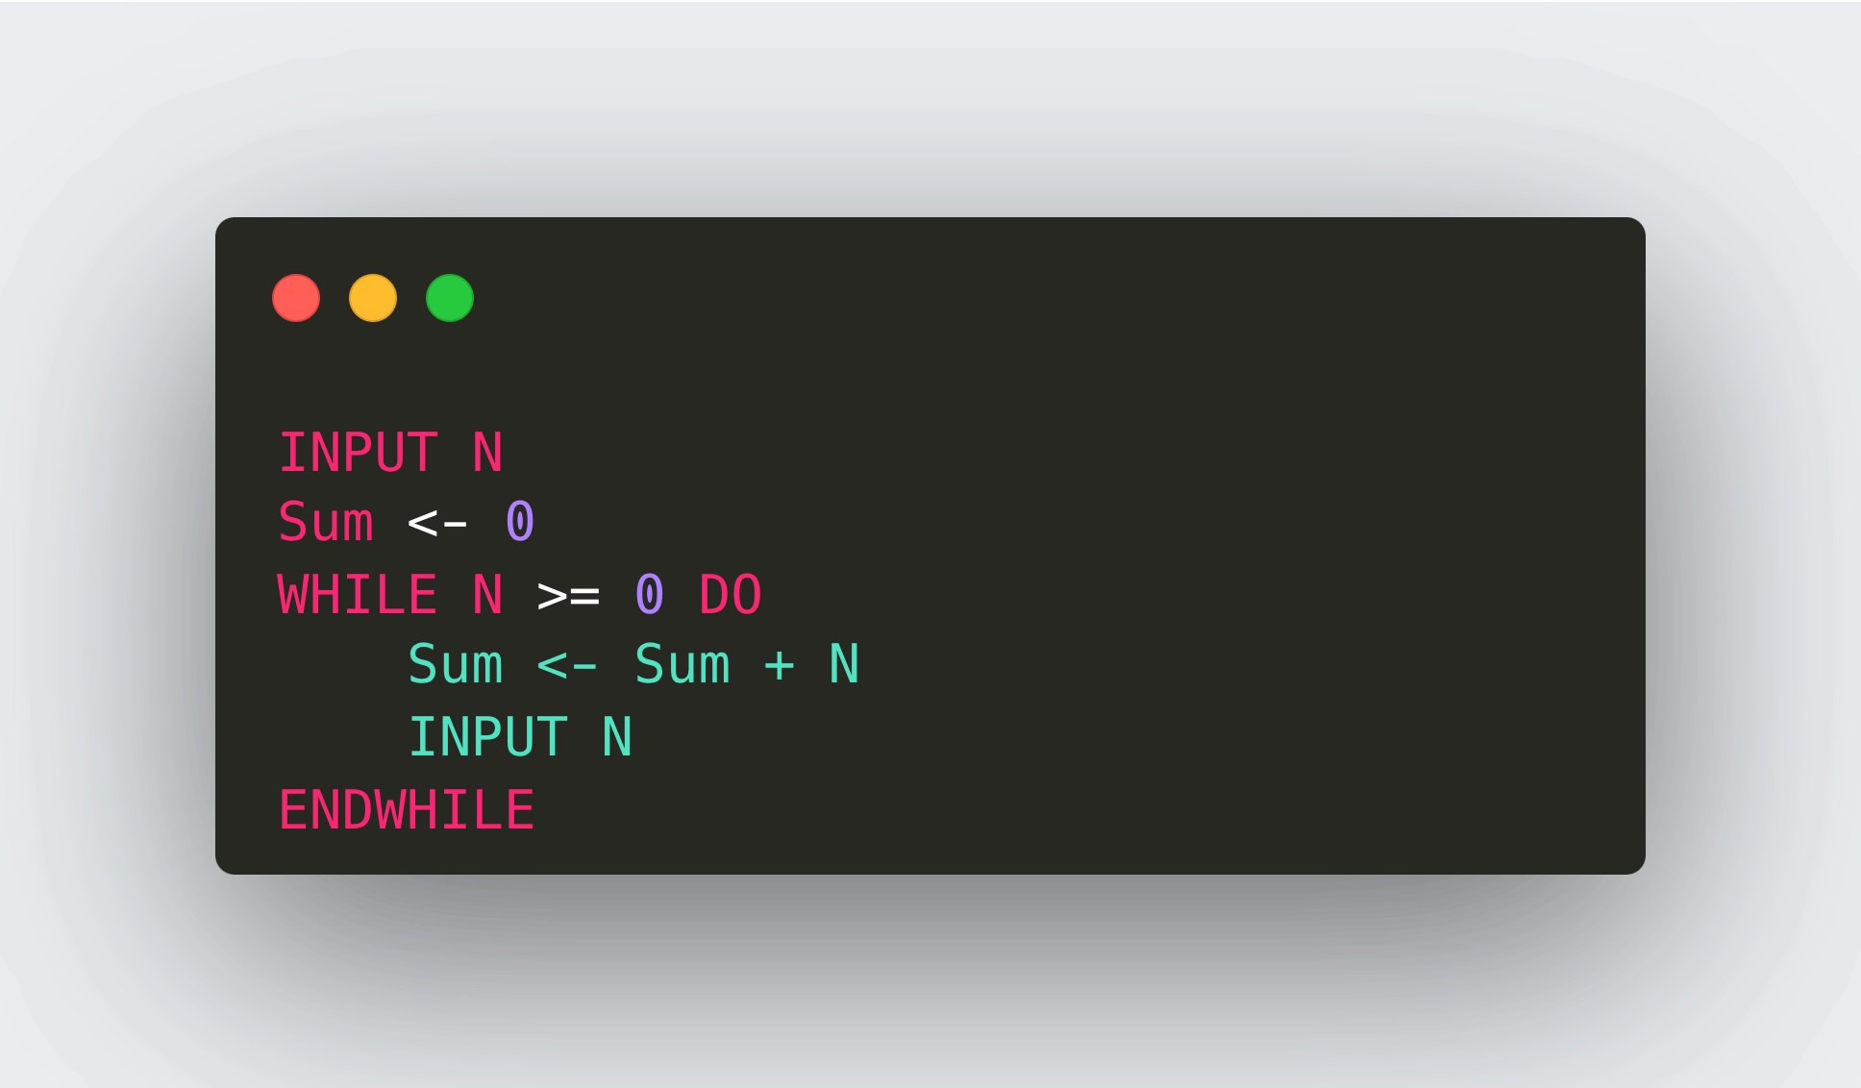
12.7 Loops
Worked Example - Repetition using a rogue value.
Keep taking inputs from the user and sum these numbers up. The program should terminate after the user enter a negative number.
(A value used to terminate a sequence of values).

Slide 47
12.7 Loops
Worked Example - Number guessing game
Your program should fulfil the following criteria:
  The player gets to input a number to guess the secret number stored.
  If the guess is correct, number of guesses made is output and game stops.
  If the number input is larger than the secret number, the player is given the message to input a smaller number.
  If the number input is smaller than the secret number, the player is given the message to input a larger number.

Slide 48
12.7 Loops
Worked Example - Number guessing game
The program in structured English:
SET value for secret number
REPEAT the following UNTIL correct guess
INPUT guess
increase the number of guess made by 1
Compare guess with the secret number
Based on the guess, determine the comment made
OUTPUT number of guesses

Slide 49
12.7 Loops
Worked Example - Number guessing game
The program in structured English:
SET value for secret number
REPEAT the following UNTIL correct guess
INPUT guess
increase the number of guess made by 1
Compare guess with the secret number
Based on the guess, determine the comment made
OUTPUT number of guesses
We need variables to store them.

Slide 50
12.7 Loops
Worked Example - Number guessing game
The program in structured English:
SET value for secret number
REPEAT the following UNTIL correct guess
INPUT guess
increase the number of guess made by 1
Compare guess with the secret number
Based on the guess, determine the comment made
OUTPUT number of guesses
SecretNumber
Guesses
NoOfGuesses

Slide 51
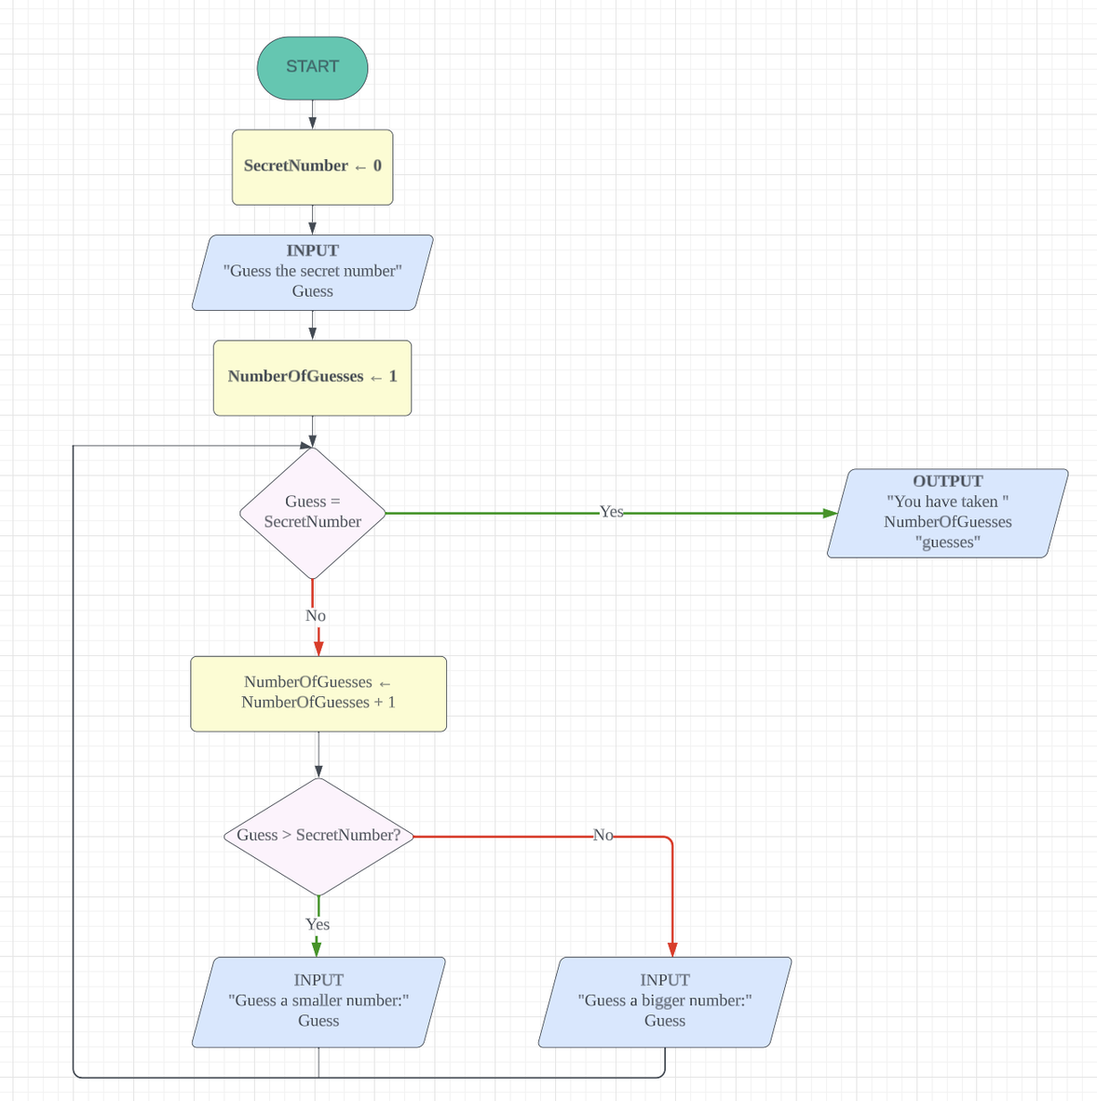
12.7 Loops
Worked Example - Number guessing game (Flowchart)
(Assuming the secret number assigned is 0)

Slide 52
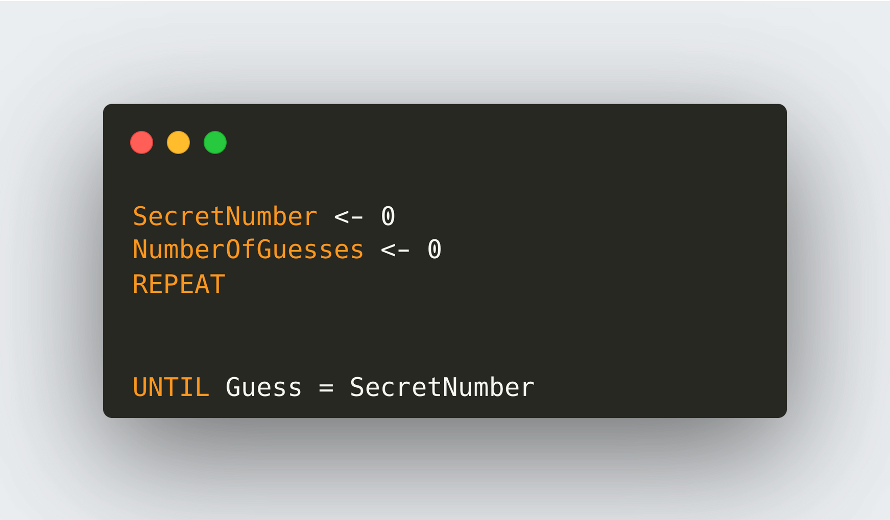
12.7 Loops
Worked Example - Number guessing game (Pseudocode)
(Assuming the secret number assigned is 0)

Slide 53
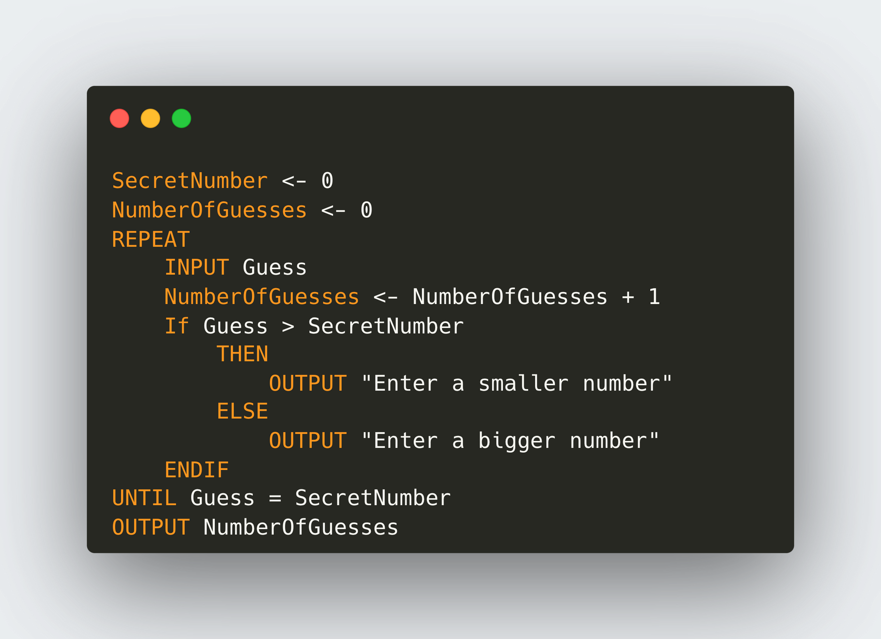
12.7 Loops
Worked Example - Number guessing game (Pseudocode)
(Assuming the secret number assigned is 0)

Slide 54
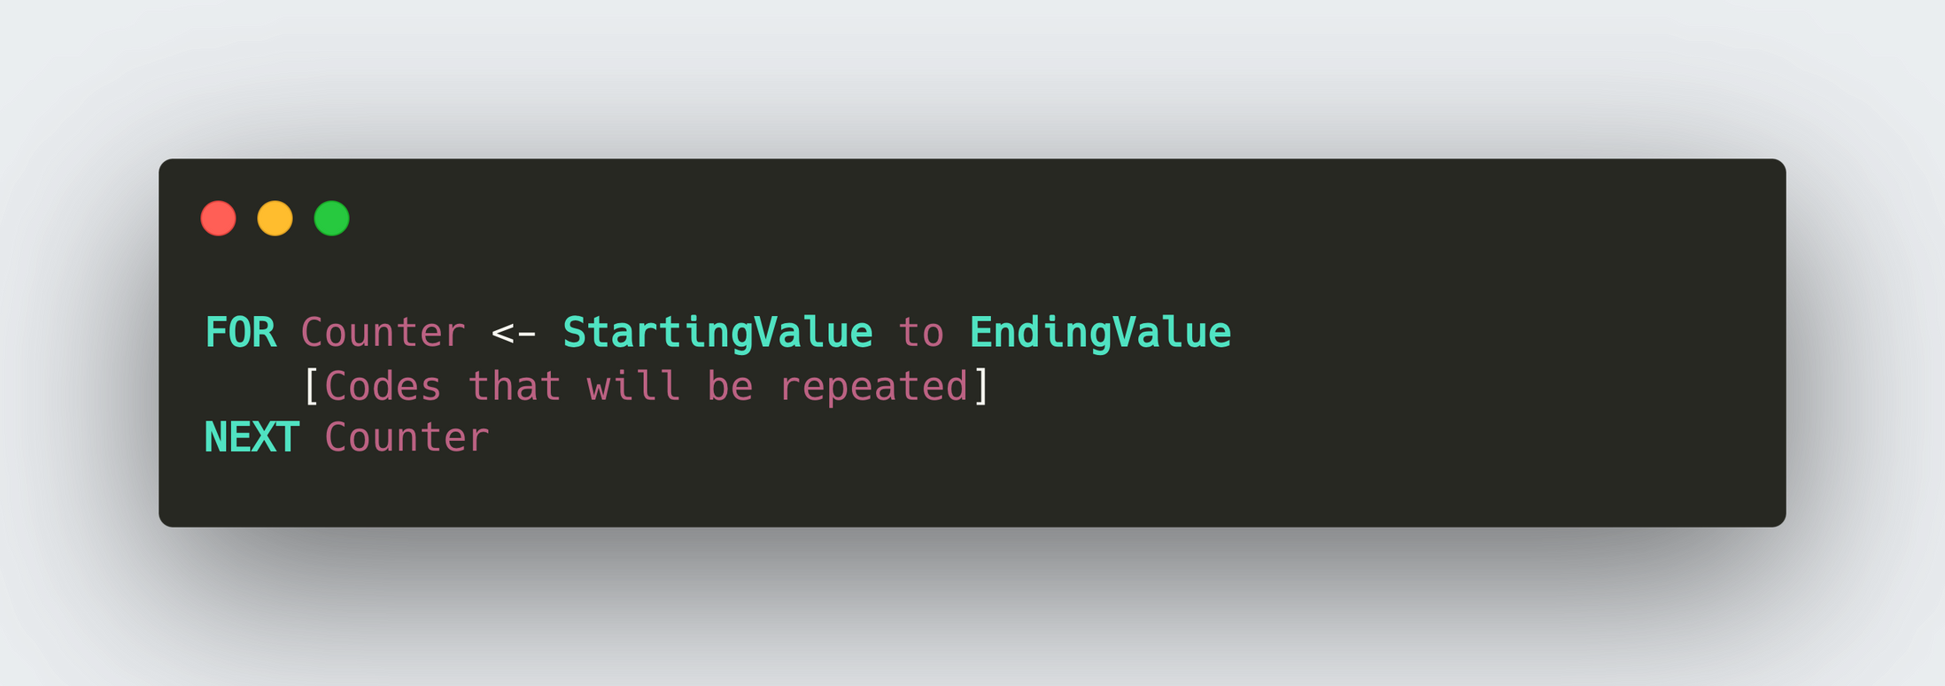
12.7 Loops
Why is loop needed?
A loop in programming allows the execution of a set of instructions repeatedly until
  A specified condition is met or
  For a defined number of iterations.

Slide 55
12.7 Loops
Worked Example
Write a program that output values from 1 - 10.

Slide 56
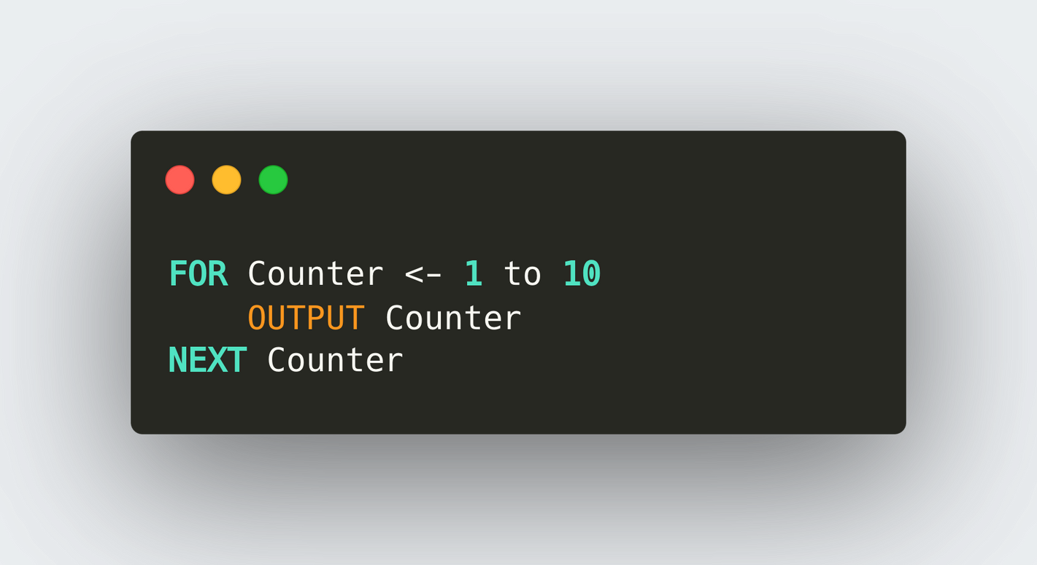
12.7 Loops
Worked Example
Write a program that output values from 1 - 10.

Slide 57
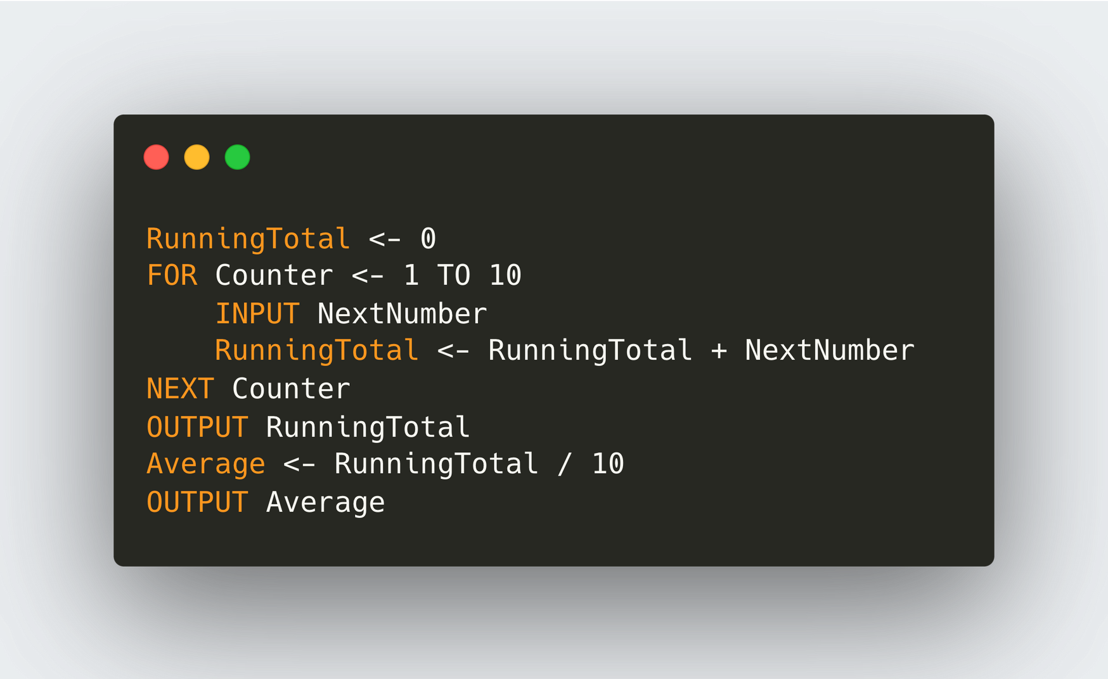
12.7 Loops
Worked Example
Take 10 numbers as input and output the sum of these numbers and the average.

Slide 58
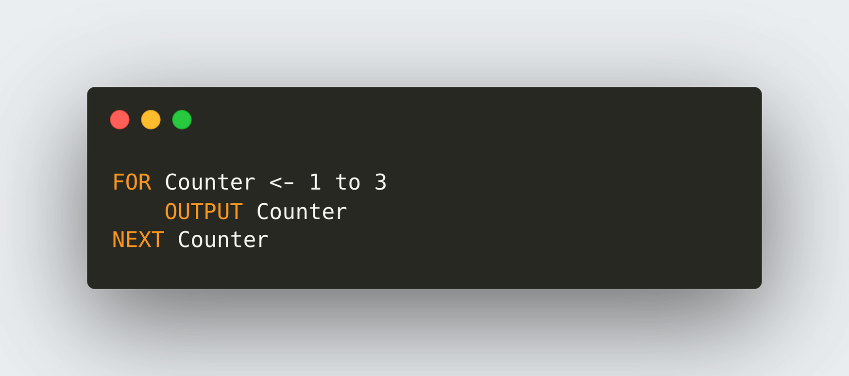
12.7 Loops
NESTED LOOP
A nested loop is a loop containing another loop.
What if I want to output the value of 1 to 3, 3 times?
Output:
1 2 3
1 2 3
1 2 3
This for loop will output the value from 1 to 3.
Output: 1 2 3

Slide 59
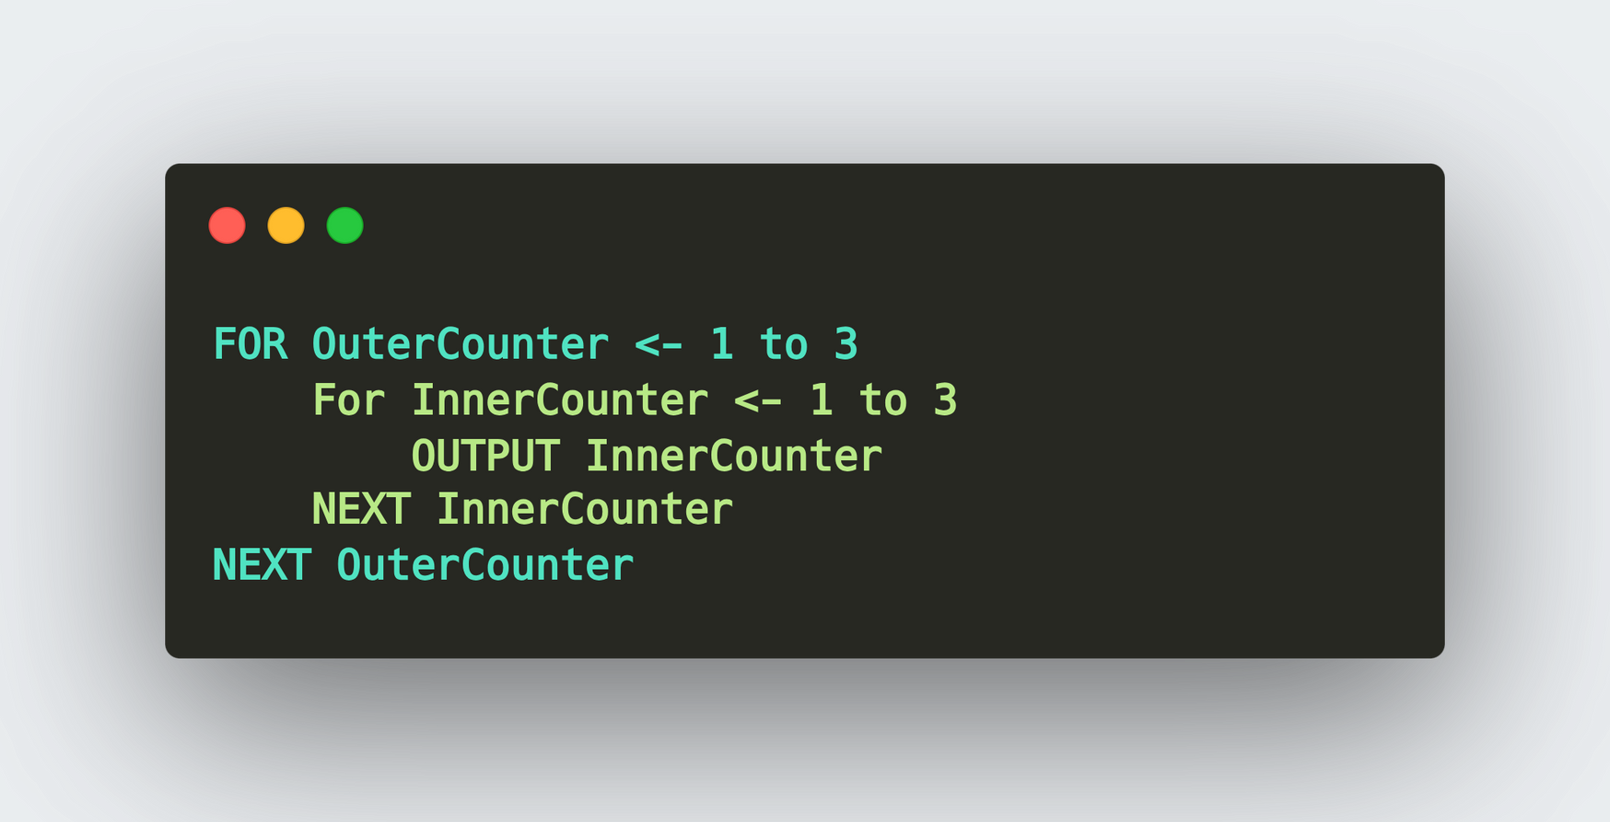
12.7 Loops
NESTED LOOP
Put the for loop inside another for loop!

Slide 60

12.7 Loops
NESTED LOOP
Put the for loop inside another for loop!
Use indentation to signify the inclusion of a loop inside a loop.

Slide 61
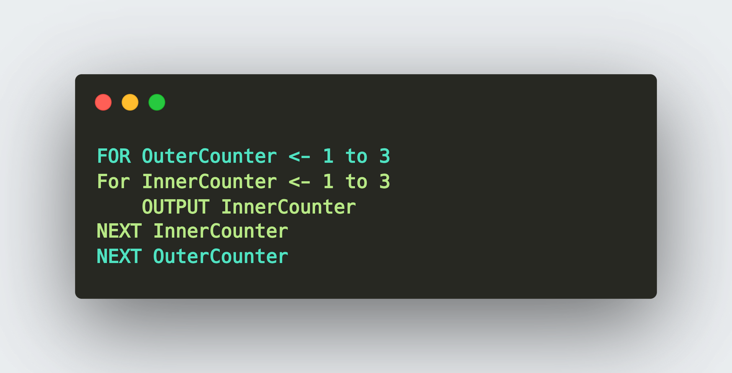
12.7 Loops
NESTED LOOP
This is wrong!

Slide 62
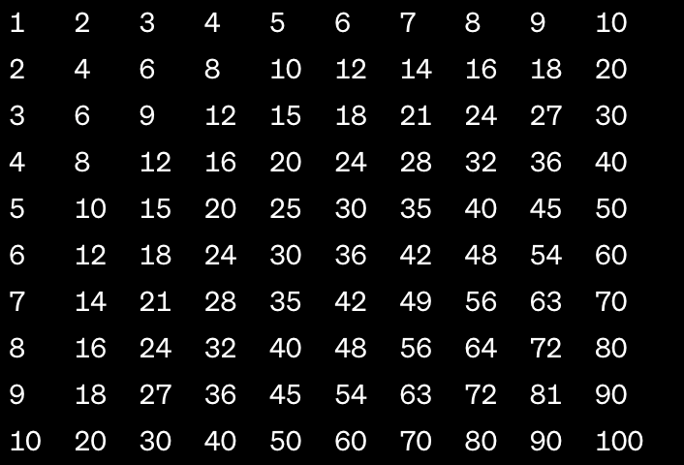
12.7 Loops
Worked Example - Nested Loop
Write a program that uses nested loops to create a multiplication table from 1 to 5. The output should display the multiplication table like the following:

Slide 63
12.7 Loops
Worked Example - Nested Loop
Write a program that uses nested loops to create a multiplication table from 1 to 10. The output should display the multiplication table like the following:
1x1
1x2
1x3
1x4
...
2x1
2x2
2x3
2x4
...

Slide 64
12.7 Loops
Worked Example - Nested Loop
Write a program that uses nested loops to create a multiplication table from 1 to 10. The output should display the multiplication table like the following:
1x1
1x2
1x3
1x4
...
2x1
2x2
2x3
2x4
...

Slide 65
12.7 Loops
Worked Example - Nested Loop
Write a program that uses nested loops to create a multiplication table from 1 to 10. The output should display the multiplication table like the following:
1x1
1x2
1x3
1x4
...
2x1
2x2
2x3
2x4
...

Slide 66
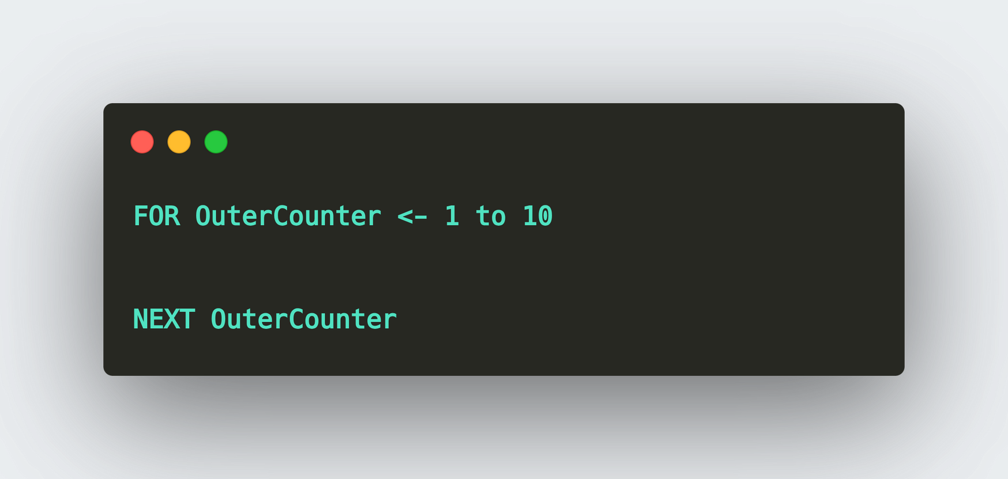
12.7 Loops
Worked Example - Nested Loop
Step 1: Need an outer loop that loops from 1 - 10.

Slide 67
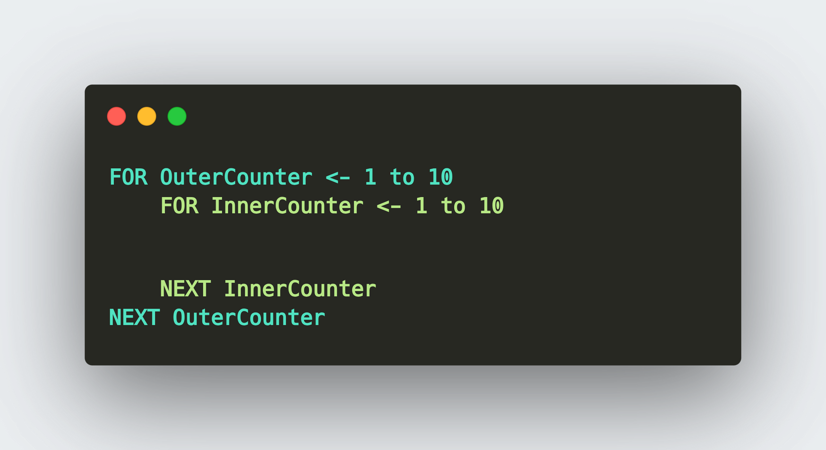
12.7 Loops
Worked Example - Nested Loop
Step 2: Need an inner loop that loops from 1 - 10.

Slide 68
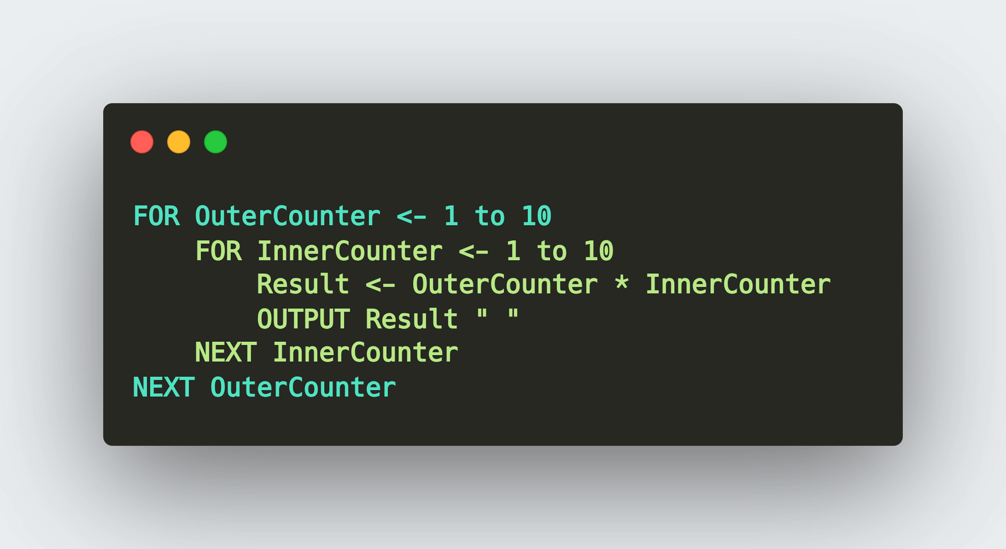
12.7 Loops
Worked Example - Nested Loop
Step 3: Multiply the value of the OuterCounter and the InnerCounter.

Slide 69
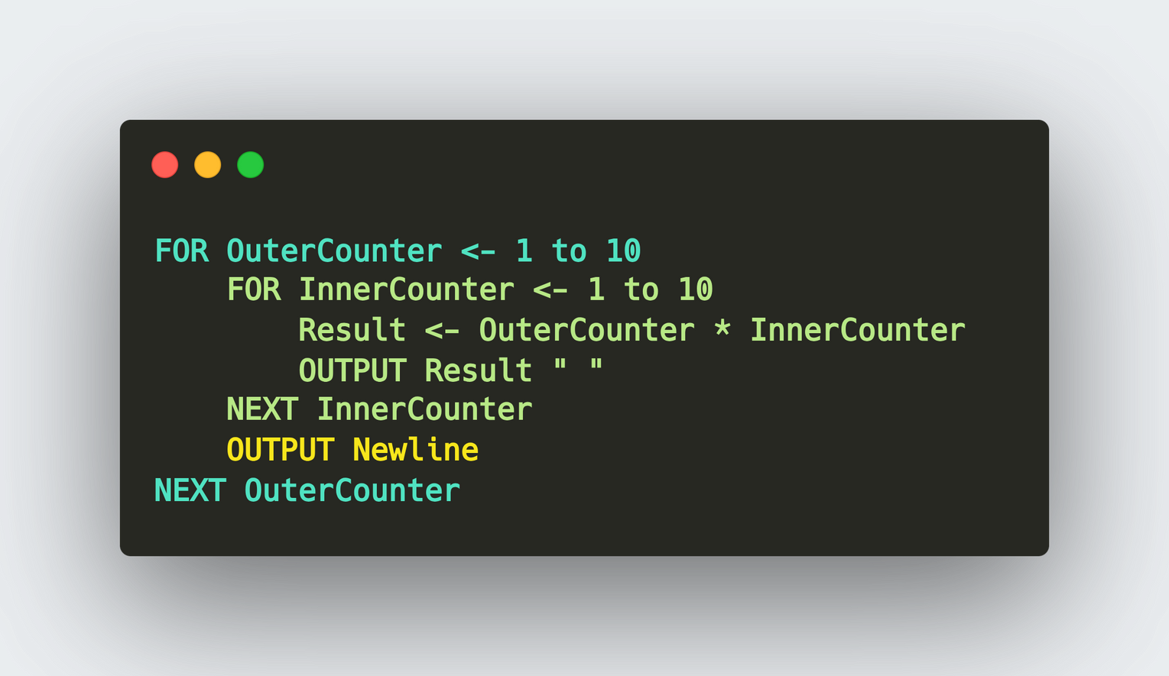
12.7 Loops
Worked Example - Nested Loop
Step 4: Add a newline after each row is done!

Slide 70
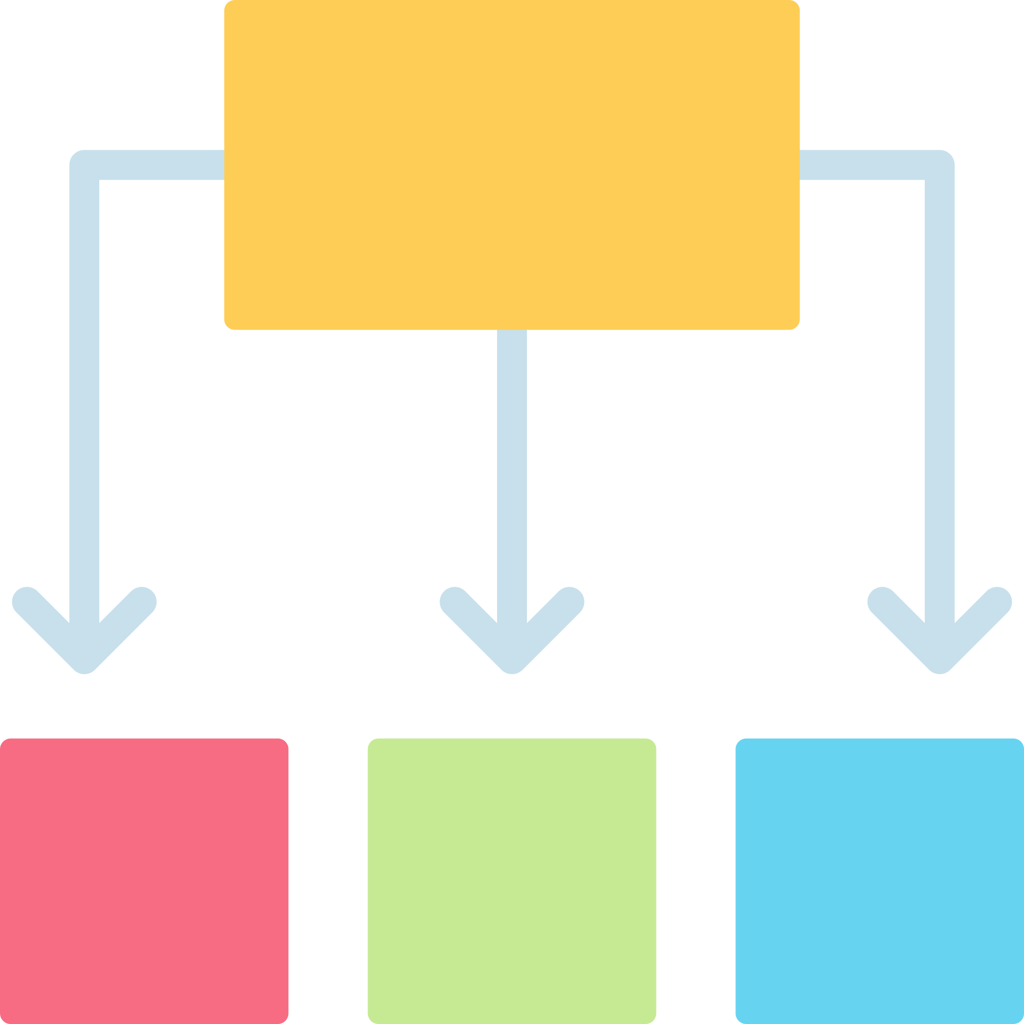
12.8 Stepwise Refinement
Definition
Stepwise refinement is a programming methodology that involves breaking down a complex task into smaller, more manageable steps or subtasks, refining each step until they are detailed enough to be implemented in code.

Slide 71
12.8 Stepwise Refinement
Definition
Take as input a chosen symbol and an odd number. Output a pyramid shape made up entirely of the chosen symbol, with the number of symbols in the final row matching the number input.
Output:
+
+++
+++++
+++++++
Symbol
+
Odd number
7

Slide 72
12.8 Stepwise Refinement
Definition
Take as input a chosen symbol and an odd number. Output a pyramid shape made up entirely of the chosen symbol, with the number of symbols in the final row matching the number input.
OUTPUT:
 |  |  | +
 |  | + | + | +
 | + | + | + | + | +
+ | + | + | + | + | + | +
Symbol
+
Odd number
7

Slide 73
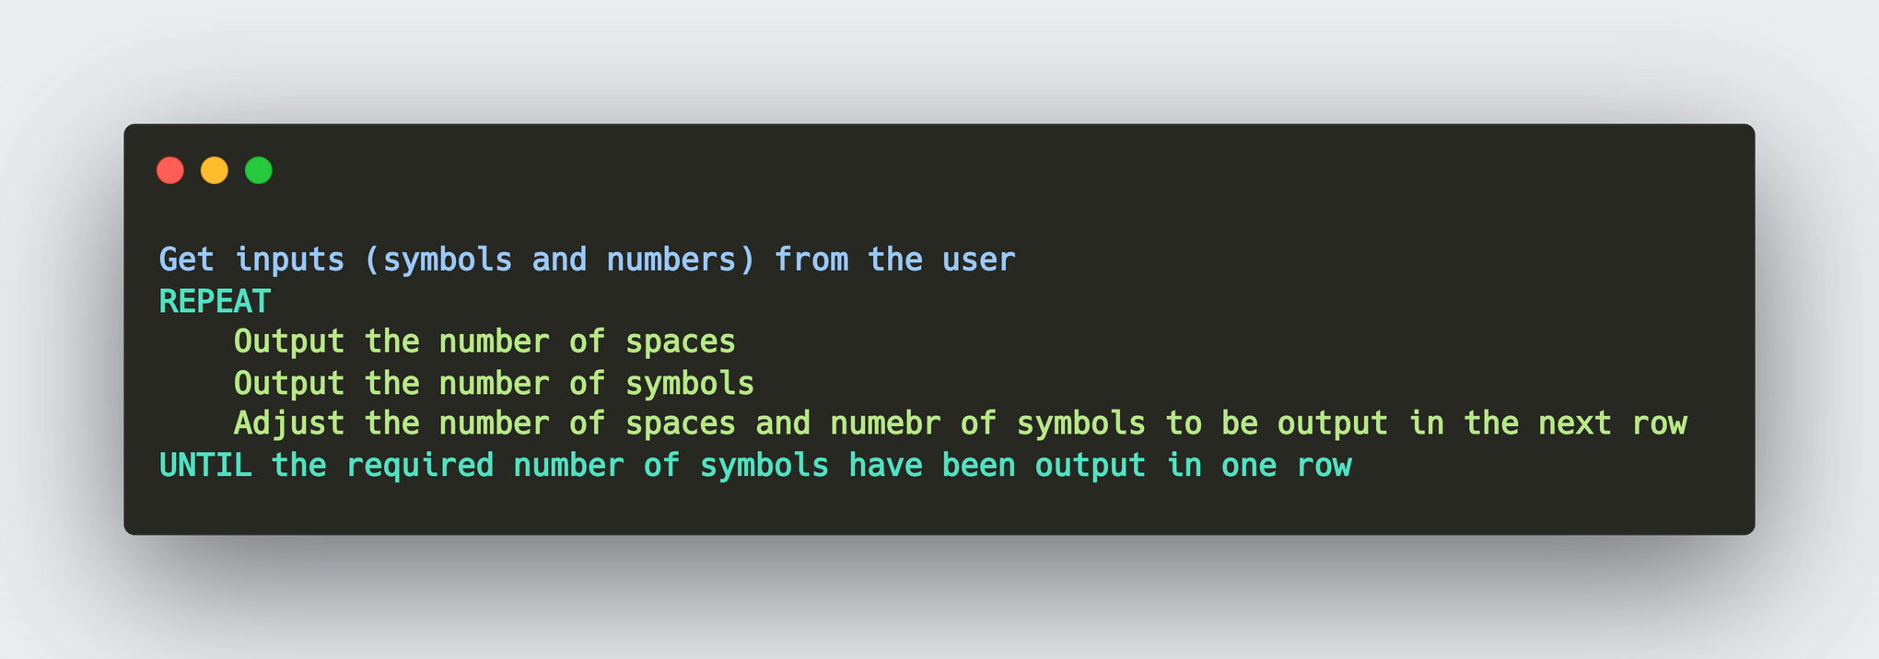
12.8 Stepwise Refinement
Write out the solution using structured English:
 |  |  | +
 |  | + | + | +
 | + | + | + | + | +
+ | + | + | + | + | + | +
OUTPUT:

Slide 74
12.8 Stepwise Refinement
Write out the solution using structured English:
Symbol
MaxNumberOfSymbols
NoOfSymbols
NoOfSpaces
Variables we need:

Slide 75
12.8 Stepwise Refinement
Set up the initial value
Making sure that the input is an odd number
Output the number of spaces
Output the number of symbols
Adjust the value of spaces symbols
Breaking down the problem into 5 steps:

Slide 76
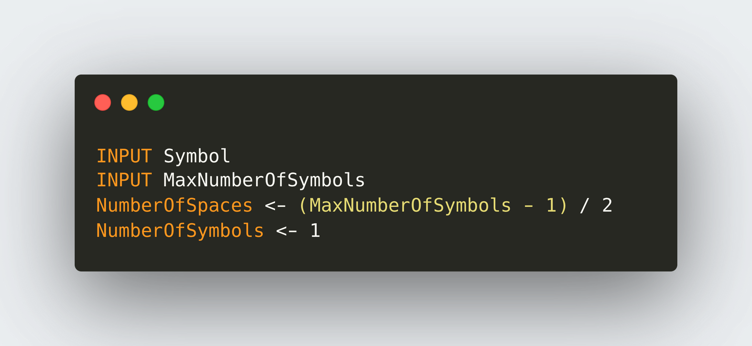
12.8 Stepwise Refinement
Symbol
+
MaxNumberOfSymbols
7
 |  |  | +
 |  | + | + | +
 | + | + | + | + | +
+ | + | + | + | + | + | +
Set up the initial value

Slide 77
12.8 Stepwise Refinement
Symbol
+
MaxNumberOfSymbols
9
 |  |  |  | +
 |  |  | + | + | +
 |  | + | + | + | + | +
 | + | + | + | + | + | + | +
+ | + | + | + | + | + | + | + | +
Set up the initial value

Slide 78
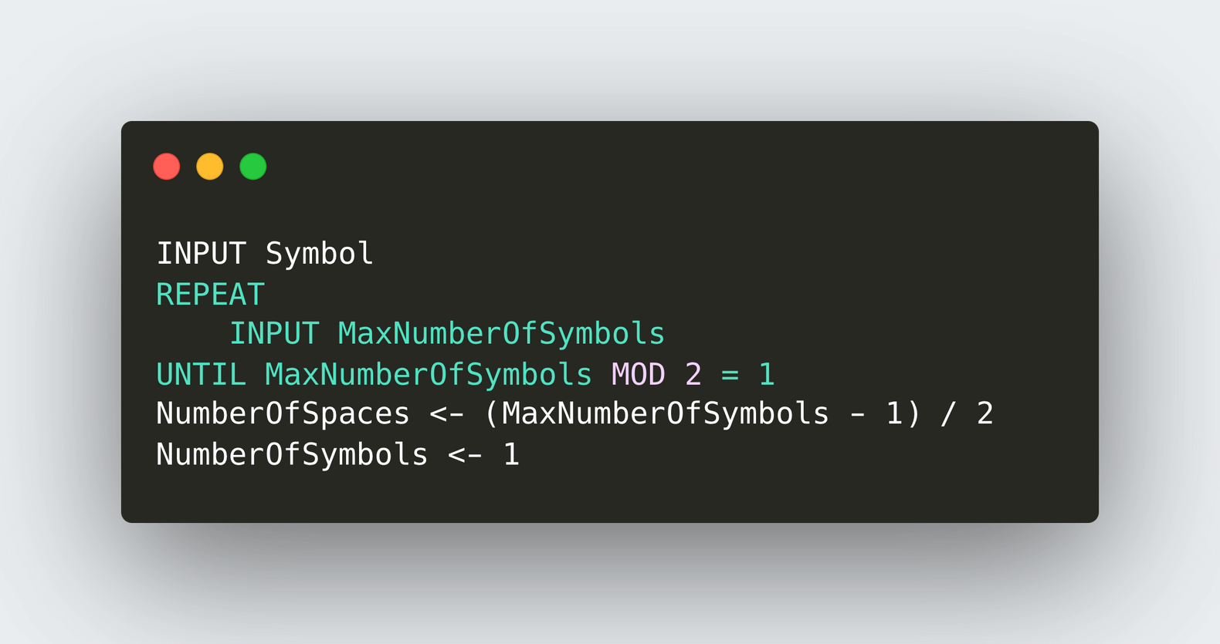
12.8 Stepwise Refinement
X Mod Y = A function that gives the remainder when X is divided by Y.
*Info: Remainder will always be 1 when an odd number is divided by 2.
Making sure that the input is an odd number

Slide 79
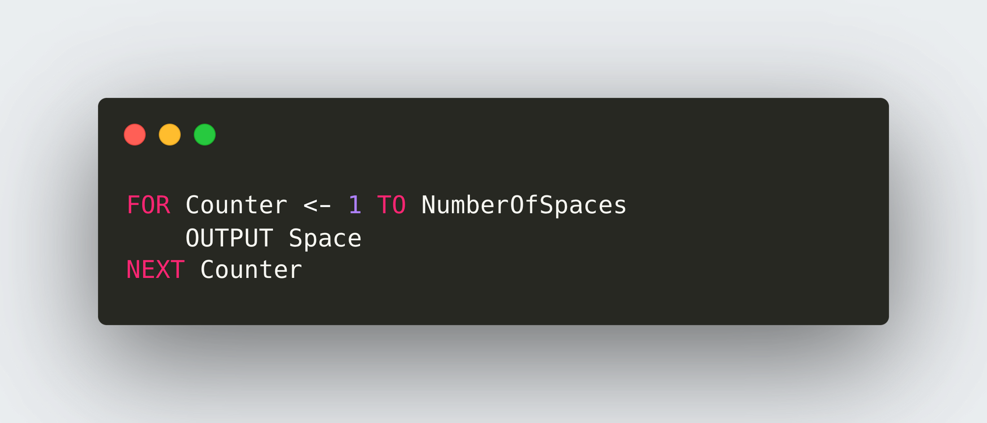
12.8 Stepwise Refinement
 |  |  | +
 |  | + | + | +
 | + | + | + | + | +
+ | + | + | + | + | + | +
Output the number of spaces

Slide 80
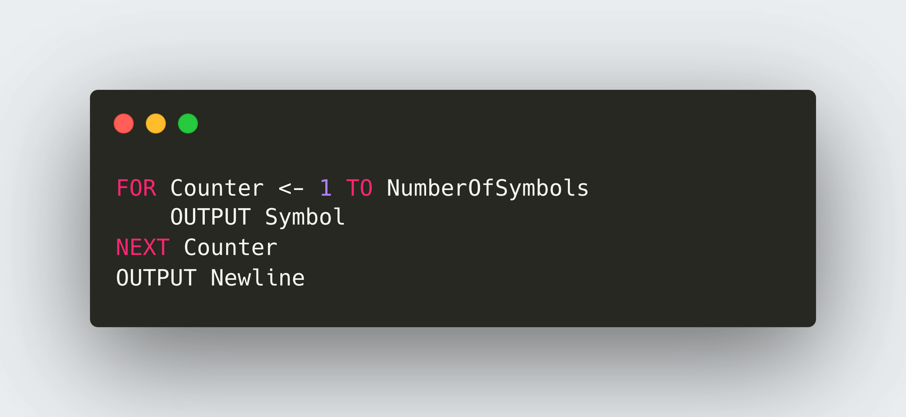
12.8 Stepwise Refinement
 |  |  | +
 |  | + | + | +
 | + | + | + | + | +
+ | + | + | + | + | + | +
Output the number of symbols

Slide 81

12.8 Stepwise Refinement
Adjust the value of spaces symbols

Slide 82

12.8 Stepwise Refinement
Putting it all together.

Slide 83
12.9 Programming with Modules
Definition
Stepwise refinement helps us to decompose a big problem into smaller sub tasks. These sub tasks can be encapsulated in a module. Module can get called whenever its functionality is needed.
Procedure
Function
Modules can be classified into:
A procedure is a named block of codes in a program that performs a specific task.
A function is a named block of code in a program that performs a specific task. It will also return a value.

Slide 84

12.9 Programming with Modules

Slide 85


12.9 Programming with Modules

Slide 86

12.9 Programming with Modules

Slide 87
12.9 Programming with Modules

Slide 88
12.9 Programming with Modules

Slide 89

12.9 Programming with Modules
Having written all the procedures, we can just call them in our main program:

Slide 90

12.9 Programming with Modules
Function
A function is a named block of code in a program that performs a specific task. It will also return a value.

Slide 91

12.9 Programming with Modules
Worked Example
Write a function that calculates and returns the sum of all the numbers from 1 - 100.

Slide 92


12.9 Programming with Modules
Parameters
A parameter in a function is a variable used to receive and store values passed to the function when it is called.

Slide 93

12.9 Programming with Modules
Worked Example
Write a function that calculates and returns the sum of all the numbers from 1 - N.

Slide 94

12.9 Programming with Modules
Local and Global Variables
Local variable:
A variable that is accessible only within a module in which is is declared
Global variable:
A variable that is accessible from all modules

